Slide 2
MPAs & Bycatch - Today
Theory and evidence for “static” MPAs as bycatch management
Dynamic ocean management as an alternative
Emerging Areas

Slide 4
Spatial Protections
The where question has a long history in marine resource management
MPAs traditionally used for management, particularly island cultures
  “Fish banks” for times of need / party
“Modern” MPAs emulated National Parks
  Don’t fish here.
“Post-modern” MPAs

Slide 5
“Post-modern” MPAs
Grorud-Colvert et al. (2021)

Slide 6
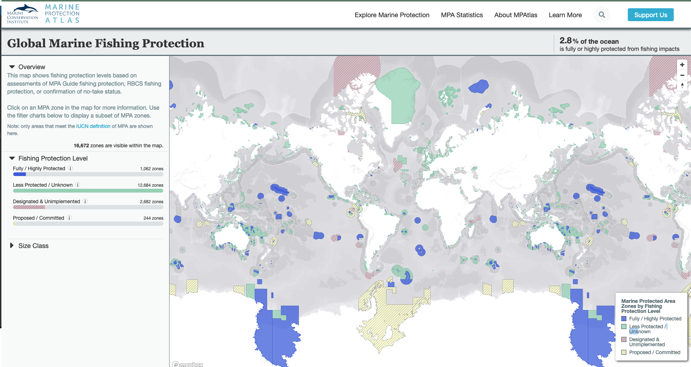
https://mpatlas.org/zones/?

Slide 7
Conservation Impacts of MPAs
This is supposed to be the easy part….
If you kill fewer fish…
  There are more fish alive
So, what’s the challenge?
  Given practical constraints on size how effective are MPAs relative to other measures?
  What are the unintended consequences of MPAs?

Slide 8
Which is worse?
High volume of discard of a highly productive species
  “trash fish”
Low volume of discard of a relatively unproductive species
  e.g. sharks in pelagic longline tuna fisheries
Low volume of bycatch mortality of “megafauna”
  Turtles, seabirds, dolphins
Moderate volume of discard of species captured in “another” fishery
  e.g. Chinook salmon in Walleye Pollock fishery

Slide 9
Static MPAs

Slide 10
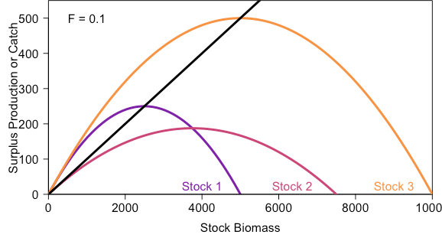
MPAs & Weak Stocks

Slide 11
MPAs & Weak Stocks
Assuming perfect selectivity, just set the right quota for every species
With perfectly non-selective gears, tradeoff is inevitable
  E.g. West Coast groundfish management
When might spatial management provide an alternative?
  Just another tradeoff?
  Access a hidden win-win?

Slide 12
MPAs & Weak Stocks
Analytical and numerical model
  Sedentary adults
    No explicit age structure
  Homogeneous habitat
  Perfectly mixed larvae
  Local density dependence
  Optimizing strong stock extirpates weak stock
Under what conditions…
  Are MPA and escapement equivalent?
  Are MPAs > escapement?

Slide 13
Notes:
Strong-stock yield (background color and circle size) and weak-stock persistence boundary (bold curves, representing 5, 20, or 40% of weak-stock carrying capacity) for combinations of reserve size (c) and strong-stock escapement outside the reserve (E) for the West Coast groundfish fishery, with Dover sole as the strong stock and four different weak stocks. Parameters are determined as described in Materials and Methods, based on the recent stock- assessment summary (26). See Fig. 1 for further description. Each panel has a different weak stock: bocaccio (A), darkblotched (B), Pacific Ocean perch (C), and yelloweye (D), with the same strong stock.

Slide 14
Under assumptions…
  MPAs can ensure persistence of weak stock while maintaining strong-stock yields
  “If the weak stock is longer-lived and matures later thant he target species, management by marine reserves always produces a higher sustainable yield, and higher stock abundance, than could be achieved by single-species approaches without a marine reserve”
Notes:
Strong-stock yield (background color and circle size) and weak-stock persistence boundary (bold curves, representing 5, 20, or 40% of weak-stock carrying capacity) for combinations of reserve size (c) and strong-stock escapement outside the reserve (E) for the West Coast groundfish fishery, with Dover sole as the strong stock and four different weak stocks. Parameters are determined as described in Materials and Methods, based on the recent stock- assessment summary (26). See Fig. 1 for further description. Each panel has a different weak stock: bocaccio (A), darkblotched (B), Pacific Ocean perch (C), and yelloweye (D), with the same strong stock.

Slide 15
Empirical Support
West Coast groundfish fishery canonical “weak stock” story
Individual Fishing Quotas provided financial incentive to avoid weak stocks
Seemed to create voluntary “fuzzy” MPA
Miller & Deacon (2016)
Notes:
Strong-stock yield (background color and circle size) and weak-stock persistence boundary (bold curves, representing 5, 20, or 40% of weak-stock carrying capacity) for combinations of reserve size (c) and strong-stock escapement outside the reserve (E) for the West Coast groundfish fishery, with Dover sole as the strong stock and four different weak stocks. Parameters are determined as described in Materials and Methods, based on the recent stock- assessment summary (26). See Fig. 1 for further description. Each panel has a different weak stock: bocaccio (A), darkblotched (B), Pacific Ocean perch (C), and yelloweye (D), with the same strong stock.

Slide 16
Problem Solved?
Evidence that spatial management can help resolve
Hastings et al. (2017) results make some strong assumptions
  Based on equivalence of yield of MPAs and F (I’ve never gotten that to work all that well…)
  Strong spatial assumptions
  Perfect information
  Optimized escapement
What are the impacts of MPAs on bycatch in wider range of more “tactical” scenarios?

Slide 17
When might MPAs make bycatch problems worse?

Slide 18
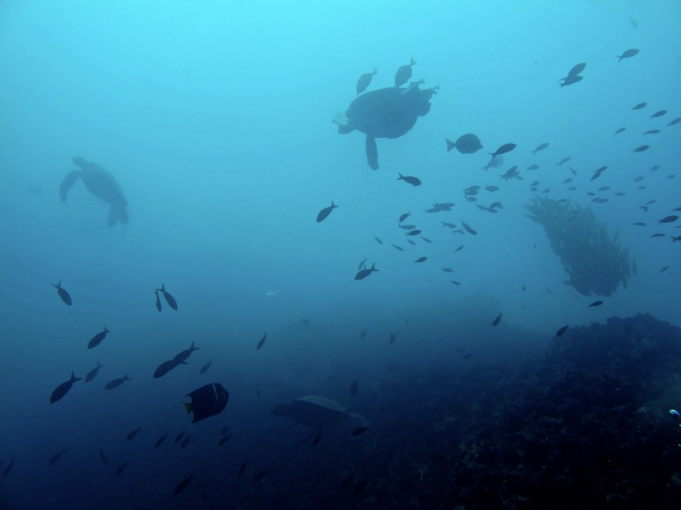
What happens when things get complicated?
Multiple species
  Multiple values
Multiple fleets
Varying degrees of technical interactions
Heterogenous habitat and movement
Seasonal migrations
Imperfect management
Introducing marlin

Slide 19
marlin
marlin is a 2D operating model
  Multi-species
  Multi-fleet
  Age-structured
Allows for technical interactions through fleet dynamics
Fast enough for batch simulation testing
Ovando, Bradley, Burnes, Thomas in prep
danovando.github.io/marlin/

Slide 20
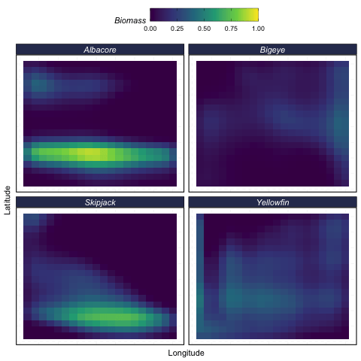
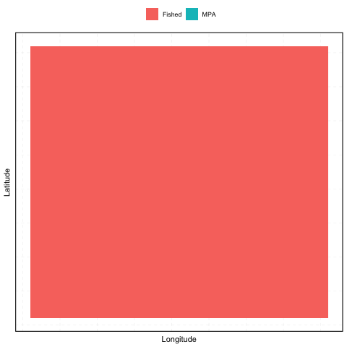
Evolution of Biomass

Slide 21
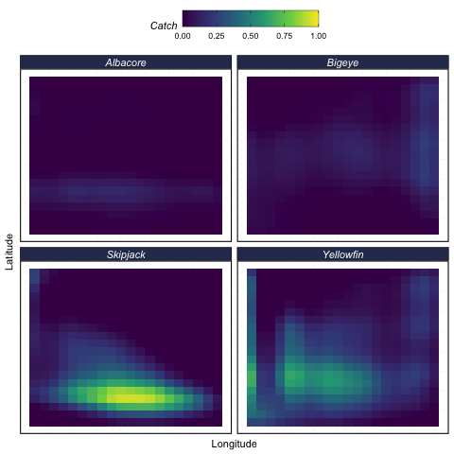
Evolution of Catch

Slide 22
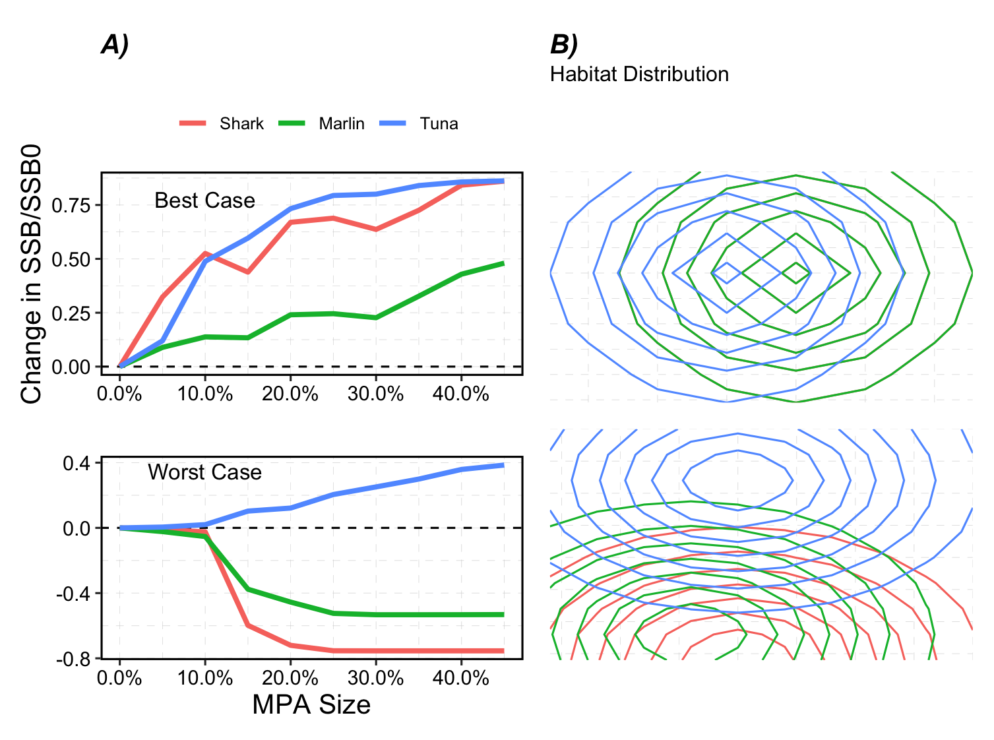
Things get trickier

Slide 23
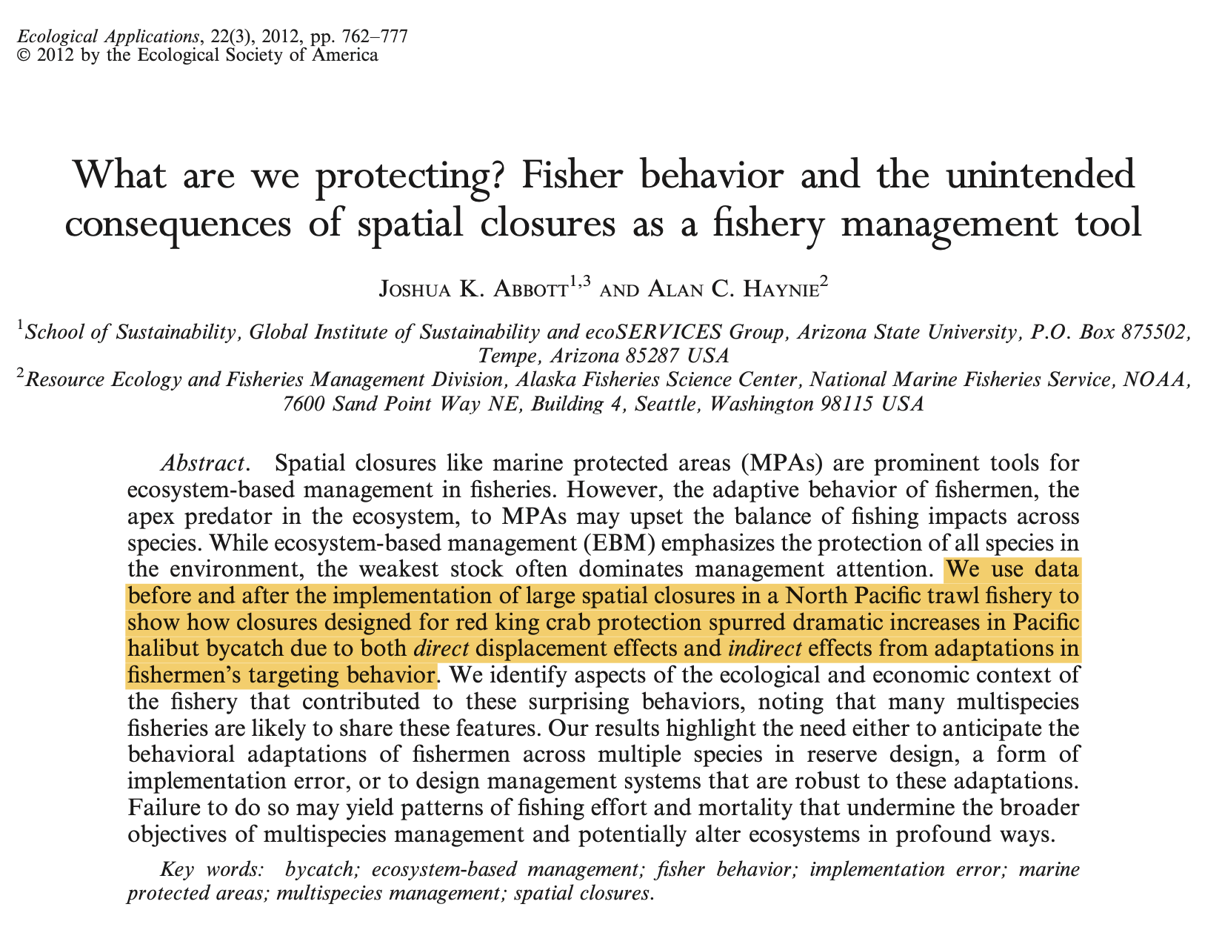

Slide 24
Effects of MPAs on multiple species when…

Slide 25
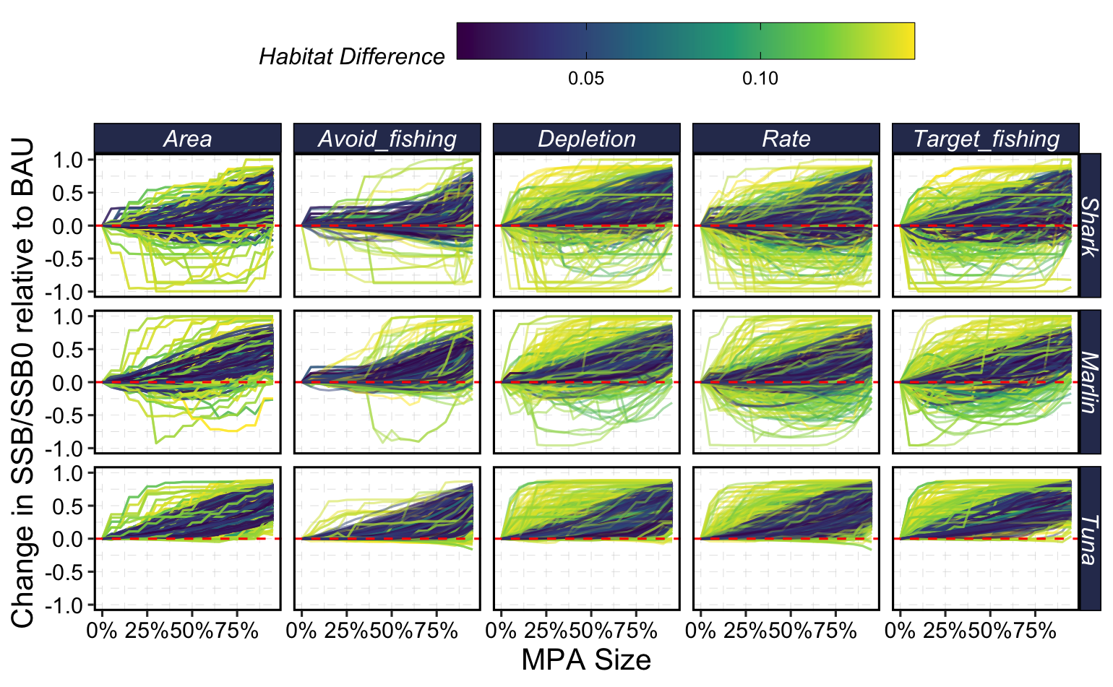
Habitat difference helps drive extreme outcomes

Slide 26
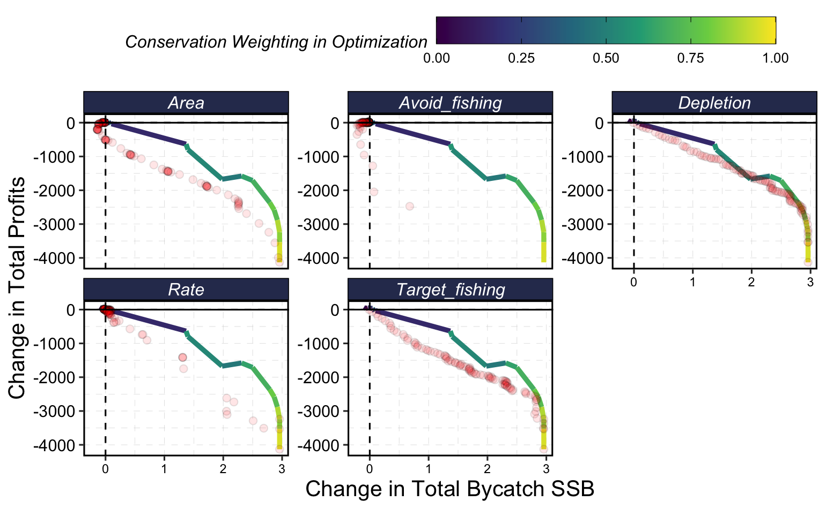
Increased complexity reduces scope for win-wins
Notes:
Bycatch here are threatened sharks and billfish

Slide 27
Dynamic
Ocean Management

Slide 28
What’s Missing?
MPAs can clearly help reduce bycatch
Fleet dynamics and habitat heterogeneity increase probability of unintended consequences
Increased complexity results in less evidence of “equal or better outcomes”
marlin has a lot of bells and whistles, but…

Slide 29
Dynamic Ocean Management
So far, we’ve either assumed equilibrium conditions, or “stability”
What if there is strong stochasticity and directionality to habitat use, with heterogeneity in these across species?
What if we let MPAs move around?

Slide 30
Dynamic Ocean Management
So far, we’ve either assumed equilibrium conditions, or “stability”
What if there is strong stochasticity and directionality to habitat use, with heterogeneity in these across species?
What if we let MPAs move around?

Slide 32
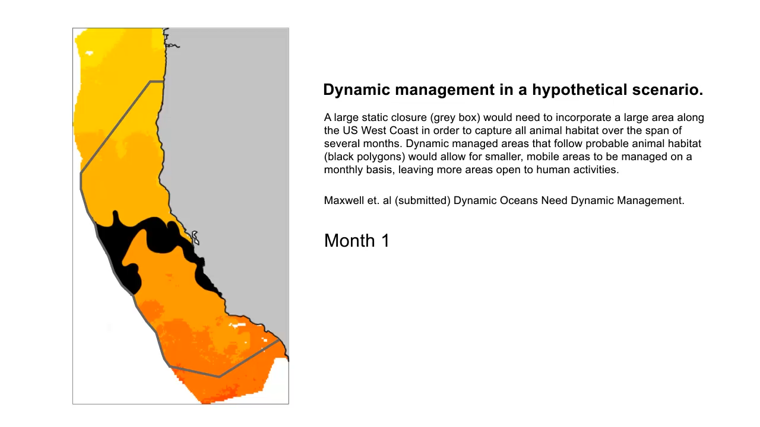

Slide 33
What do we get when we go dynamic?
Given perfect information… dynamic must be ≧ static
The question then is, how much better?
Pons et al. estimated tradeoffs in target and bycatch under different MPA designs

Slide 37
Frontiers in
Spatial Management of Bycatch

Slide 38
Where Next?
MPAs are expanding
  Varying definitions of what an MPA is
From a perspective of bycatch reduction
  When and how should we expand tactical dynamic ocean management?
  How do we measure success?
  How does spatial management compare to alternatives?

Slide 39
Why Not Be Dynamic?
Allowing for dynamics ocean management seems obvious
  Can be static if called for, e.g. deep water corals
So, for a given set of objectives, just optimize degree of “dynamicness”
What could go wrong?

Slide 40
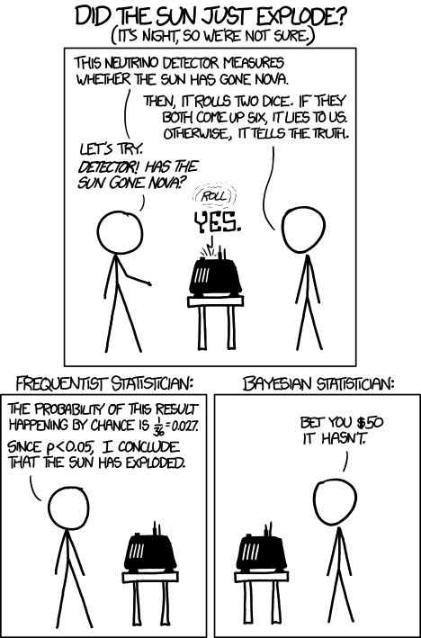
Why Not Be Dynamic?
Suppose we discover that vampires are real, but very very rare
We develop a crazy accurate test to detect vampirism
Under what conditions is it rational to test for vampirism every day?
XKCD

Slide 41
Why Not Be Dynamic?
Moving around…
  Allows you to adapt to new conditions ☺
  Allows for smaller protected areas at a time ☺☹
  Increases costs ☹
  Increases chance of making the wrong move ☹
Costs and benefits of dynamic vs. static will depend on
  Accuracy of prediction
  Frequency of need for prediction
  Costs action
  Costs of “misdiagnosis”

Slide 42
How do we know what works?
  Top-of-the-line policy evaluation depends being able to ask what would have happened in the absence of this policy?
  What’s the counterfactual for an MPA?
    Under what conditions does “inside vs. outside” work?
  What’s the counterfactual for the effect of spatial management on a rare bycatch species?
    Sadly, not a lot of “control” vaquita populations running around…

Slide 43
How do we know what works?
Large and growing field of causal inference in social-ecological systems
  Plan for evaluation
  Invest in pre-intervention monitoring!
When impossible, serious discussion of how we will measure performance
  Model-informed indicators?
Those of us in the forecasting business need to put more skin in the game
The goal is reducing bycatch.
We need to be ready to acknowledge
successes and failure to make that happen

Slide 44
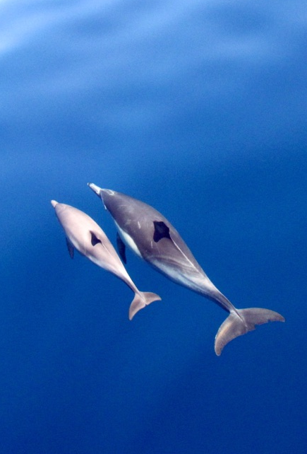
Questions?
twitter: @danovand0
email: danovan@uw.edu
website: danovando.com

Slide 45
