Slide 1
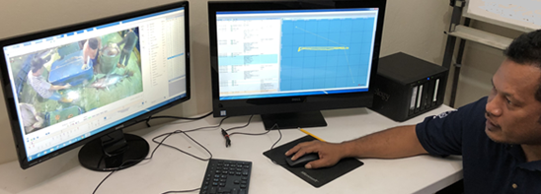
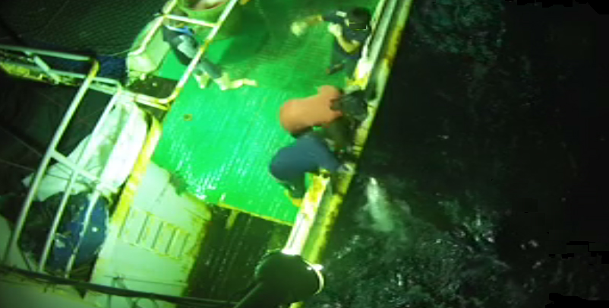
Electronic Monitoring Systems for Pelagic Longline Fisheries
UCSD Scripps Institution of Oceanography - SIOB 296 Bycatch: Problems and Solutions
Week 4: 27 January 2020
Eric Gilman, EGilman@utas.edu.au
https://www.researchgate.net/profile/Eric_Gilman2

Slide 2
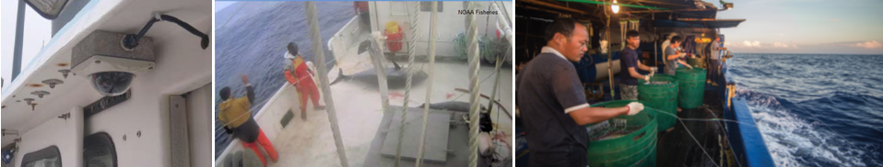
Contents
  Fisheries EM systems
  Trends in fisheries EM pilots and fully implemented systems
  Benefits of EM over at-sea observer programs – including overcoming sources of statistical sampling bias
  Relative accuracy of alternative monitoring methods
  Deficits of contemporary longline EM systems
  Alternative solutions to address identified longline EM deficits

Slide 3
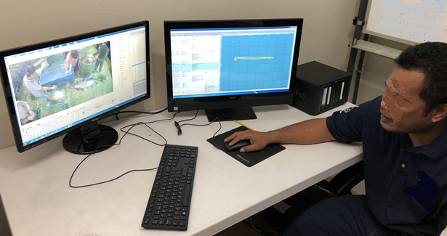

Slide 4
886 fishing vessels w/ EM systems
(Michelin et al. 2018 – CEA & The Nature Conservancy)
Van Helmond et. 2019 Fish & Fisheries
Van Helmond et. 2019 Fish & Fisheries

Slide 5
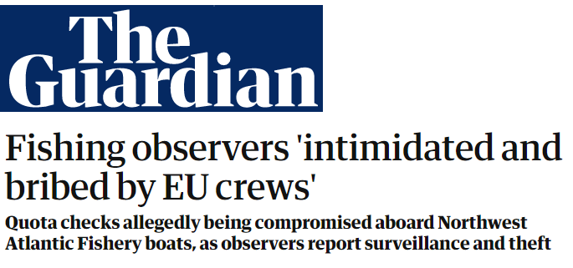
Benefits of EM over at-sea observers
Overcome observer effect
Overcome observer displacement effect
No coercion & corruption;
independent audit
Multiple fields of view
Monitor continuously
Bartholomew et 2018. Biological Conservation 219: 35-45.
Michelin et al. 2018 – CEA & The Nature Conservancy
Gilman et al. 2018. Aquatic Conservation 29: 901-926.

Slide 6
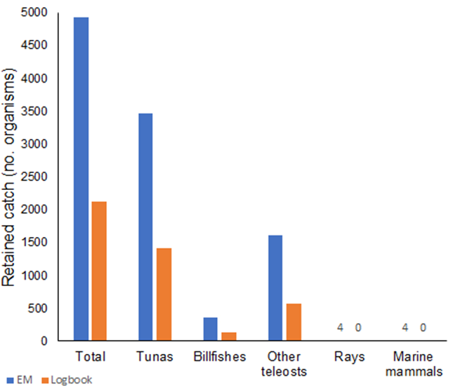
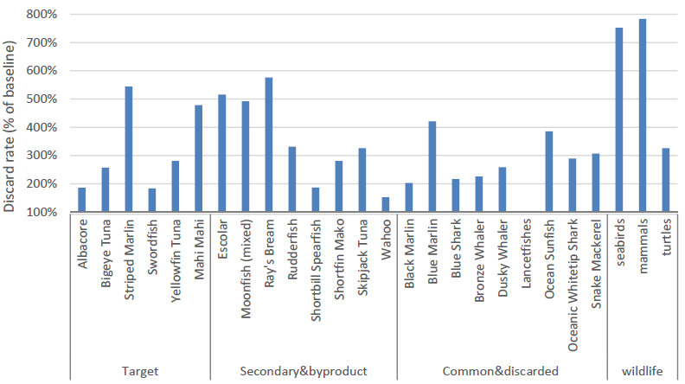
Relative accuracy of fisheries monitoring approaches
ABARES, 2016

Slide 7
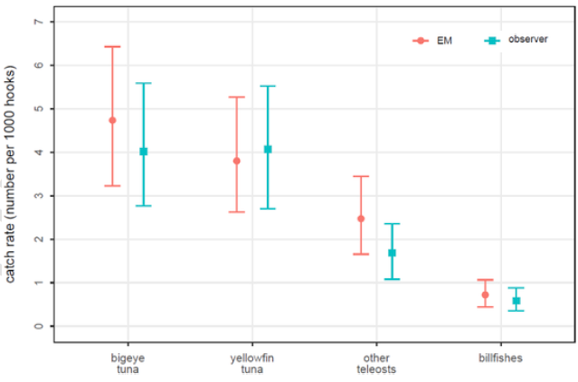
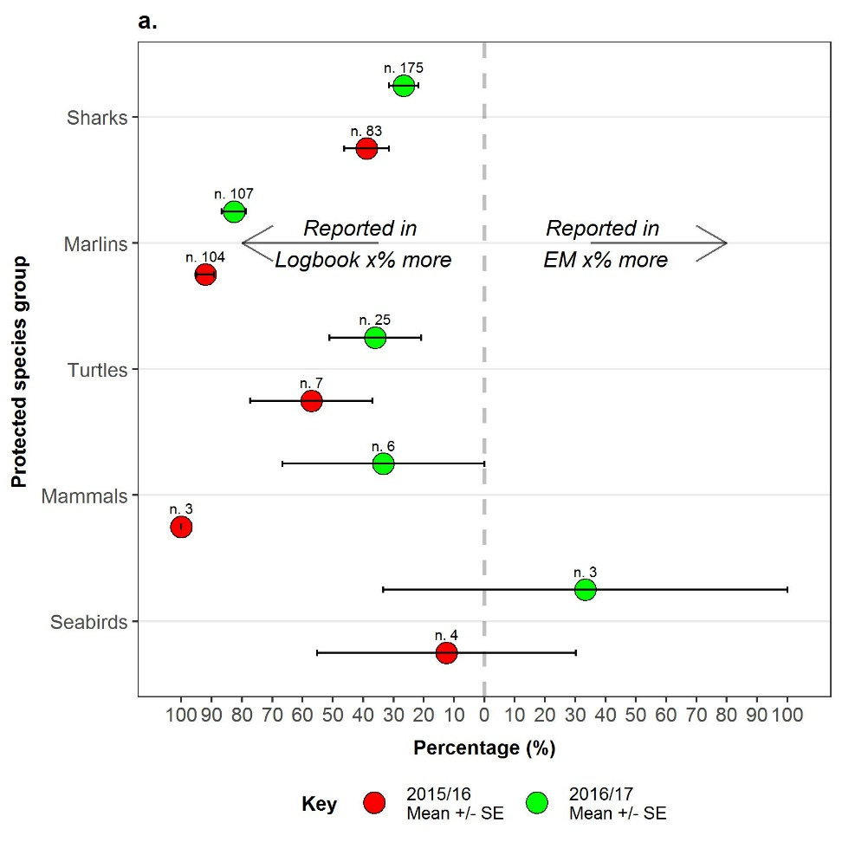
Deficits with some contemporary EM systems
Fields on discards – species (43%), length (1%), at-vessel condition (57%), release condition (48%)
Fields on terminal tackle components
Gilman et al. 2019. Marine Policy
https://doi.org/10.1016/j.marpol.2019.103792
Emmery et a. 2019. Ocean & Coastal Management 168: 307-321

Slide 8
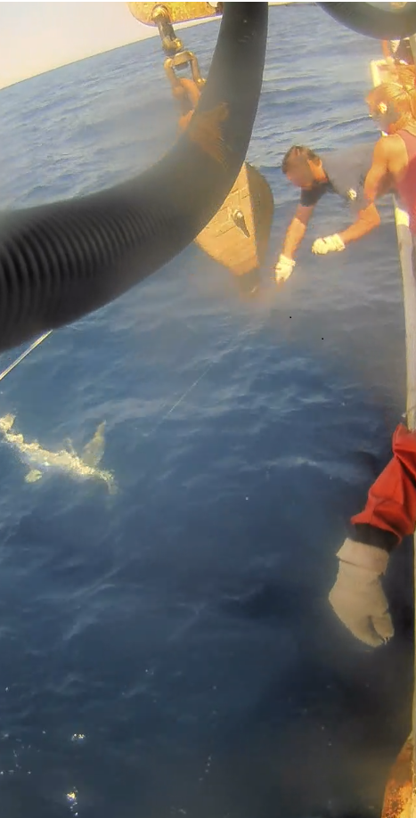
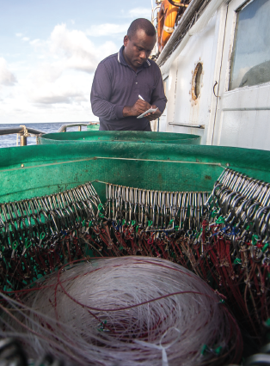
Repositioning existing or adding new cameras
Obtaining crew cooperation
Dockside data collection

Slide 9
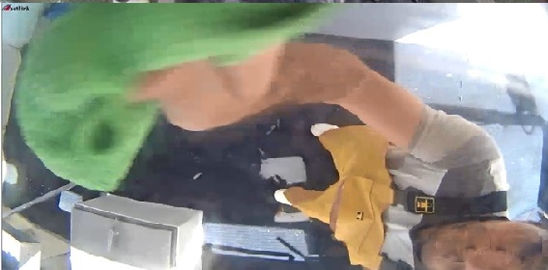
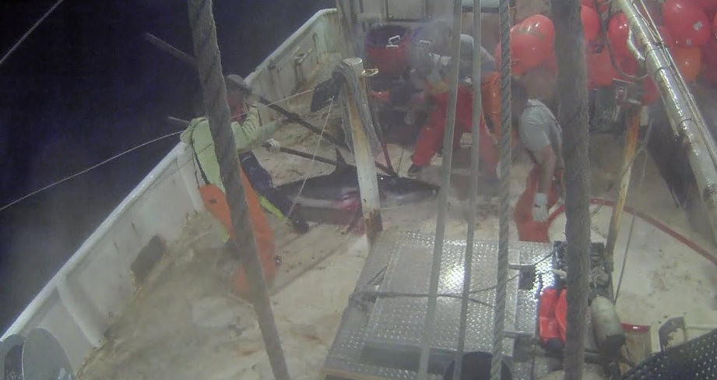
Programme Observateur de la Nouvelle‐Calédonie
National Marine Fisheries Service

Slide 10
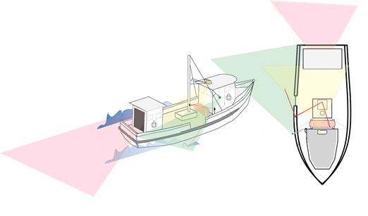
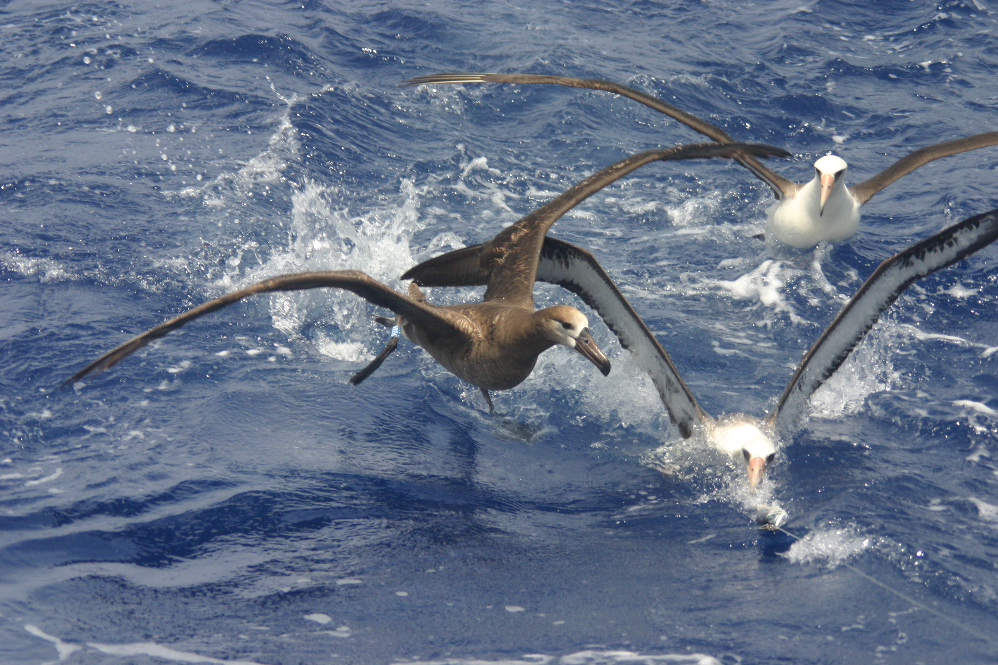
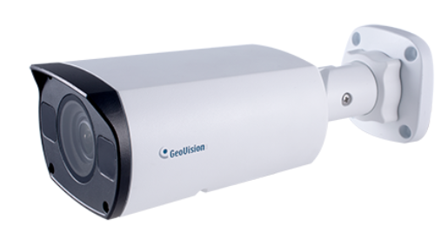
Seabird Scan Counts
8-megapixel low lux camera for view astern (20 fps, 1440p resolution) in addition to 2 standard 3-megapixel cameras positioned to monitor the haul (10fps, 720p)
Trial EM recording of 5 bird bycatch mitigation methods

Slide 11
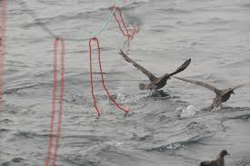
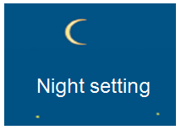
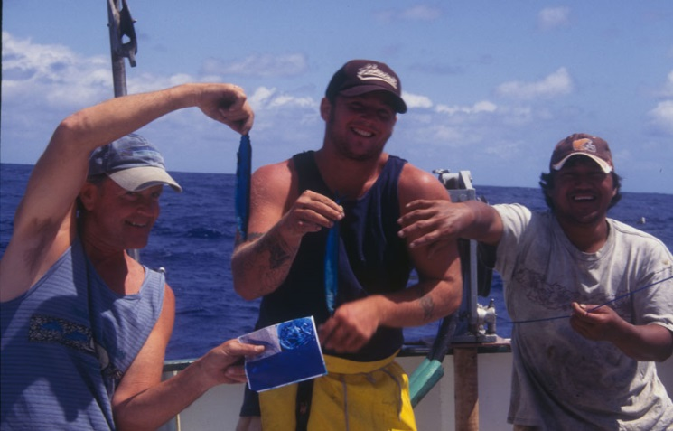
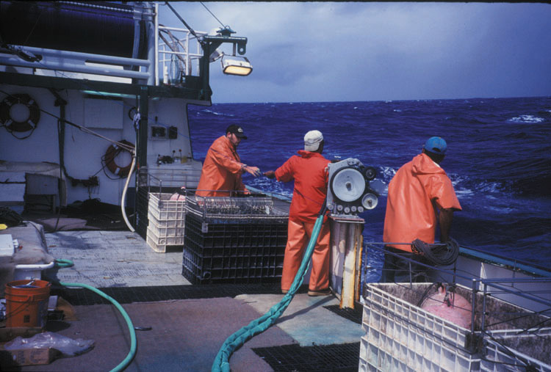
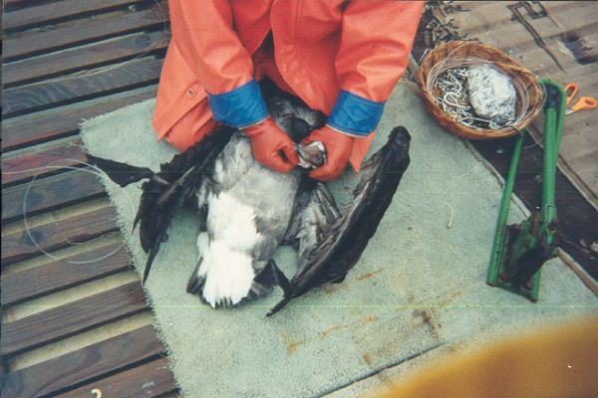
Blue-dyed bait

Slide 12
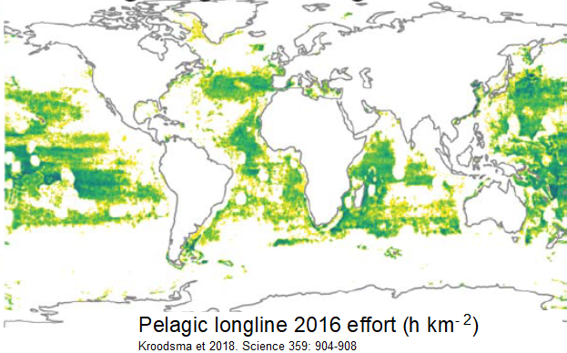
Eric Gilman
EGilman@utas.edu.au
https://www.researchgate.net/profile/Eric_Gilman2

