Slide 1
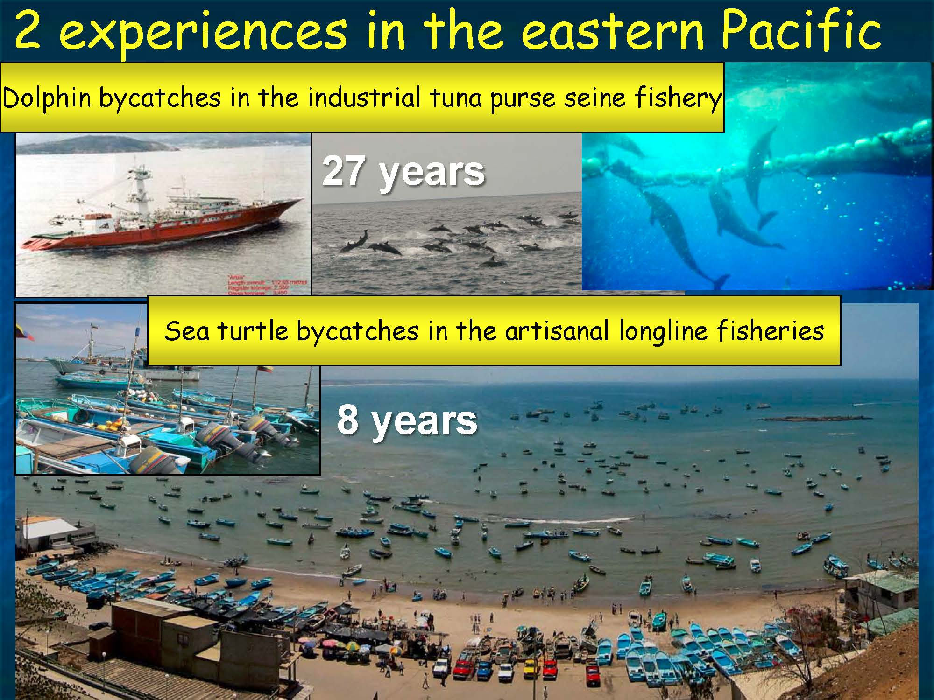
Experiences in the eastern Pacific
35 years
10 years

Slide 2
Google Scholar
  Profile https://scholar.google.com/citations?user=Vf88DYwAAAAJ&hl=en
www.martinhallfisheries.com

Slide 3
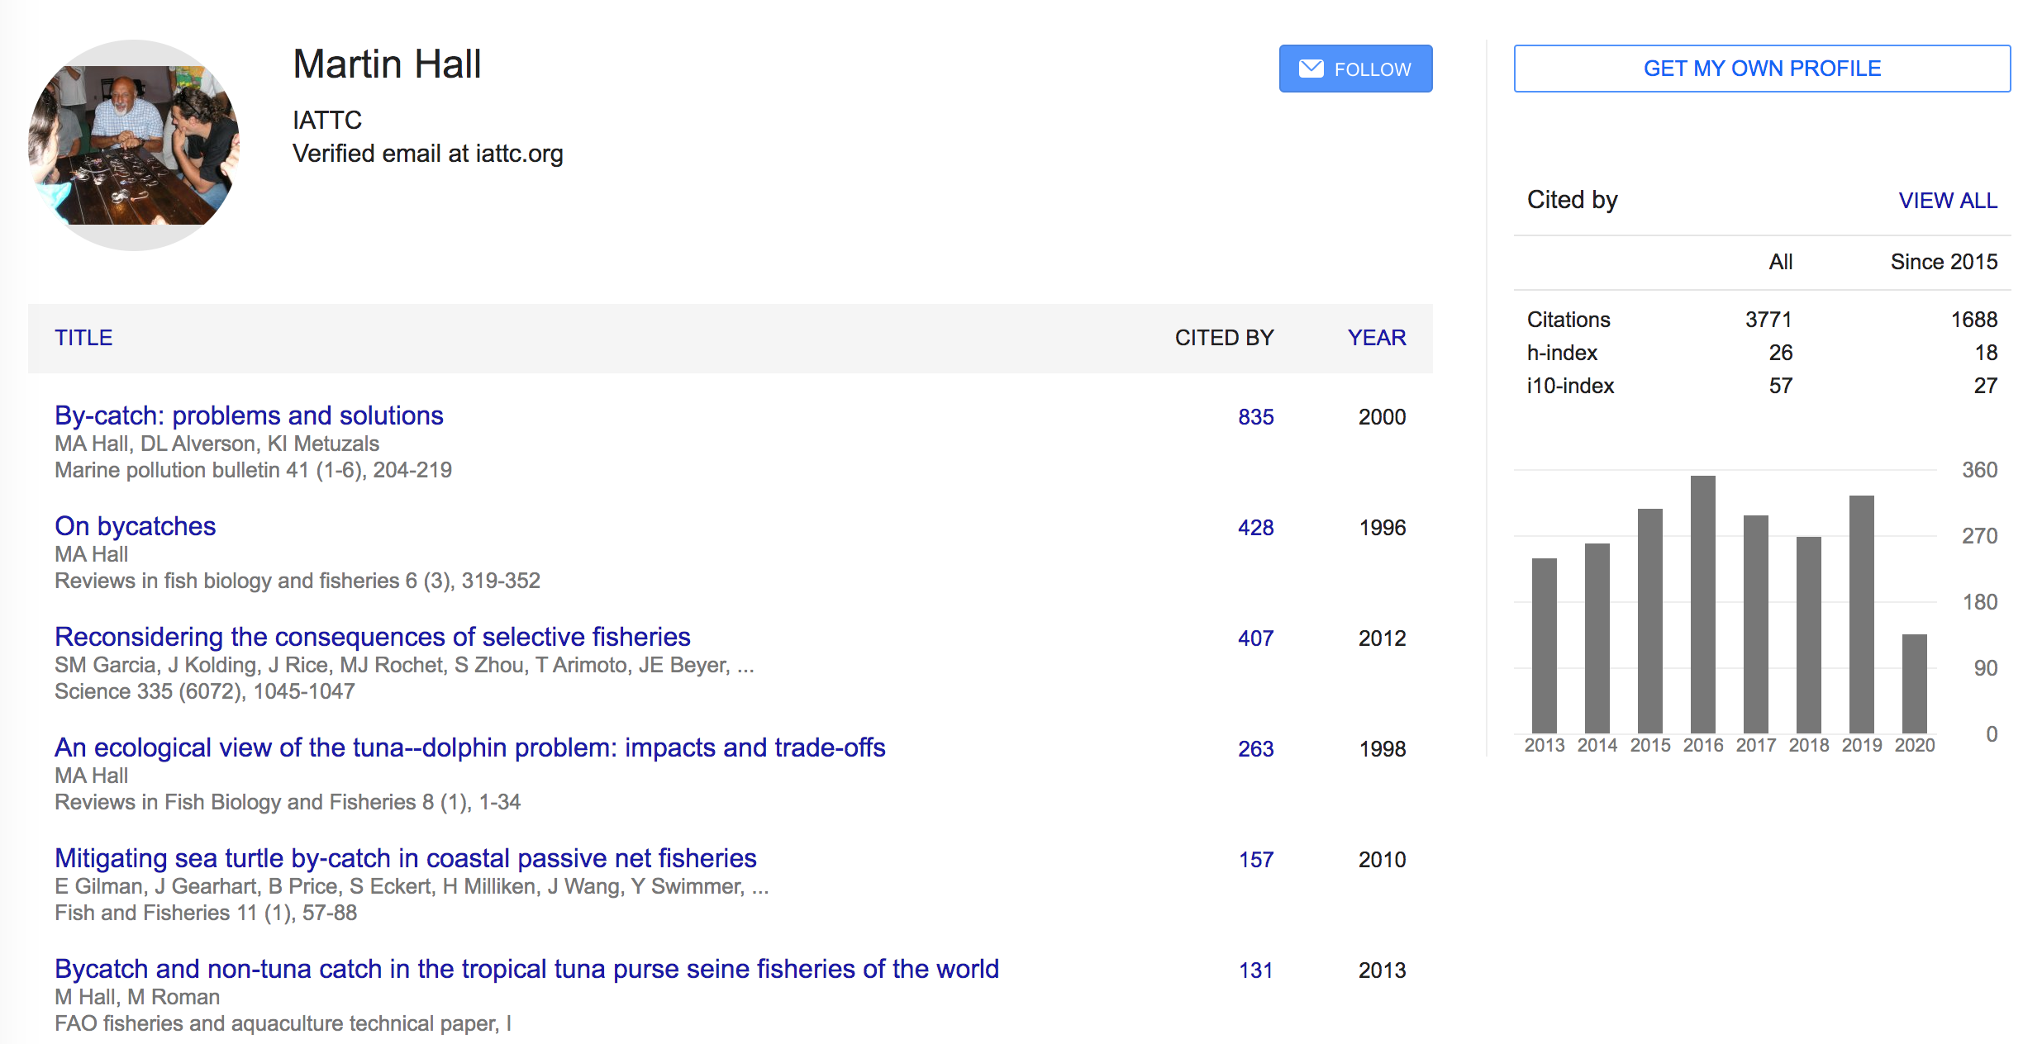

Slide 4
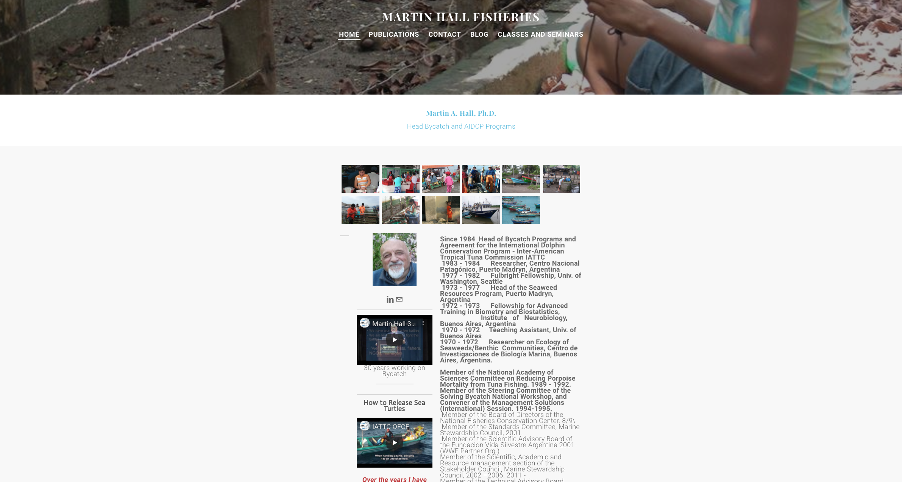

Slide 5


Slide 6
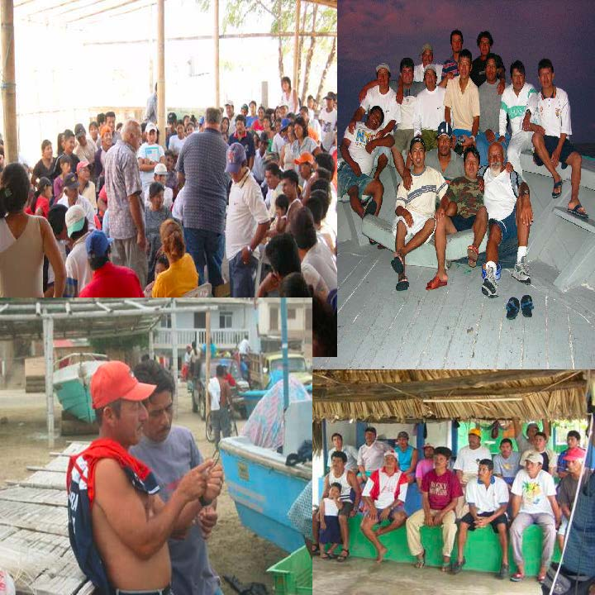

Slide 7
Main goal
Help you see fisheries in a different way than you saw them before
What is a fishery in ecological terms?
    It is an invasion
    and it has impacts at the population and ecosystem level

Slide 8
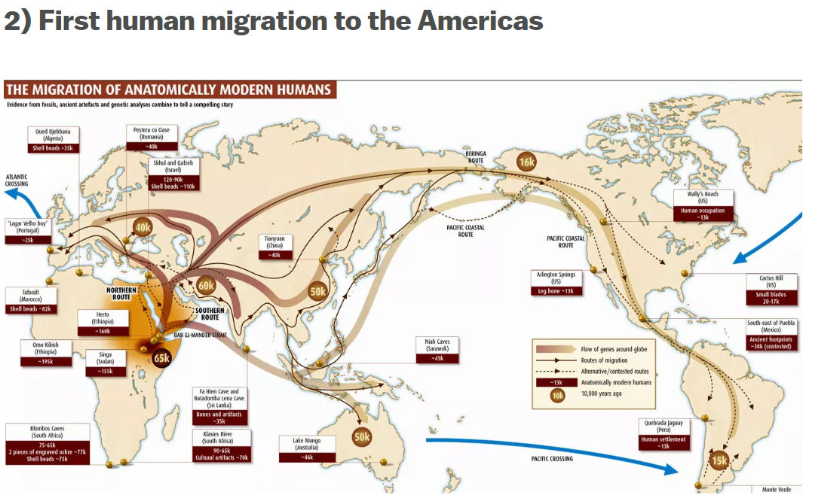

Slide 9
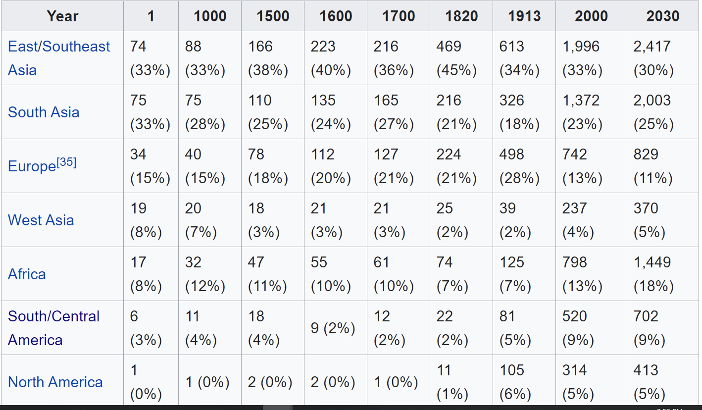
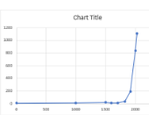
Table: Population in millions and annual growth rate
23,000 years ago around 250 individuals
formed the founding population

Slide 10
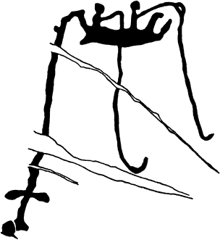

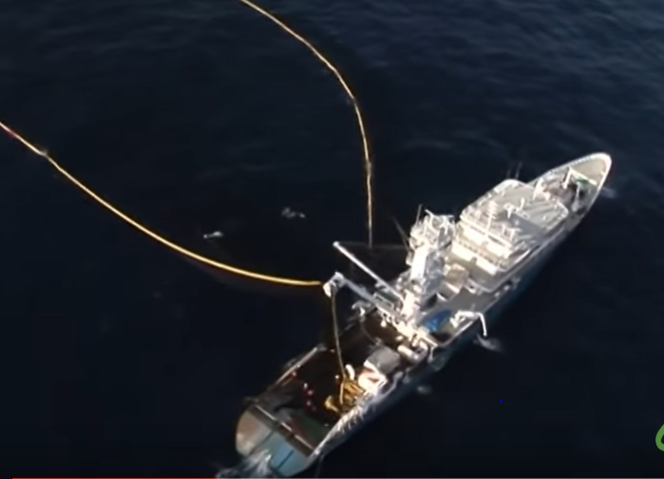
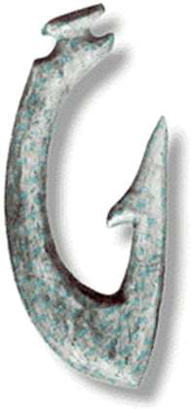

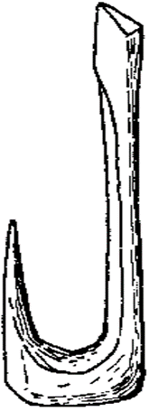
Egypt 2,000 BC
4000 BC
30,000 BC
4,000 BC
6,200 BC
bone

Slide 11
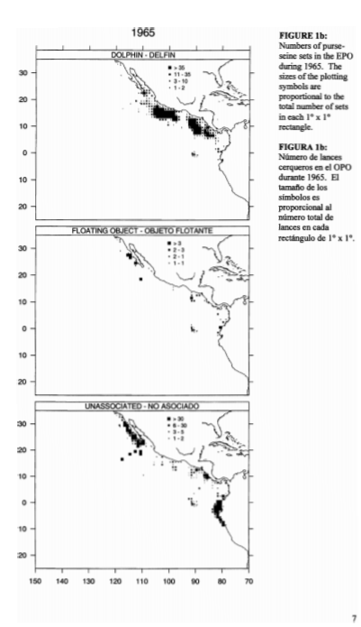
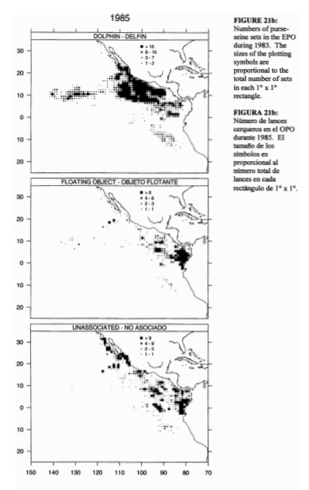
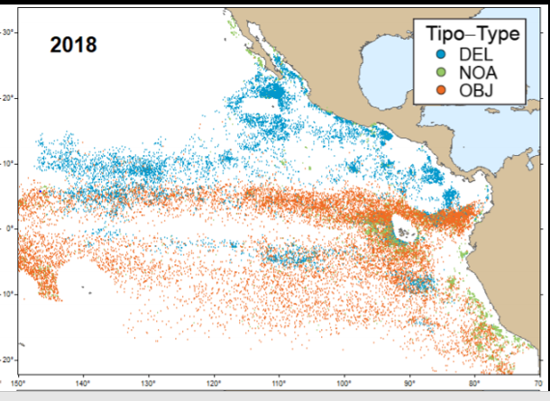

Slide 12
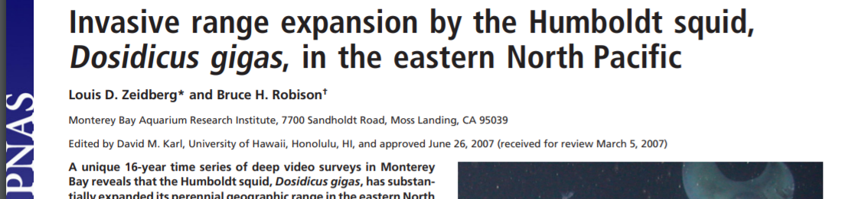
NATURAL INVASIONS HAPPEN ALL THE TIME
https://www.pnas.org/content/pnas/104/31/12948.full.pdf

Slide 13
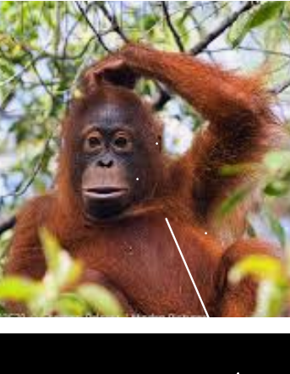
Intellectual workout 1 :
Compare an invasion from a natural predator with one by a fishery

Slide 14
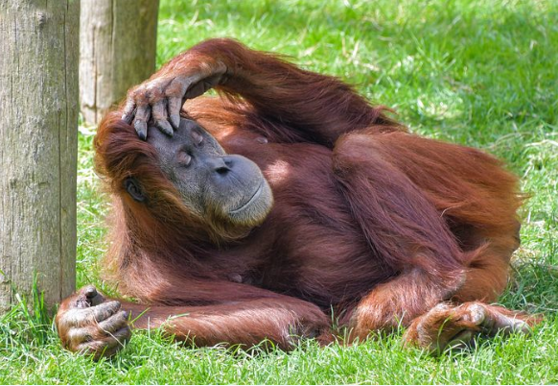
Think First, READ LATER

Slide 15
How fisheries may affect ecosystems

Slide 16
Changes in species and size compositions
Facilitated feeding and depredation (during the fishing operation)
Feeding on discards in the water column (after the operation)
Feeding on discards reaching the bottom – benthic communities
Habitat impacts, marine debris
Cryptic mortality, ghost fishing
We are supposed to move towards ECOSYSTEM-BASED FISHERIES MANAGEMENT
https://static1.squarespace.com/static/511cdc7fe4b00307a2628ac6/t/516c5a62e4b0b45503427148/1366055522805/Forage_Hilborne_2011.pdf

Slide 17
    Some fisheries select high trophic levels (tunas, sharks, salmon, cod, billfishes);
    Others select low trophic levels (sardines, anchovies, krill)

Slide 18
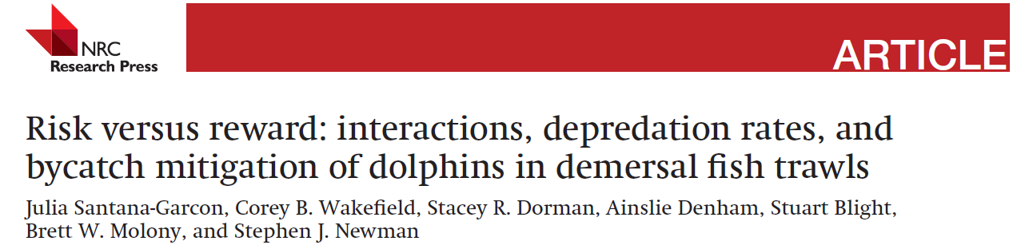
Facilitated feeding
Facilitated feeding: species take advantage of fishing operations (subsidies)
  (Santana-Garcon et al 2018) https://tspace.library.utoronto.ca/bitstream/1807/90072/1/cjfas-2017-0203.pdf

Slide 19

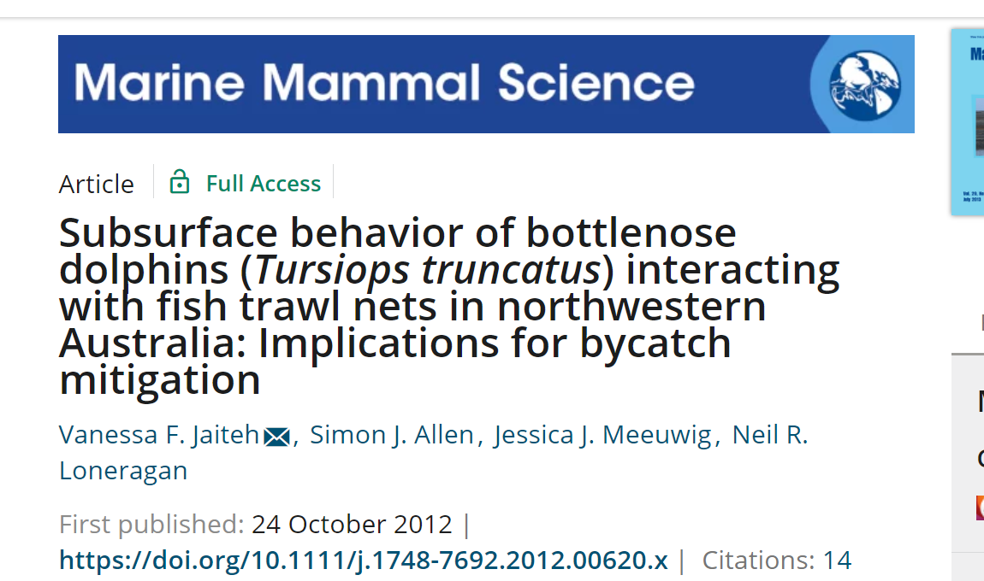
Facilitated feeding
http://scientiamarina.revistas.csic.es/index.php/scientiamarina/article/viewFile/369/369
https://onlinelibrary.wiley.com/doi/full/10.1111/j.1748-7692.2012.00620.x?casa_token=O7gOQT_kaPMAAAAA%3AnEn77uYwrx-br4gZvKzp0EG43YAdOzUT31dW5NHB9g428vQBZEjQ3eDtfBPIKMvDt4jsGUOubAFx2A
Killer whales – sea lions – jack mackerel fishery

Slide 20
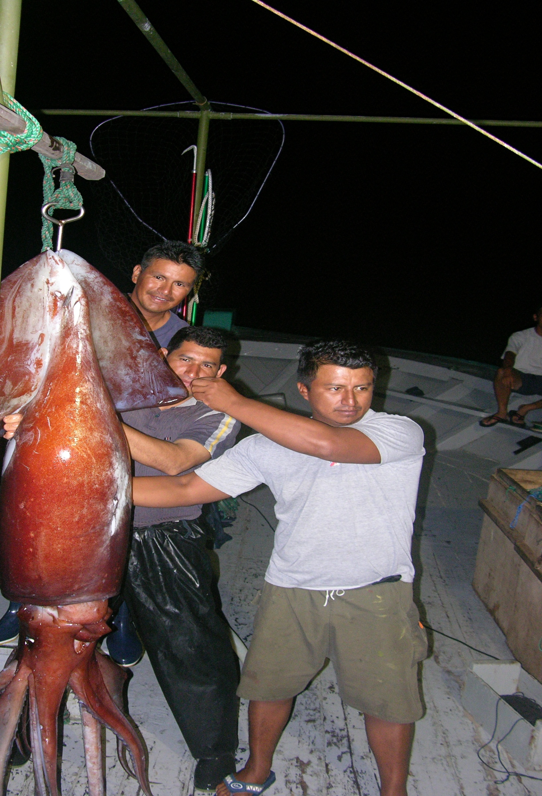
Depredation
  Depredation: individuals steal the catch; frequently leads to bycatch
  Bearzi G., Piwetz S., Reeves R.R. (2019) Odontocete Adaptations to Human Impact and Vice Versa. In: Würsig B. (eds) Ethology and Behavioral Ecology of Odontocetes. Ethology and Behavioral Ecology of Marine Mammals. Springer, Cham
  Gilman, E., Clarke, S., Brothers, N., Alfaro-Shigueto-J., Mandelman, J., Mangel, J., Petersen, S., Piovano, S., Thomson, N., Dalzell, P., Donoso, M., Goren, M., Werner, T. 2007. Shark Depredation and Unwanted Bycatch in Pelagic Longline Fisheries: Industry Practices and Attitudes, and Shark Avoidance Strategies. Western Pacific Regional Fishery Management Council, Honolulu, USA.
  https://wedocs.unep.org/bitstream/handle/20.500.11822/13627/shark_depredation_and_unwanted_bycatch.pdf?sequence=1&isAllowed=y

Slide 21
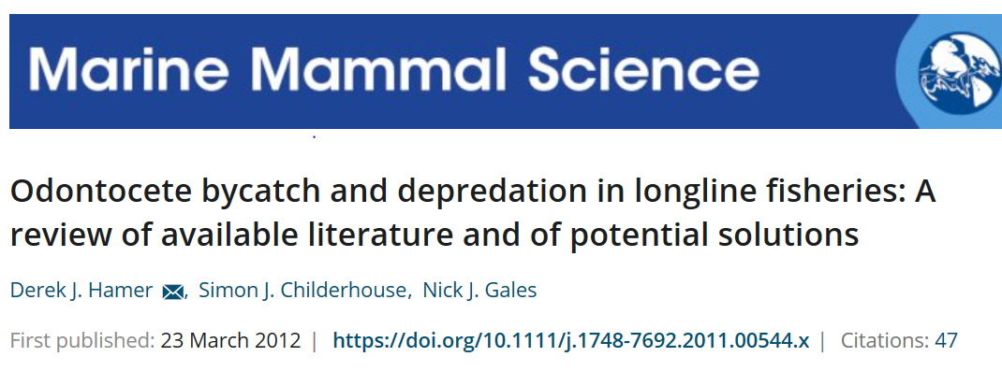
  https://onlinelibrary.wiley.com/doi/full/10.1111/j.1748-7692.2011.00544.x?casa_token=gfO1dhCXAzgAAAAA%3AvylR5o0s_b3XdM9Rvl6mUAniHBqdjhfJLgyo3efUxMgXnM6d9oQWg_0pokJ1FKsJSNCRMkNxdPkyIw

Slide 22
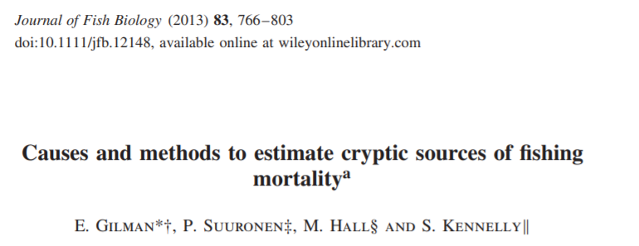
Cryptic mortality
1) Pre-catch losses (drop-offs, fishes going through meshes)
2) Post-release mortality (released alive but dies as a consequence of fishing operation)
3) Ghost fishing: lost or abandoned fishing gear keeps causing mortalities
4) Collateral mortality: indirect effects of fishing operation (trawl destroys bottom structures that served as refuges; fisheries reduces school size)
https://onlinelibrary.wiley.com/doi/pdf/10.1111/jfb.12148?casa_token=QWpCKde9dYcAAAAA:yKGDAV3Xl-gN-aL_8vptaXt6IFRSbQdWivjjOkeIPbLwb338v0vSFfoY9BRUC1HQtEU2fxP-1JwIeA

Slide 23
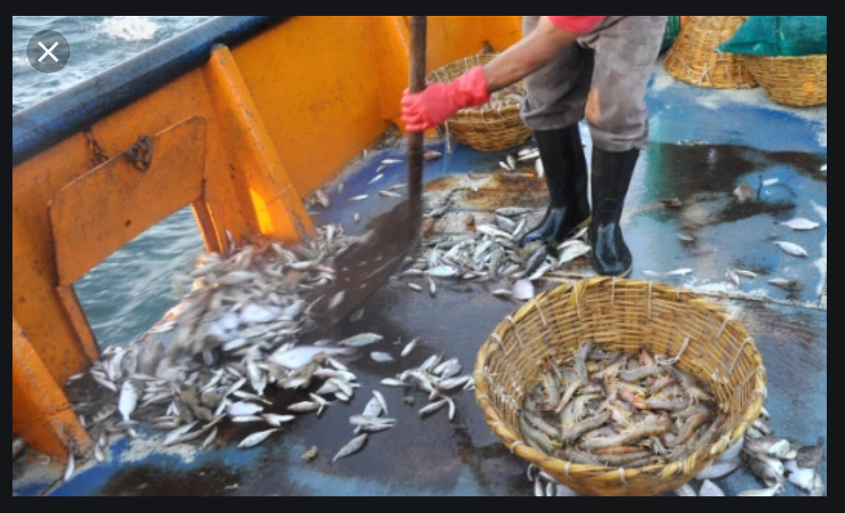
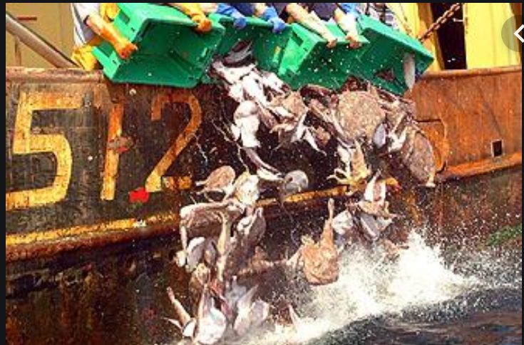

Slide 24
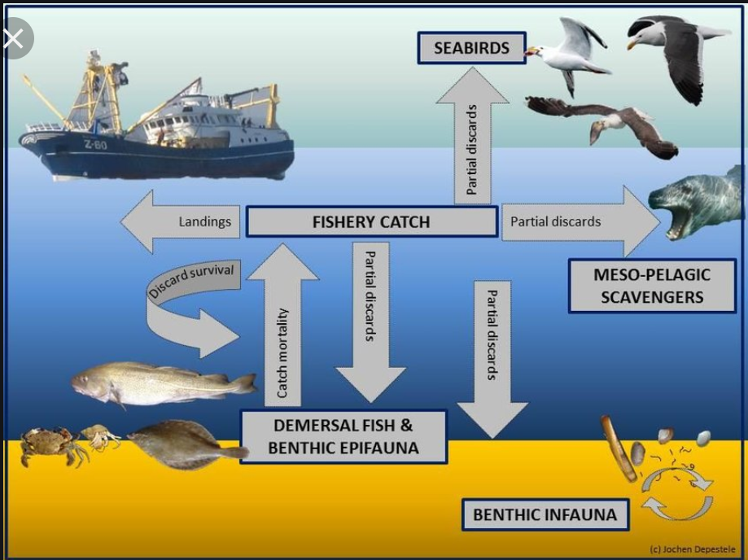

Slide 25
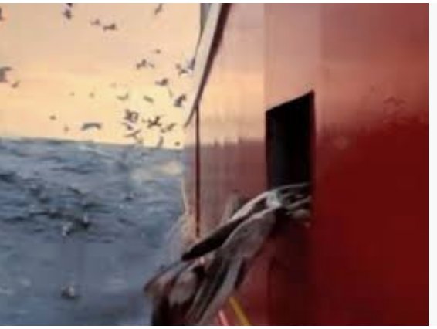
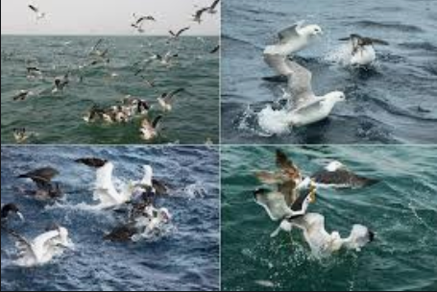
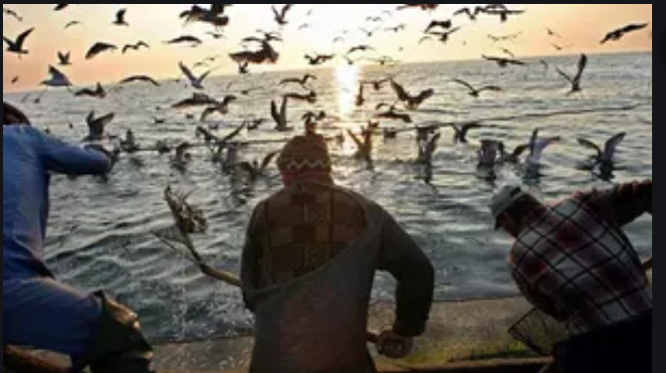
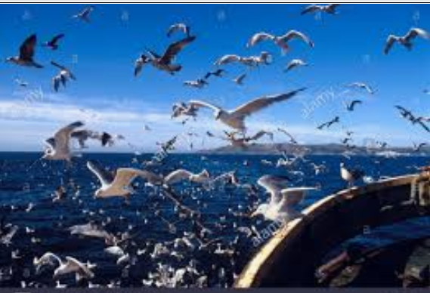

Slide 26
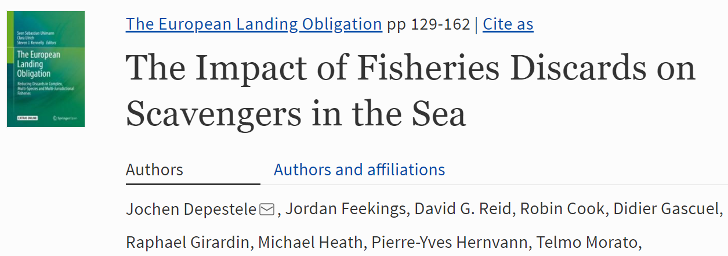
Fisheries discards as a food source
  https://backend.orbit.dtu.dk/ws/files/164307732/Publishers_version.pdf#page=143

Slide 27

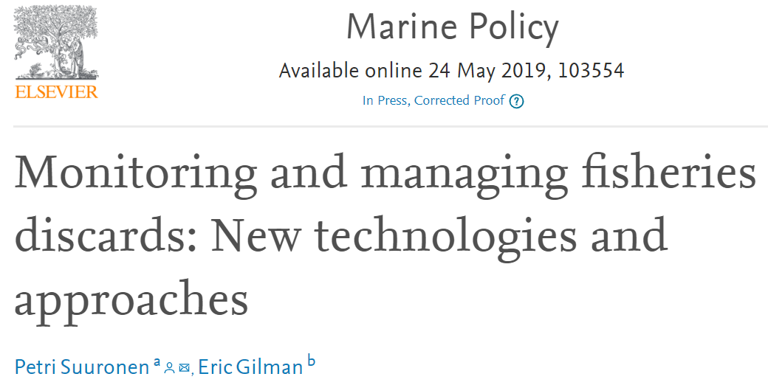
Fisheries discards management
https://www.sciencedirect.com/science/article/pii/S0308597X18308716

Slide 28
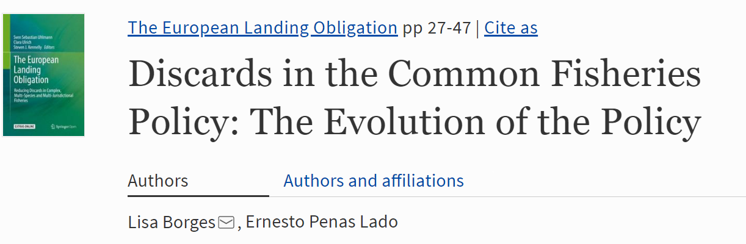
Fisheries discards : a policy and its consequences

Slide 29
POPULATION CHANGES CAUSED BY FISHING
If fishing is size selective:
  Age (and size) at first maturity will decrease
    Fewer eggs, lower “quality” eggs
  Fewer age groups present, more variability in recruitment
  Reduced average size of individuals in population may change trophic level
  If males or females grow larger or faster, it may affect sex ratios and reproduction

Slide 30
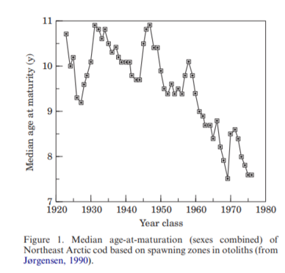
Classical study on effect of fishing on age at maturity

Slide 31
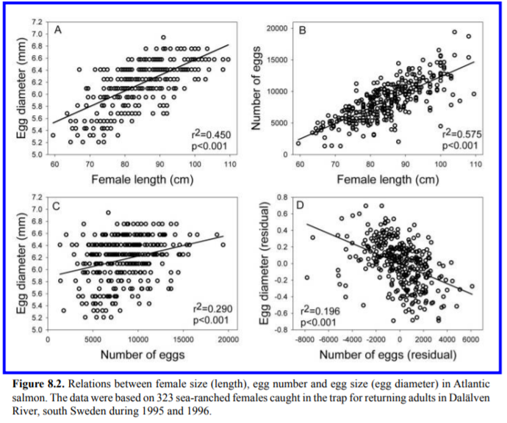
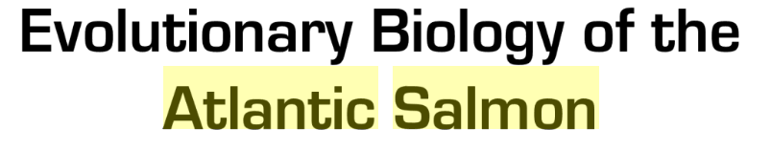

2016

Slide 32
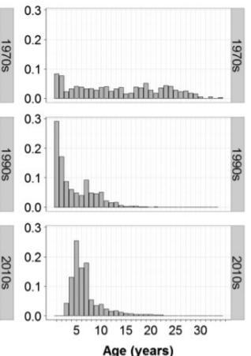
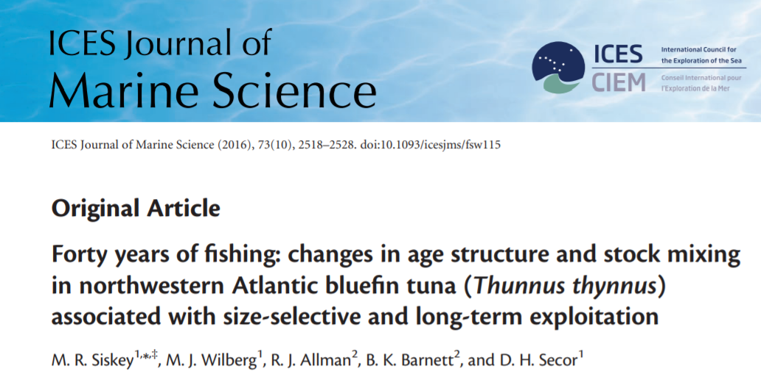

Slide 33
What is Fisheries Induced Evolution FIE ?

Slide 34
Fisheries-induced evolution Physiology
  Examples: visual acuity, and other sensory systems
  metabolism to affect swimming speed and stamina
  response to stressors, injuries, handling
  FISHERIES-INDUCED EVOLUTION Google Scholar FIE
  Hollins, J., Thambithurai, D., Koeck, B., Crespel, A., Bailey, D.M., Cooke, S.J., Lindström, J., Parsons, K.J. and Killen, S.S., 2018. A physiological perspective on fisheries‐induced evolution. Evolutionary applications, 11(5), pp.561-576.
  https://onlinelibrary.wiley.com/doi/pdf/10.1111/eva.12597

Slide 35
Fisheries-induced evolution Behavior
Behavioral changes
  Escape behaviors
  Migratory behavior
  Schooling behavior
2 has schooling become maladaptive?
Is there a different optimal school size now?
(fewer natural predators, more boats)

Slide 36
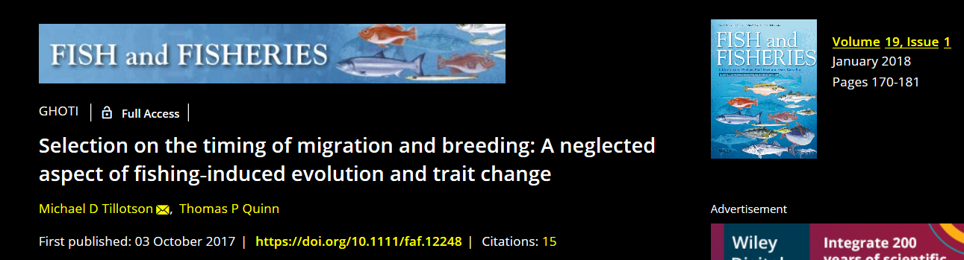
https://onlinelibrary.wiley.com/doi/full/10.1111/faf.12248
3 - How can management address this issue?

Slide 37
4 Can you imagine a few physiological, anatomic, behavioral, ecological changes that may be evolving because of fishing?

Slide 38
And now to BYCATCH

Slide 39
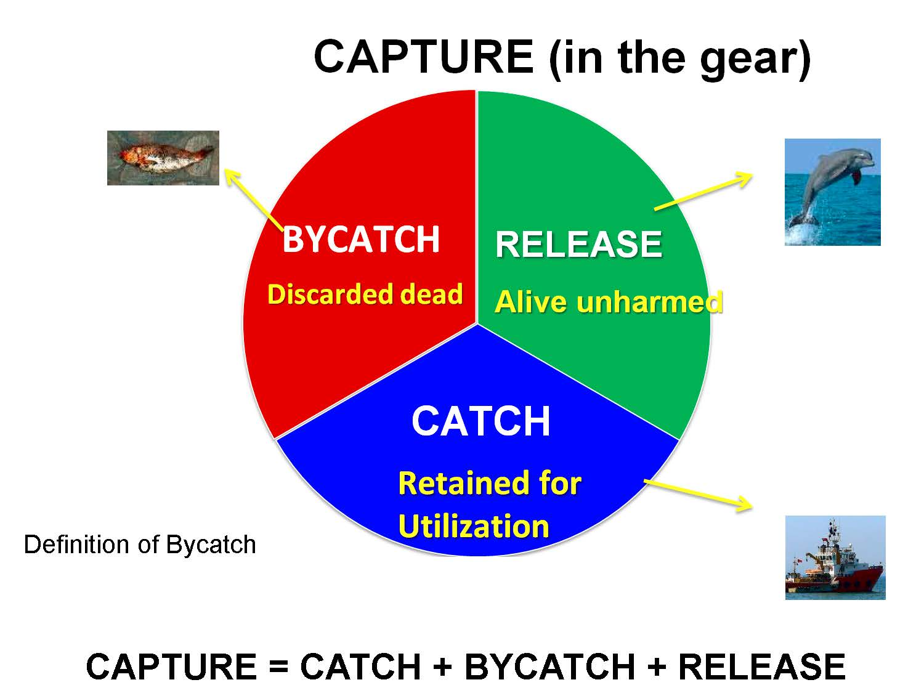
Bycatches are one of the ways fisheries impact ecosystems
What is bycatch?
Are discards the same thing?
Definitions:
You need to know what you
and others are talking about

Slide 40


Slide 41
a) Fishing industry concerned with mortality of juvenile, undersized fish of the target species that had to be discarded - a size selectivity problem
  Solution: Mesh sizes that allow escape of unwanted fishes;
  The objective was to maximize catches

Slide 42
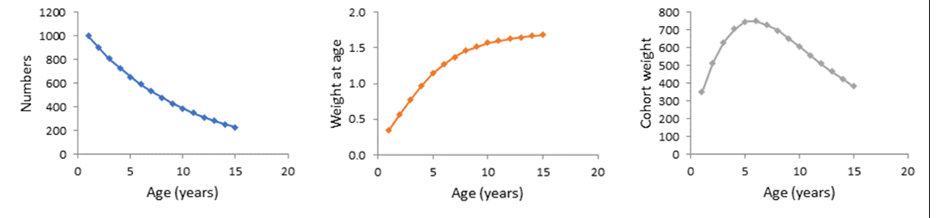
Biomass Of a cohort
Sablefish Valero-Hilborn

Slide 43
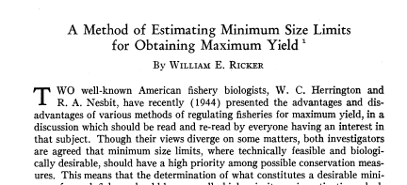
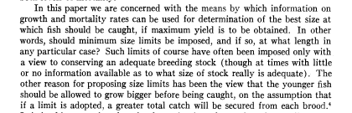

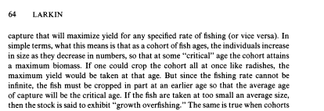
CRITICAL AGE
How to reduce the bycatch of small individuals to maximize production

Slide 44
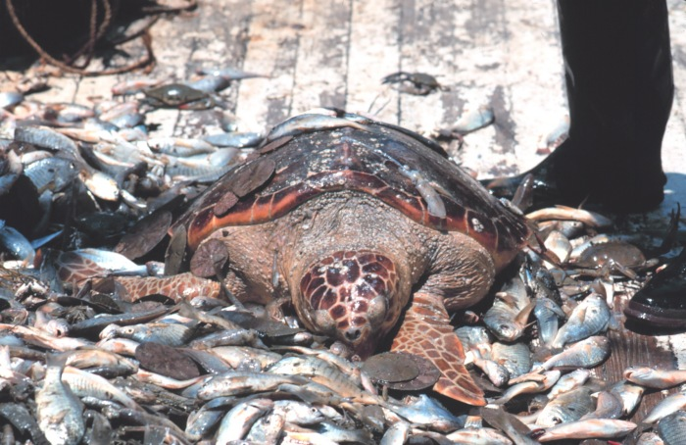
b) Some fisheries become notorious because of their waste of fish and their impacts on vulnerable populations
“Good” shrimp trawl fisheries: 8 kg fish discarded per kg of shrimp
“Bad” fisheries: Up to 17 kg of fish discards per kg of shrimp

Slide 45
A very visible problem
b) The discards of shrimp trawlers
  Developed world: How to reduce it?
  Bycatch as a conservation issue
  Developing nations: How to utilize it?
  Bycatch as a waste issue
  A species-selectivity problem

Slide 46
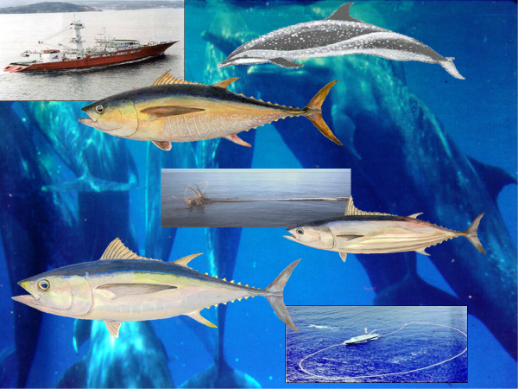
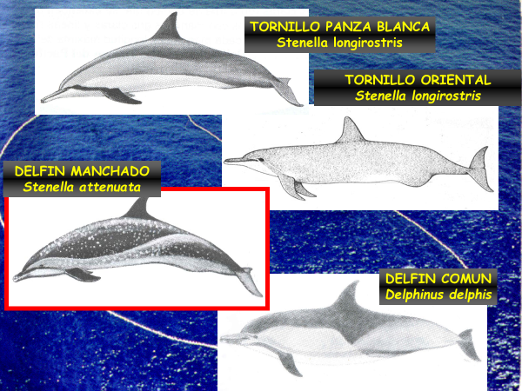
Whitebelly spinners
Eastern spinners
Spotted dolphins
Common dolphins

Slide 47
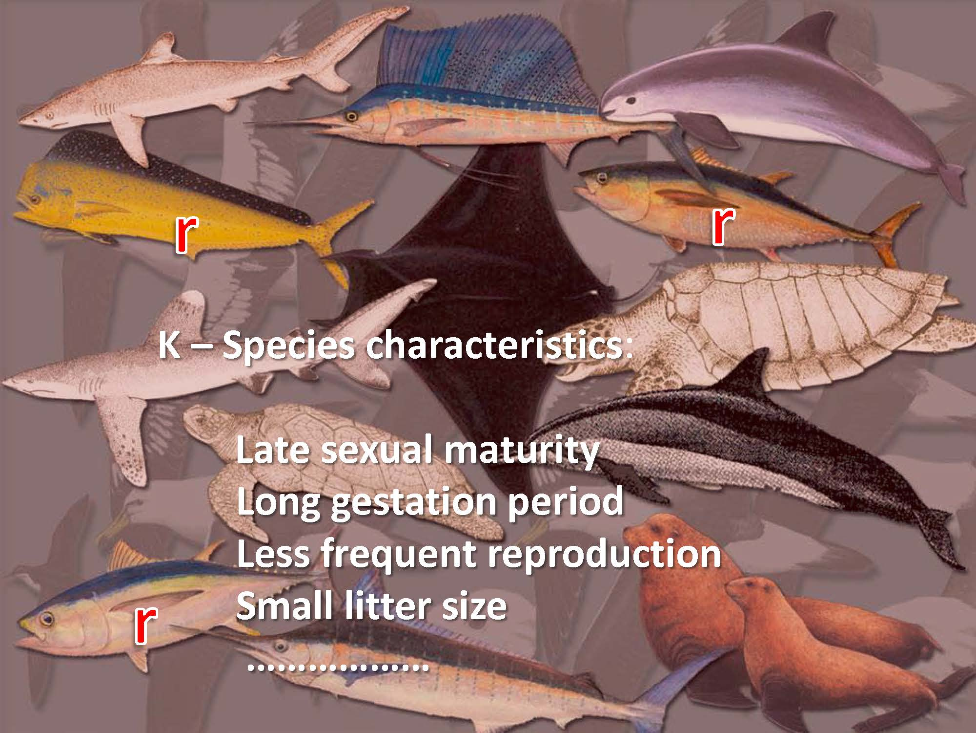

Slide 48
LIFE HISTORY STRATEGIES
 | r strategy | K strategy
Longevity | Short life | Long life
Growth | Fast growth | Slow growth
Environments | Unstable | Stable
Age at first maturity | Early maturity | Late maturity
Nr offspring | Many small offspring | Few large offspring
Parental care | Little parental care | High parental care
Investment in individual offspring | Little | High
Trophic level | Lower | Higher
MANY EXCEPTIONS

Slide 49
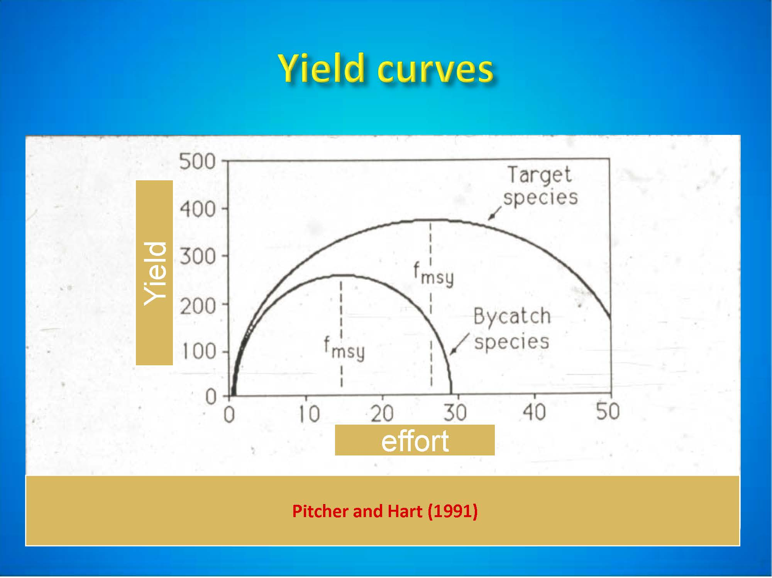

Slide 50
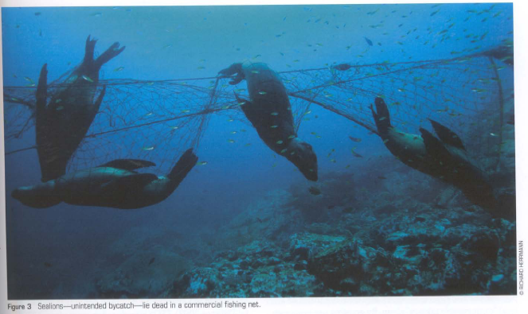
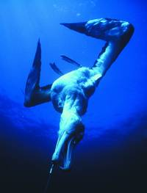

Slide 51




Fishing gear and taxa
 | Purse seine | Trawls | Longline | Gillnet | Traps
Marine mammals |  |  |  |  | *
Seabirds
Sea turtles
Sharks - rays

Slide 52



Slide 53


Technological and operational changes
Equipo y maniobras requeridos
Tuna seining “on dolphins”
Towing speedboat
Backdown
Raft
Small mesh: 3.2 cm (1 ¼”)
Notes:
The drawing illustrates a vessel in the process of a backdown maneuver and shows some of the techniques employed to avoid injuring dolphins.
After the vessel has retrieved three quarters of its net it starts to move astern.
The movement of the vessel causes the net to form a channel and its movement through the water causes the apex of the net to sink so it can be towed out underneath the dolphins.
At this stage, all of the net that the dolphins could come into contact with is made of fine mesh to ensure the dolphins to not become entangled.
Some of the crew, equipped with diving masks are in a raft in the channel to make sure all the dolphins leave the net, while others are stationed on a speedboat at the apex of the net.
If necessary, other speedboats pull on the edges of the net to ensure the channel stays open and to avoid the formation of canopies which could trap dolphins.
The vessel has a high intensity floodlight in case any of the operations involving dolphins extend until dark.

Slide 54

Sea turtles and shrimp trawls
TEDs

Slide 55
“Georgia Jumper”
standard grid
Ring TED
“Georgia Jumper”
Parrilla standard
TED De Aro
“Super Shooter”
Varilla doblada
“no brush”
Bent tube
Fixed angle
Ángulo fijo
TEDs designs

Slide 56


Gulf Fisheye
BRD
Fisheye

Slide 57

Dolphins and gillnets
Technological changes: Pingers
from NOAA HPTRT

Slide 58






Slide 59


Slide 60
c) The target of a fishery is a bycatch of another fishery, because of size, or legal reasons.
  INTERFERENCE BYCATCH

Slide 61
Objectives of bycatch management
Account for all sources of mortality for all species
Make all bycatches sustainable … and then ????
Reduce all bycatches to a minimum level ?
Reduce bycatches to zero ?

Slide 62








Consumer & Market pressures

Slide 63

Next class: fishing gear and effort
Now feedback

Slide 64


