Slide 1
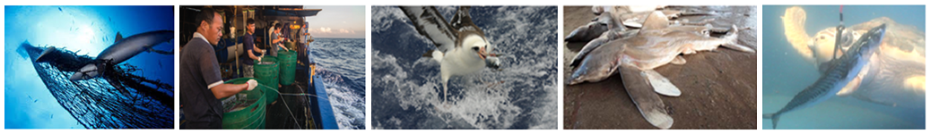
Decision support tool for integrated bycatch management
Scripps – Bycatch Problems & Solutions
21 April 2022
Eric Gilman, The Safina Center, EricLGilman@icloud.com
Notes:
10:30 – 11 pre-chat
Scripps talk – 2pm Pacific time (11am Hawaii) 21 April 2022

Slide 2
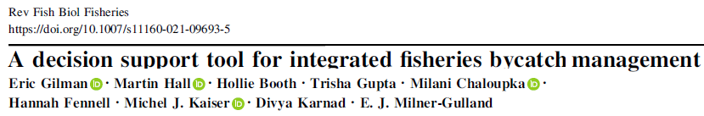
Components of a decision tool to develop a bycatch mgmt. strategy
Criteria to assess alternative bycatch mitigation methods
  Sequential evidence hierarchy
  Sequential mitigation hierarchy
  Objectives on population-specific catch and fishing mortality rate targets
  Objectives on costs from multispecies conflicts
  Objectives on costs to commercial viability
Applications of the tool (Thai Union pelagic longline, SIOTI tuna purse seine)
Bycatch offsets, pilot in-lieu fee-based compensatory mitigation

Slide 3
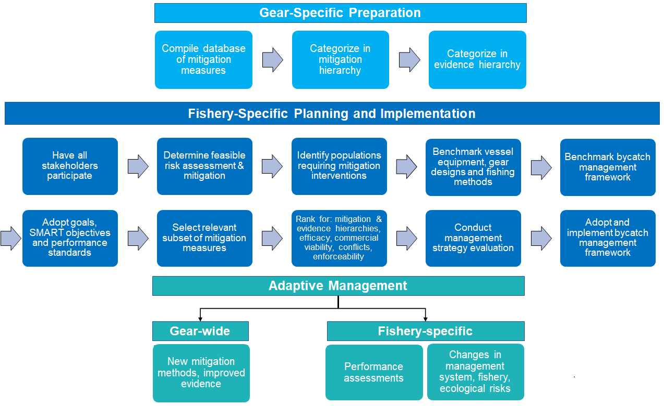

Slide 4
Criteria to Assess Alternative Bycatch Mitigation Methods
Tier in a sequential evidence hierarchy
Tier in a sequential mitigation hierarchy
How they contribute to objectives for mitigation of catch and fishing mortality rates
Whether they meet objectives on acceptable multispecies conflicts
Whether they meet objectives on commercial viability (practicality, safety, economic viability)
Commercial availability
Enforceability

Slide 5
Sequential Evidence Hierarchy
Tier | Method Category
1 | Meta-analytic synthesis studies of RCTs
2 | Individual RCTs
3 | Meta-analytic synthesis studies that include quasi-experimental, comparative or observational studies
4 | Individual quasi-experimental and comparative experimental studies
5 | Individual observational studies applying statistical modelling approaches to standardize catch and fishing effort time series data and applying quasi-experimental modelling approaches to infer causal impacts of an intervention
6 | Individual observational studies with nominal estimates
7 | Mechanistic studies
8 | Qualitative systematic synthesis
9 | Qualitative unstructured synthesis
10 | Expert survey
11 | No records Conflicting results Non-expert surveys/opinion Flawed studies

Slide 6
Sequential Mitigation Hierarchy
Avoid the risk of capture
Minimize the risk of capture
Remediate impacts by reducing the probability of one or more of the components of fishing mortality (pre-catch, at-vessel, fate, at-release, ghost-fishing, post-release, collateral)
Offset residual bycatch mortalities that were not avoided, minimized and remediated.

Slide 7
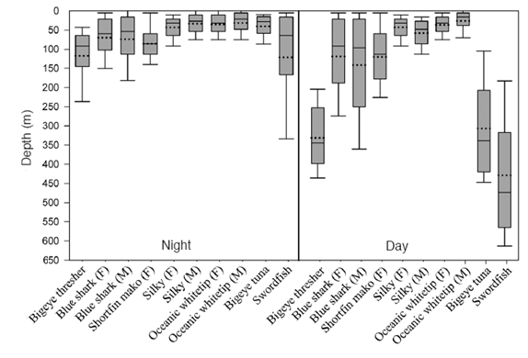
Time-of-day and depth of fishing
Depth preferences for selected pelagic teleost and sharks from satellite tag data. Boxes are 25% and 75% quartiles, solid horizontal line is the median (50% quartile), dashed horizontal line is the mean, and bars represent 10-90th deciles. M=male, F=female (Musyl et al., 2011).

Slide 8
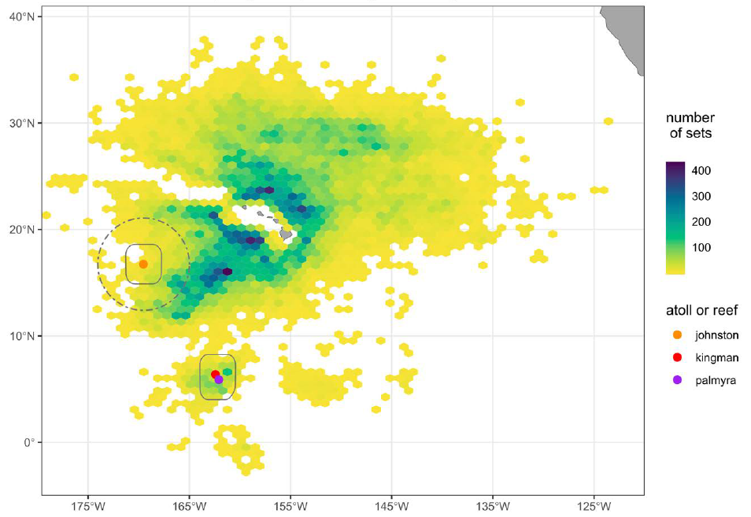
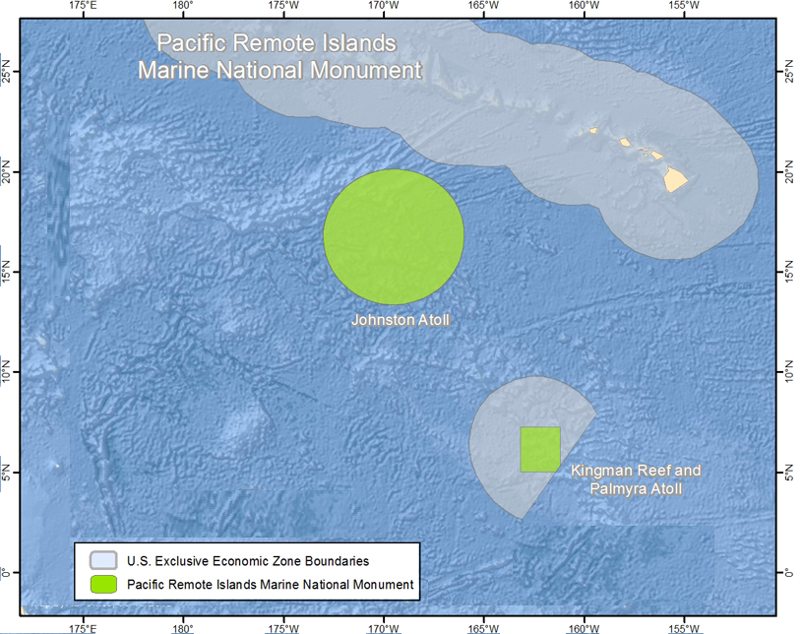
Fisheries Area-Based Management Tools
Closures designed to reduce the bycatch of one threatened species can displace fishing effort temporally and spatially, increasing the bycatch of other threatened species
Gilman et 2020 Ecological response to blue-water MPAs. PLoS ONE 15: e0235129

Slide 9
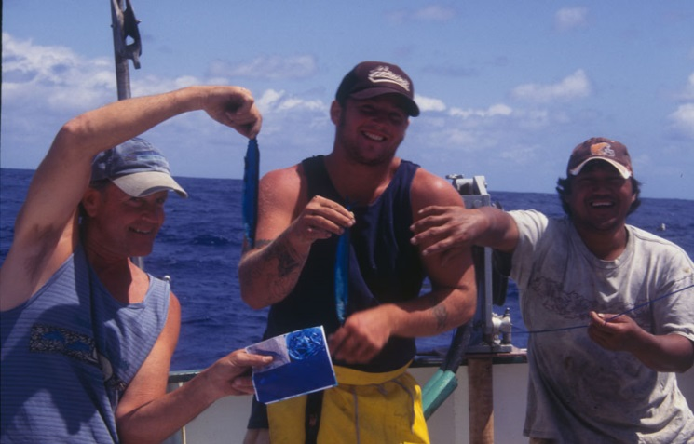
Commercial Viability and Availability
Costs to economic viability
Costs to practicality
Costs to crew safety
Commercial availability

Slide 10
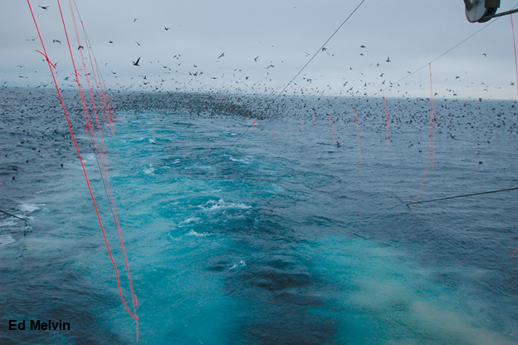
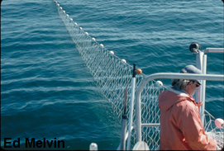
Compliance likelihood
Does crew behavior affect the performance of the bycatch mitigation method?
Is voluntary compliance expected – what are commercial viability costs?
What monitoring and surveillance methods enable determining compliance – dockside inspection, at-sea observers/EM, VMS/AIS…?
What are current resources of the fisheries’ monitoring and surveillance systems?

Slide 11
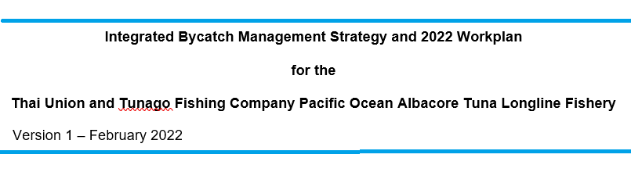
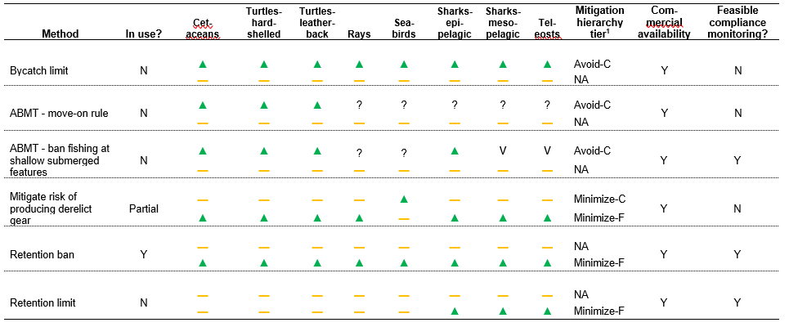

Slide 12
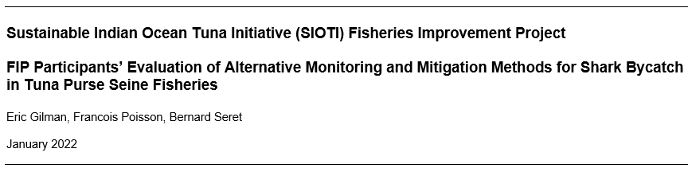

Slide 13
Offsetting Residual Bycatch Impacts
Direct
Compensatory mitigation banking
In lieu fee-based compensatory mitigation

Slide 14
Potential ecological, socioeconomic and governance benefits of bycatch mitigation offsets
Benefits
Address broad ecological and socioeconomic objectives
Avoid temporal loss in biodiversity
Achieve larger conservation gains from consolidated offset conservation activities than numerous single interventions
Achieve permanent conservation gains
Realize more certain performance – conservations gains are confirmed before being eligible for debit
Realize more certain performance – create a system where maximizing conservation gains maximizes economic benefits
Streamline offset authorization process and governance
Reduce and provide more predictable economic costs
Incentivize more effective bycatch avoidance, minimization and remediation

Slide 15
Potential risks of bycatch mitigation offsets
Risks
Deviate from strict sequencing
Cause a temporal loss in biodiversity
Deviate from bycatch bank minimum standards
Fail to perform
Fail to achieve permanent conservation benefits
Generate inadequate demand for bank credits
Fail to achieve equivalency due to not using evidence-informed metrics
Fail to achieve equivalency due to off-site and/or out-of-kind mitigation
Fail to achieve equivalency when averted loss offsets would have been undertaken without the offset investment

Slide 16

Sequential mitigation hierarchies in fisheries policy, bycatch offsets in practice
ISSF - US$1 per ton of albacore tuna for marine turtle conservation
California swordfish driftnet fishing association – fund Mexico leatherback turtle nesting site conservation activities

Slide 17
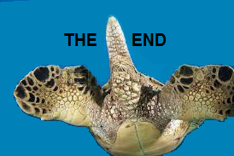

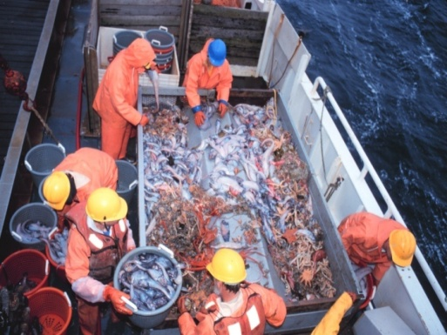
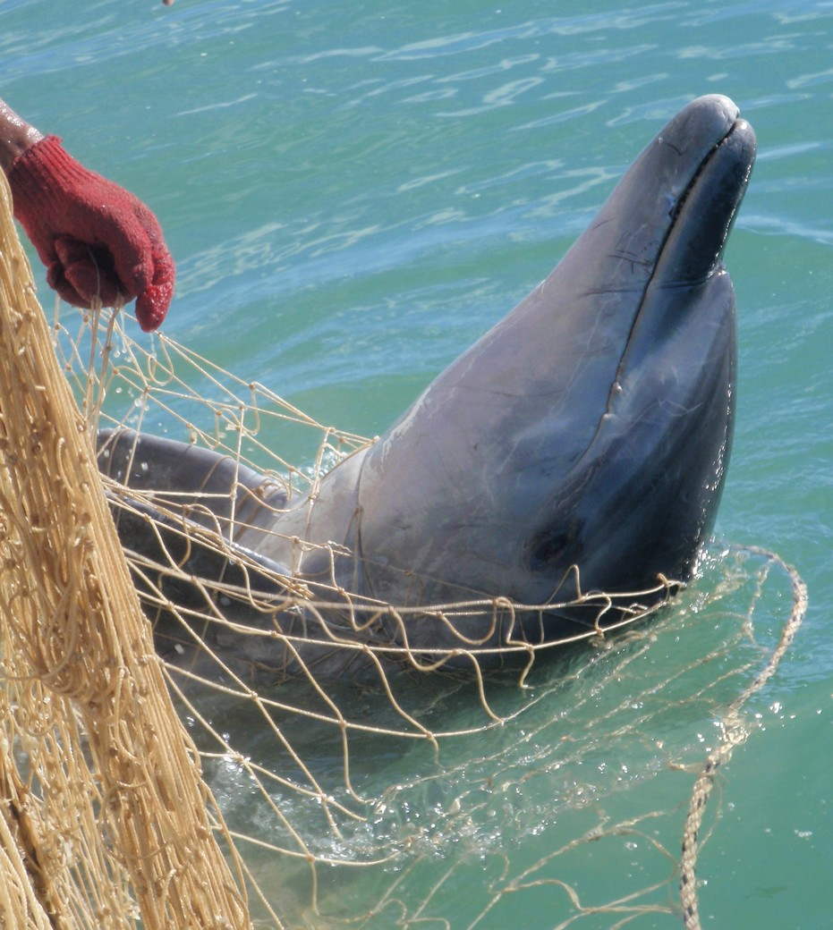
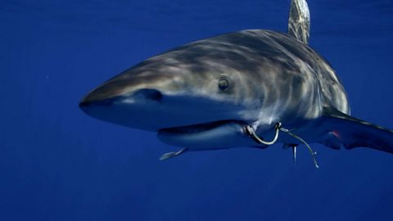
Key Traceability, Thai Union, SIOTI FIP

