Slide 1

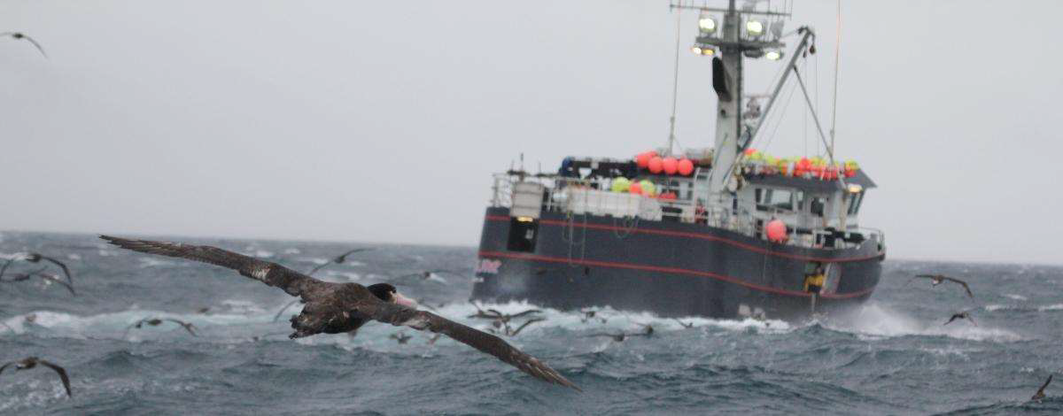
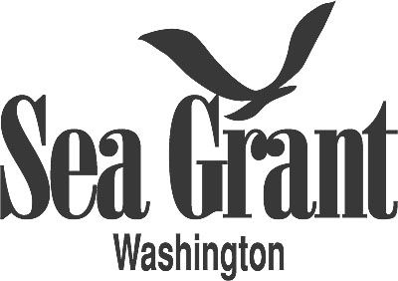
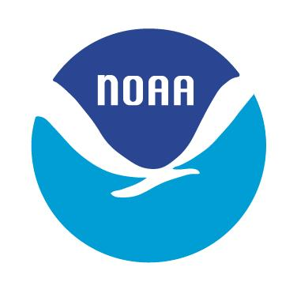
Reducing seabird bycatch in
Alaskan longline fisheries
Ed Melvin
School of Aquatic and Fishery Sciences,
University of Washington, Seattle, WA
Rob Suryan
Alaska Fisheries Science Center,
NOAA Fisheries, Juneau, AK

Slide 2
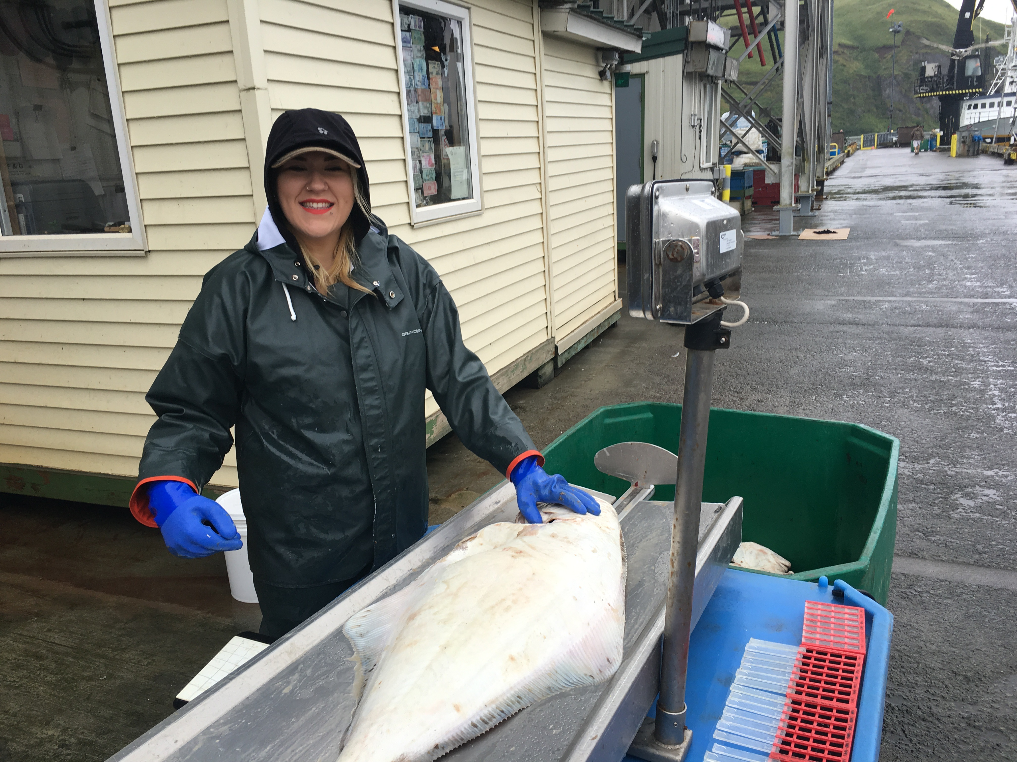
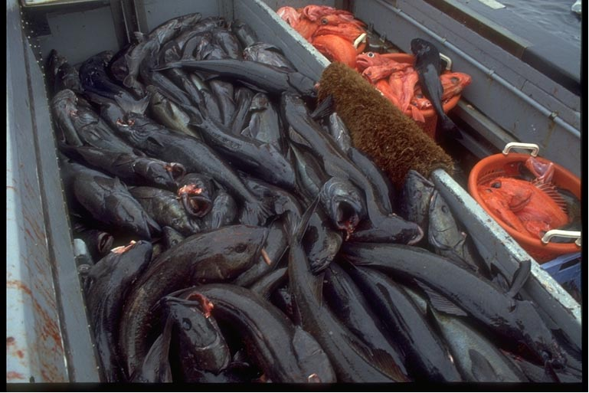
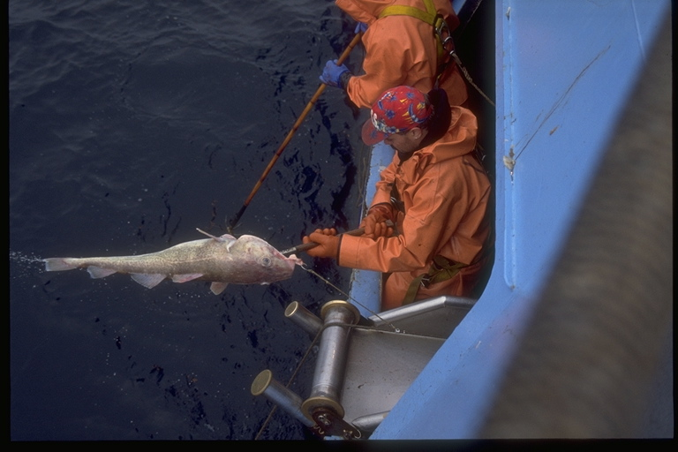
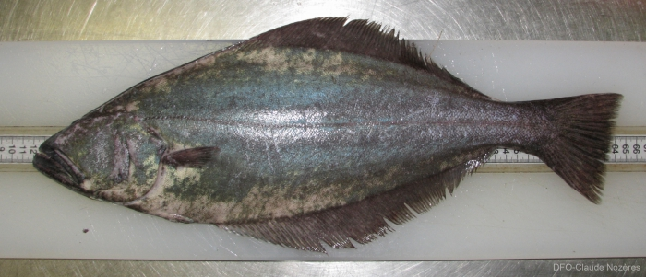
Target Species: Alaskan Longline Fisheries
Sablefish
Pacific halibut
Greenland Turbot
Pacific cod

Slide 3
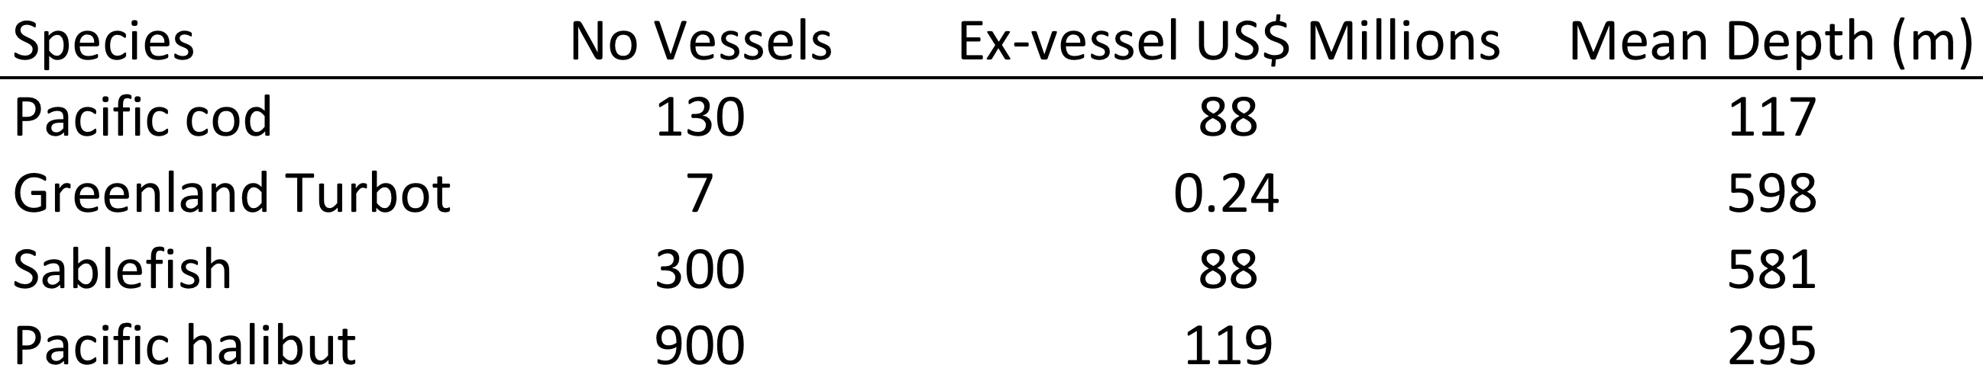
Fishery Description: Alaskan Longline Fisheries
One of the largest (US$ 300 million ex-vessel value, 1,000 vessels) and most diverse commercial demersal longline fisheries in the world.
Mostly separate fleets targeting four species:
High Vessels diversity: Ships to skiffs

Slide 4
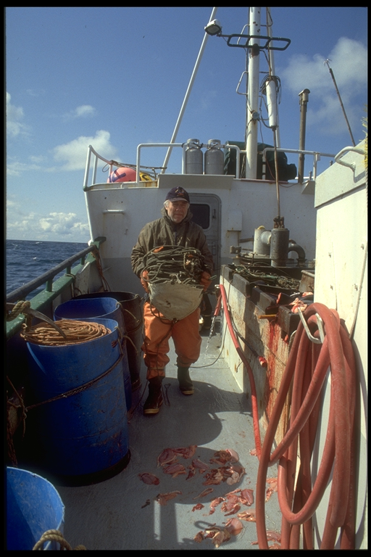
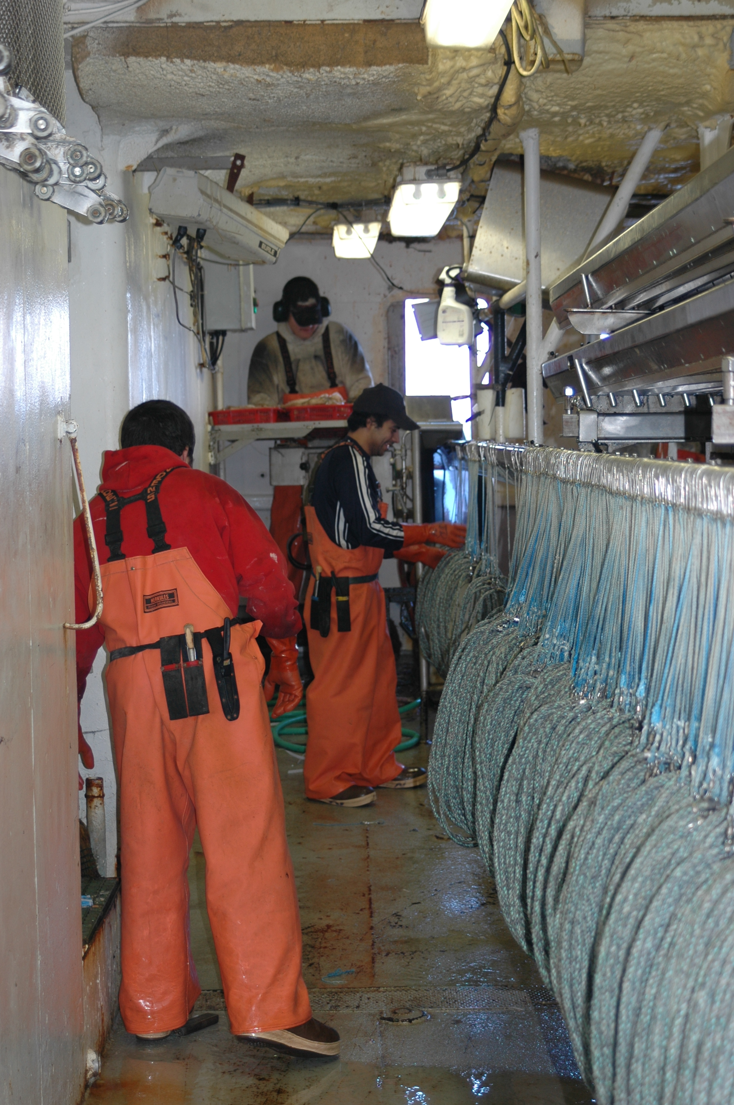
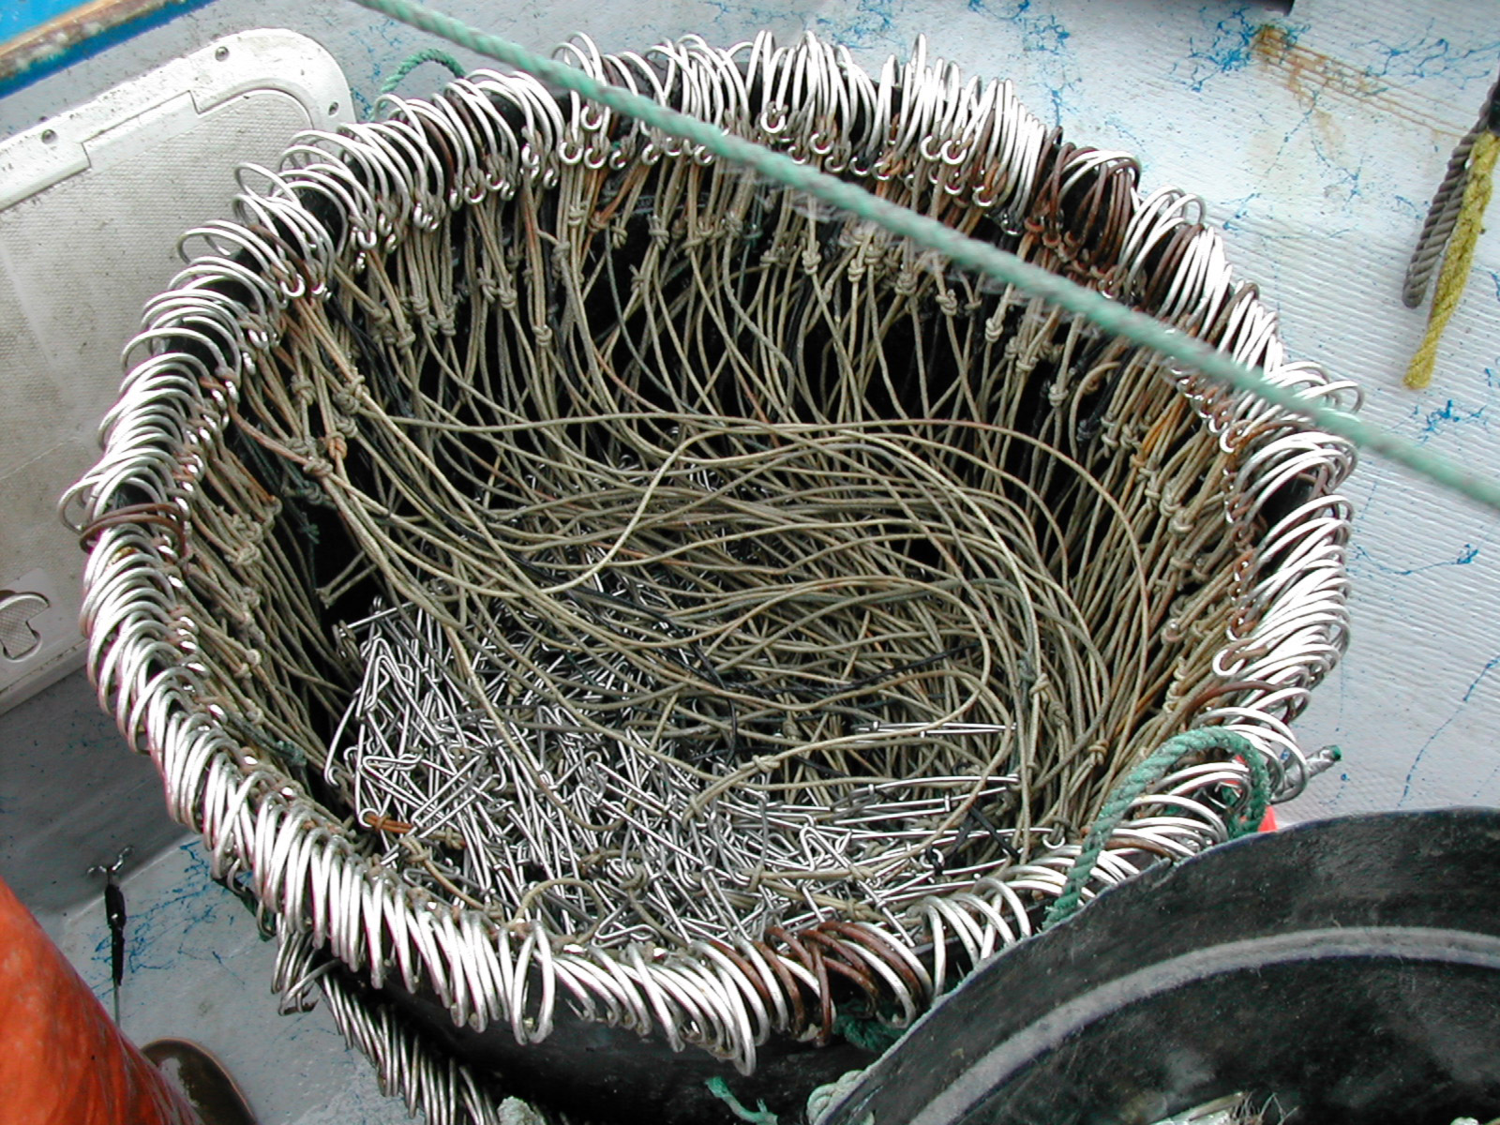
Hand baited and Auto-baited longline gear
Hand baited gear
Auto-bait longlines
Skate bottom
gear
Snap
Gear

Slide 5
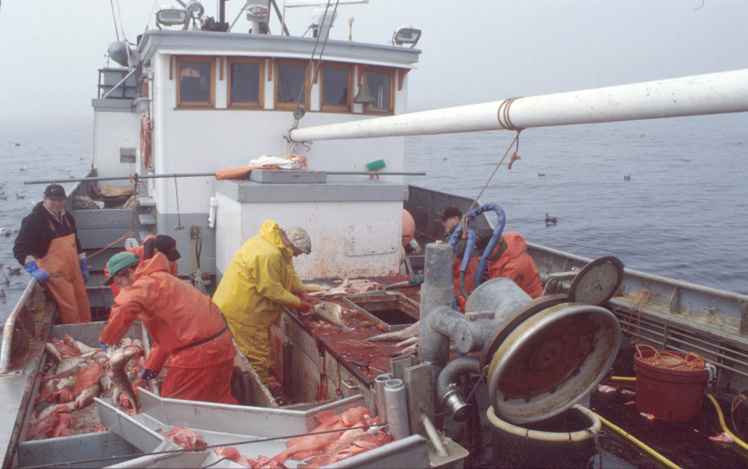
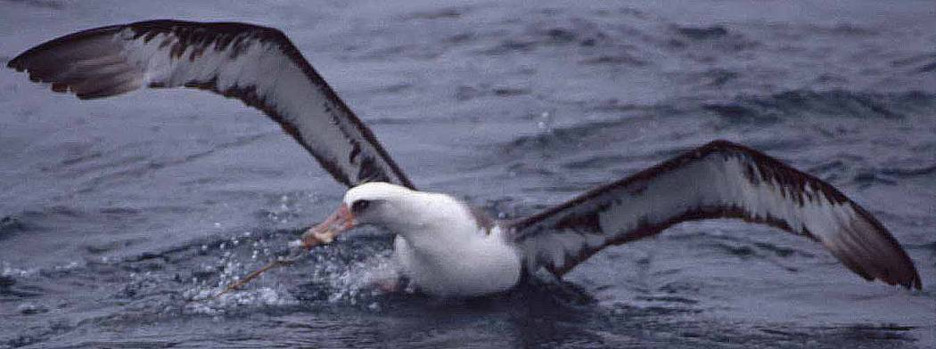
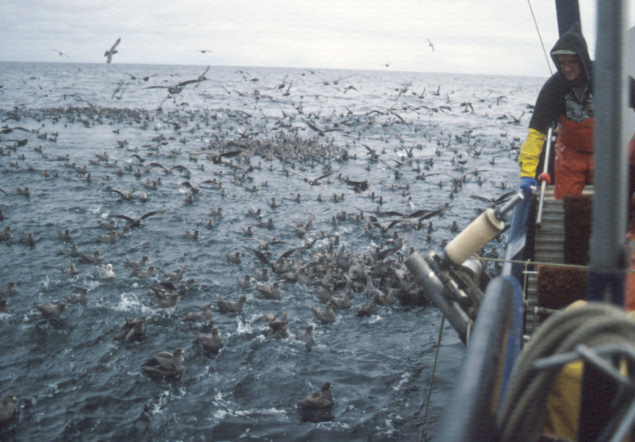
Seabirds aggregate in response to offal discards.
Birds attack baits, get hooked, and drown.
Fishermen loose baits/
compromising efficiency
In some cases, lost fishing opportunity
Notes:
Seabird bycatch = worldwide conservation problem
Aggregate
Hooked and drowned
Long-lived, delayed repro and low RS, so very vulnerable to adult mortality - these bycatch mortalities can = real threat to species

Slide 6
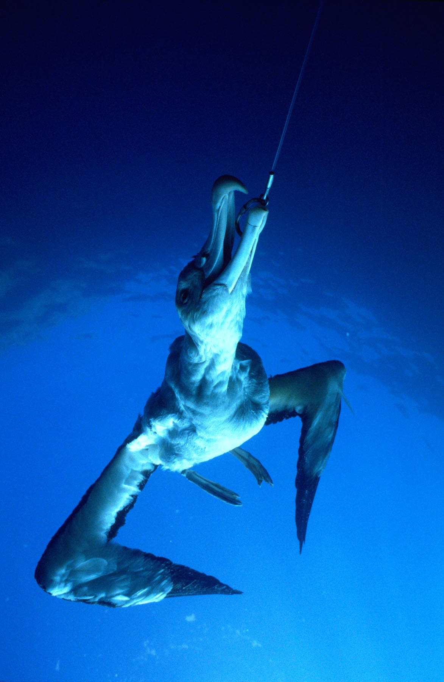
Seabird Bycatch in Longline Fisheries:
A Global Perspective
  Linked to population declines and poor recovery of seabird populations
  The primary at-sea threat to albatross and petrel populations
  Albatrosses are the most threatened of any bird family
    15 of 22 albatrosses threatened
Prompted International Action
  National Plans of Action (FAO)
  Agreement for the Conservation of Albatrosses and Petrels

Slide 7
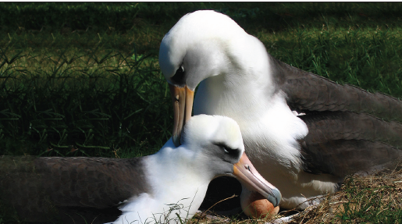
The Albatrosses: Seabird family most threatened with extinction
Long-lived (to 60+ years)
Low fecundity
  one egg/yr. or 2/yr
Deferred maturity
(4 to 13 years)
High adult survival
Highly Migratory/ interact with many fisheries

Slide 8
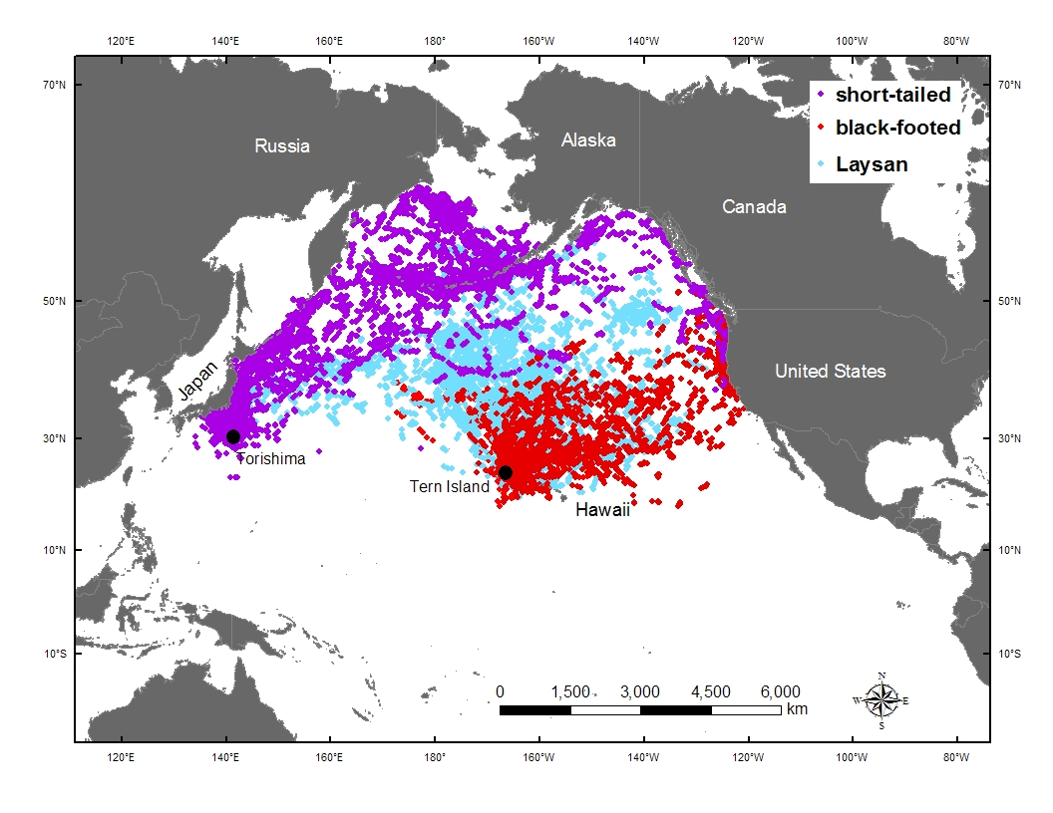
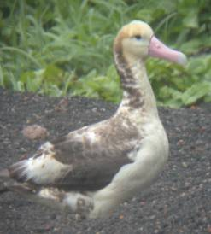
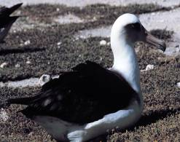
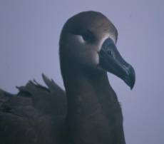
short-tailed
“STAL”
Laysan
black-footed
“LAAL”
“BFAL”
Tracking data from Fernández et al. 2001 J. Zool 254:391-404, Suryan et al. 2006 Deep-Sea Research II 53:370-386, Suryan et al. 2008 PLoS ONE 3:e4016. Courtesy of D.J. Anderson (WFU) and S.A. Shaffer (UCSC\TOPP), R.M. Suryan (OSU), K. Ozaki (YIO), G. R. Balogh (USFWS)
Notes:
Population centers for the 3 N Pac alb species. Samples of satellite tracking locations.

Slide 9
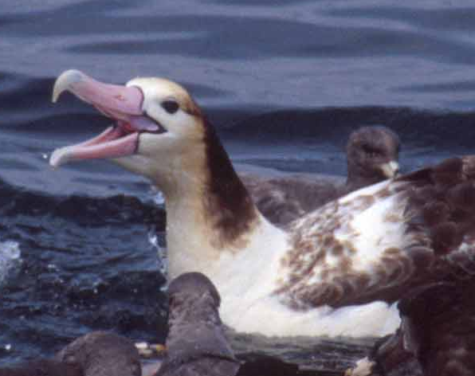
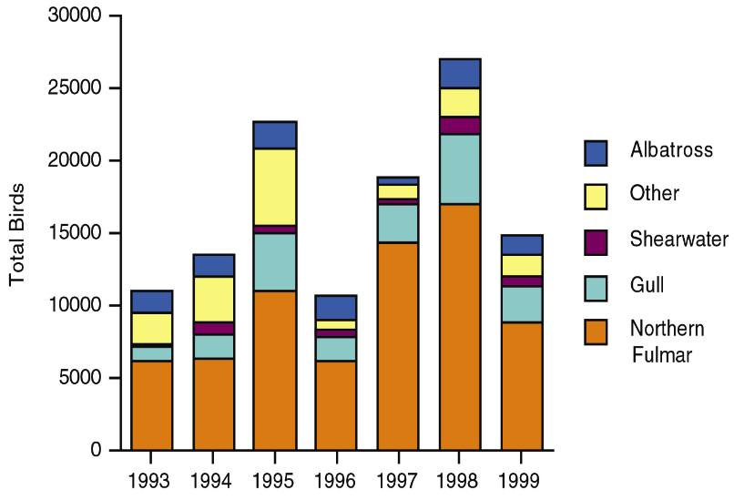
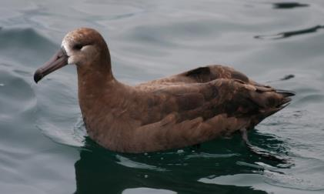
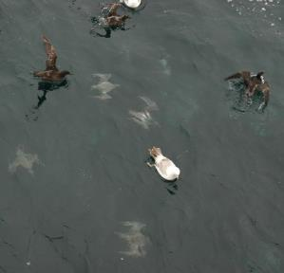
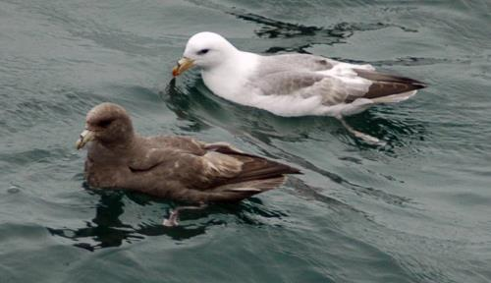
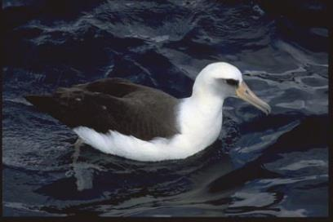
Seabird Bycatch Species: Alaskan Longline Fisheries
Bycatch: 10,000 to 26,000 birds/year
Short-tailed Albatross
Black-footed Albatross
Shearwater & Gull
Northern Fulmar
Laysan Albatross
Notes:
Rob

Slide 10
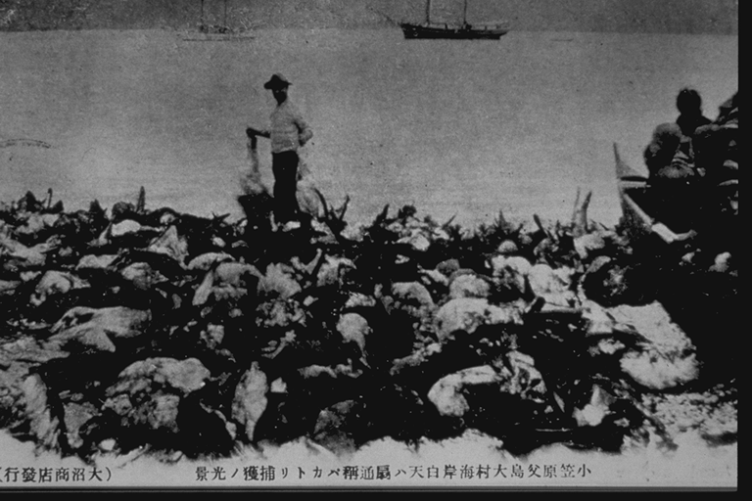
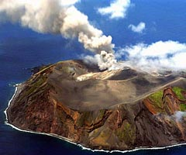
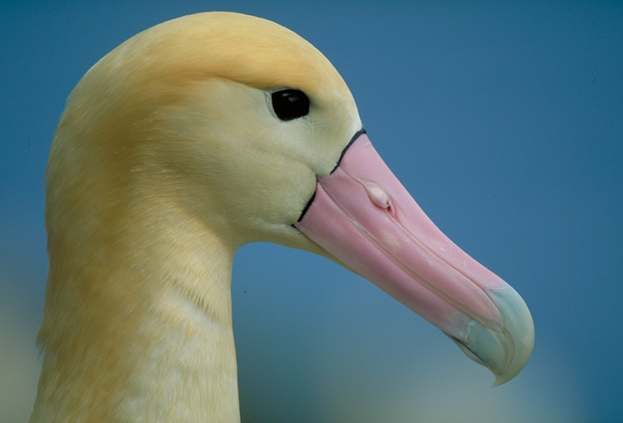
Short-tailed Albatross
Endangered under ESA
Notes:
Harvested on the colony for feathers, eggs and oil
Though extinct by end of WW II
Some survived and now over 2000 animals but 85% on an active volcano 300 nm
South of Tokyo
After breeding the adults head straight to AK

Slide 11
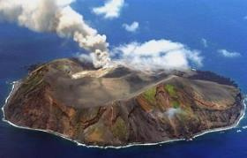
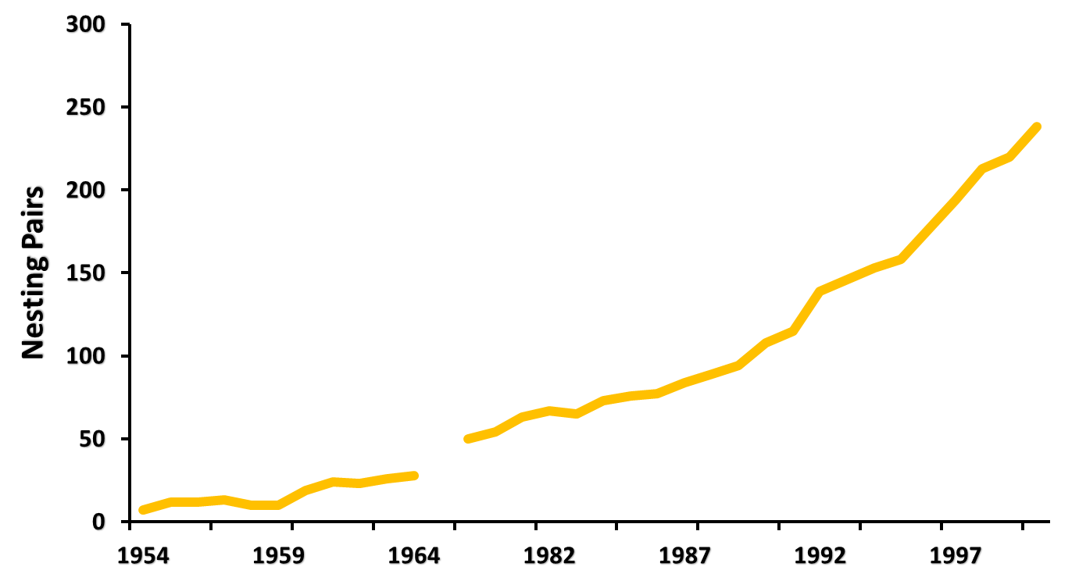
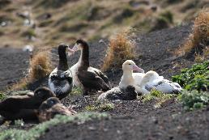
Short-tailed Albatross Population on
Torishima & Reported Bycatch in Alaska
Research
2
1
2
1
# observed bycatch in Alaska
1
Hasegawa and Sievert unpubl. data, USFWS 2014
Notes:
Bob
How industry was alerted to the problem, initially became involved, and supported the effort
5 Short-tailed taken 1995-1998, raised concern for impact on small population

Slide 12
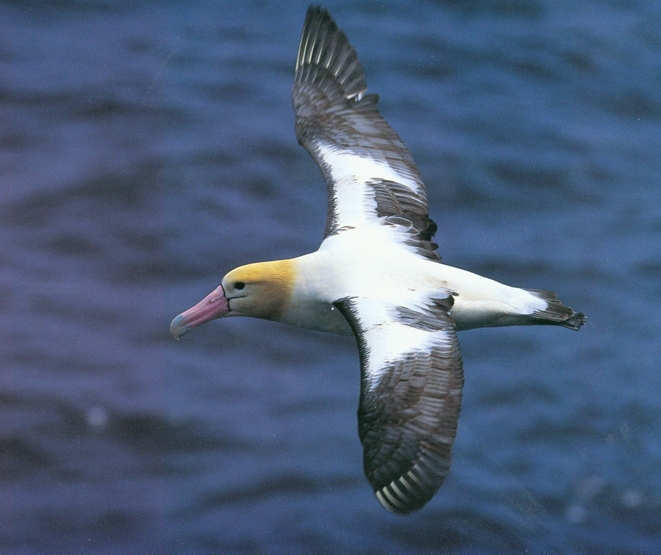
Short-tailed Albatross
Endangered Species Act BiOp
Incidental Take Statement (1999)
Longline:
  4 birds/2 years Groundfish
  2 birds/ 2 years Halibut
Mitigation Research Required
Fisheries could be disrupted or closed
> $ 300 million
> 1,000 vessels
Notes:
Short-tails are listed under the endangered species act
If more than 4 birds are taken in the groundfish fishery or 2 birds taken
In the halibut fishery both in a 2 year period the fishery could be closed or
Disrupted until next steps are determined

Slide 13
Industry Instigated Alaska Pre-Research Regulations
(1997 Groundfish & 1998 Halibut)
General
  Hooks sink ASAP
  Offal discharge guidelines
  Release hooked birds
Specific(use 1 of 4 deterrent settings)
  Night setting
  Streamer lines
  Towed Object (buoy, board, stick or other device)
  Lining Tube

Slide 14
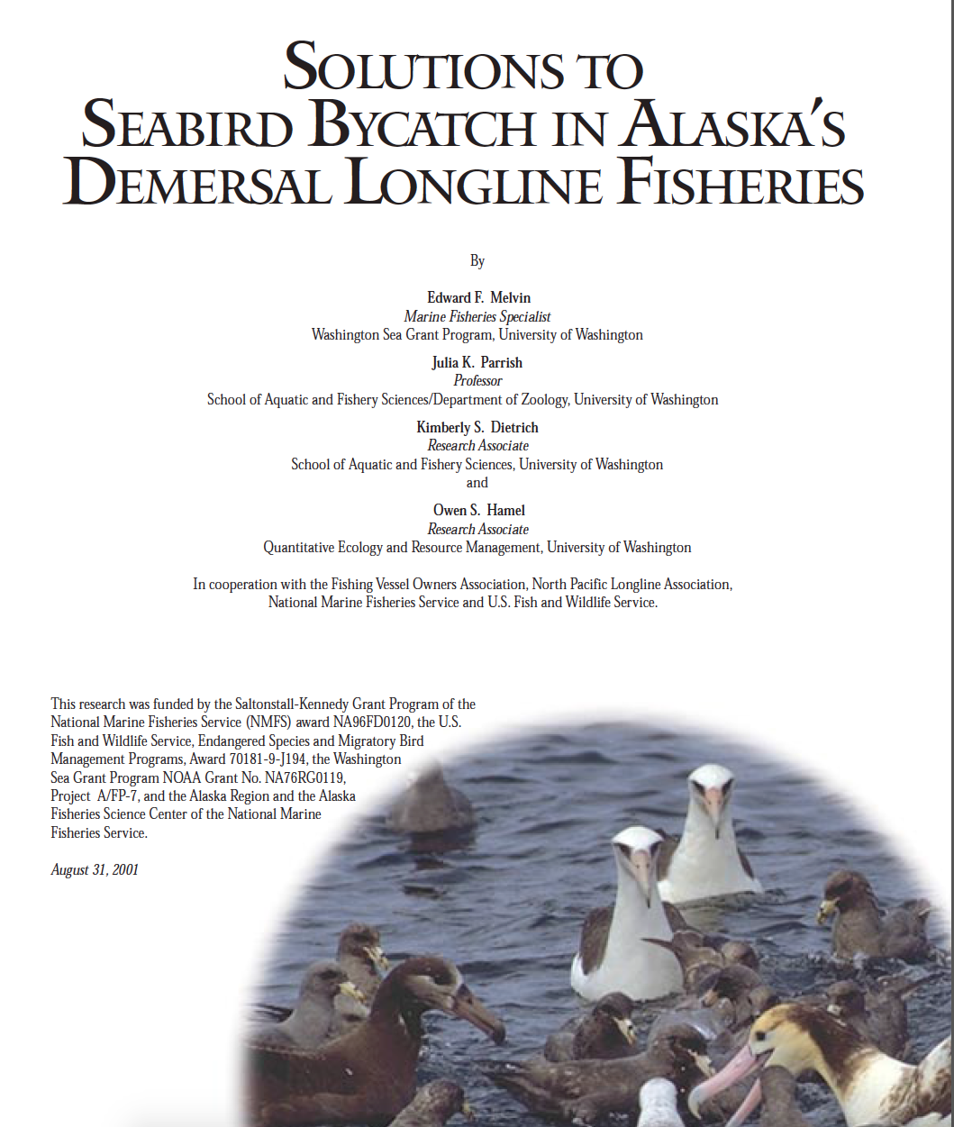
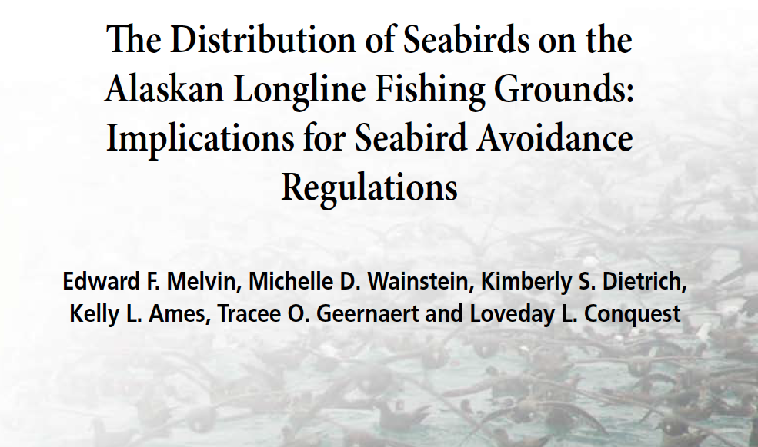
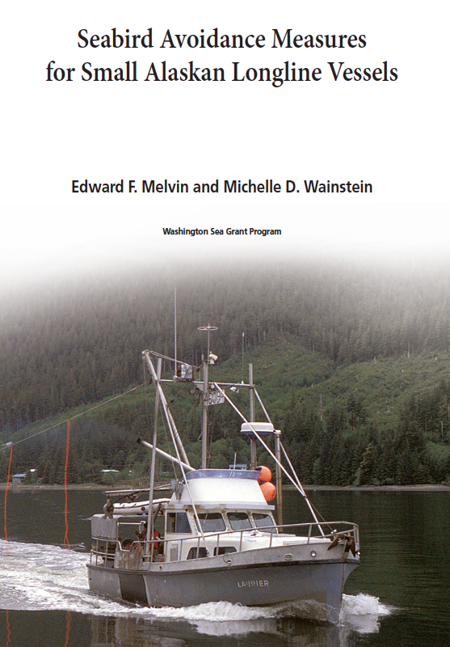
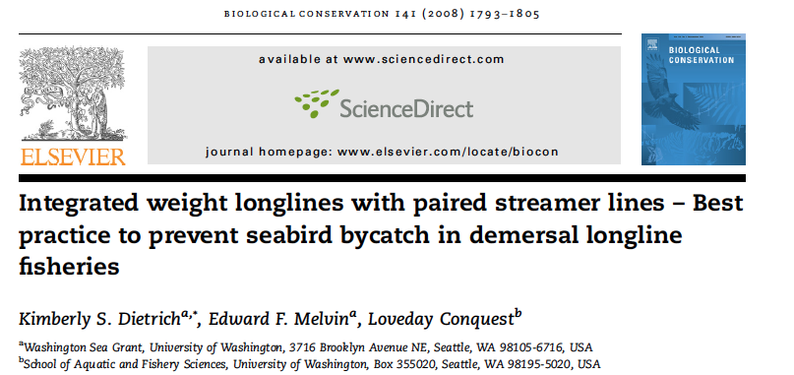
BiOp leads to four research programs to find science based Alaska specific solutions

Slide 15
Research Goal
Significantly reduce seabird bycatch without reducing target catch or increasing bycatch of other species

Slide 16
Model Rationale
Focused on solutions not confrontation
Proof at two levels
  Industry: practical solutions they identified and helped test that work
  Managers and conservation community: scientifically rigorous results that work
Common Sense Approach

Slide 17
Collaborative Conservation Model
Recruit
Collaborators:
Industry
Managers
University
NGOs
ID
Problem/
Goal
ID
Candidate
Solutions
Gillnet
Longline
Trawl
Ad hoc Committee
Research
In Context of
Production Fishing
Recommendations
&
Future Research
Implement
Peer Pressure
Video
Flyers
Free Gear

Slide 18
Possible Deterrent Strategies
5 of 11 selected for at sea trials
Sink Gear Quickly
Weighted Lines
Underwater Setting (Lining tube)
Line shooter
Surface Deterrents
Towed Buoy
Single streamer Line
Paired streamer lines
Water Jets
Other
Night Fishing
Offal Discharge
Color Bait (Hawaii)
Combinations
Loud Sound

Slide 19
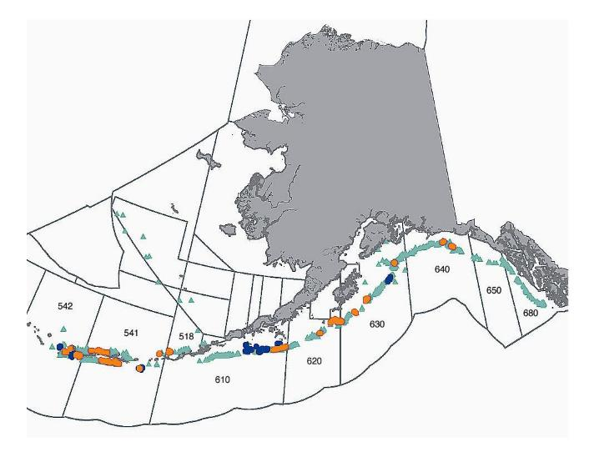
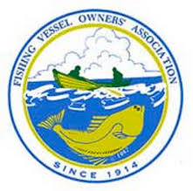
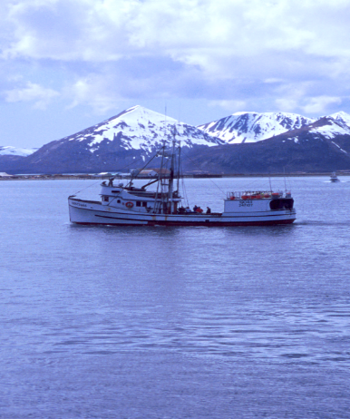
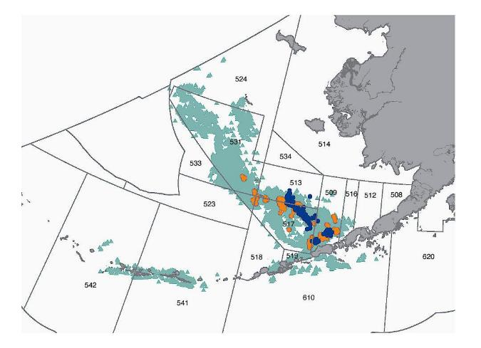
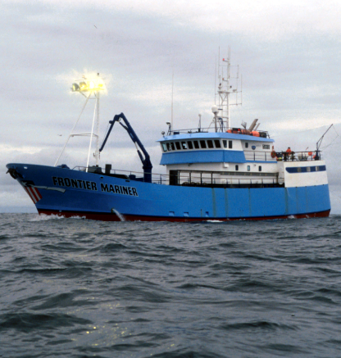

Sablefish - Hand Bait
Research Program
2 Years
8 Vessels
7.5 M Hooks
Control of no deterrent
Pacific Cod - Autoline

Slide 20
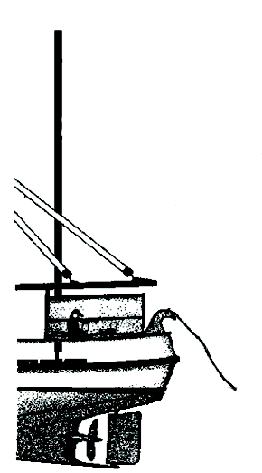
Streamer Lines
The length in the air with streamers scares birds from the area with baited hooks within reach of birds
High Point
Distance off the water (aerial extent)
Towed object for drag
6 feet
Bird access distance

Slide 21
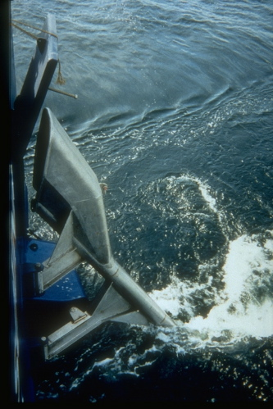
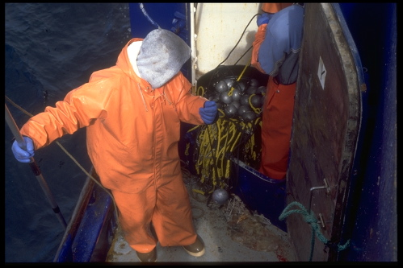
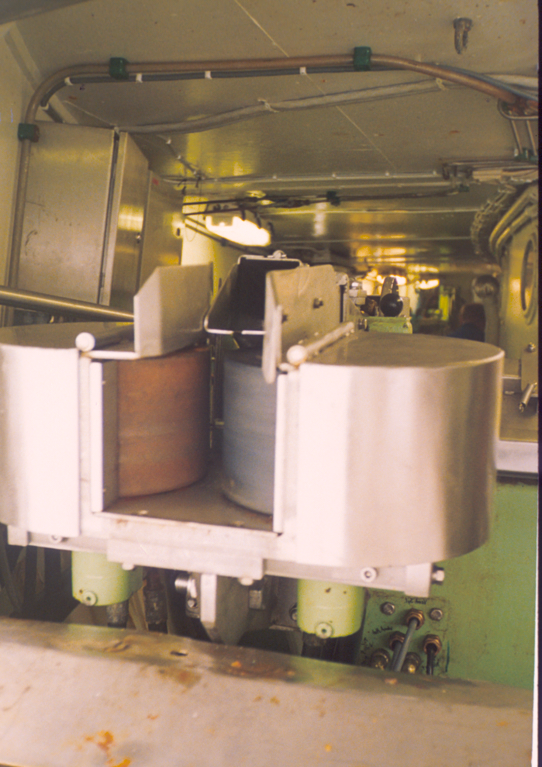
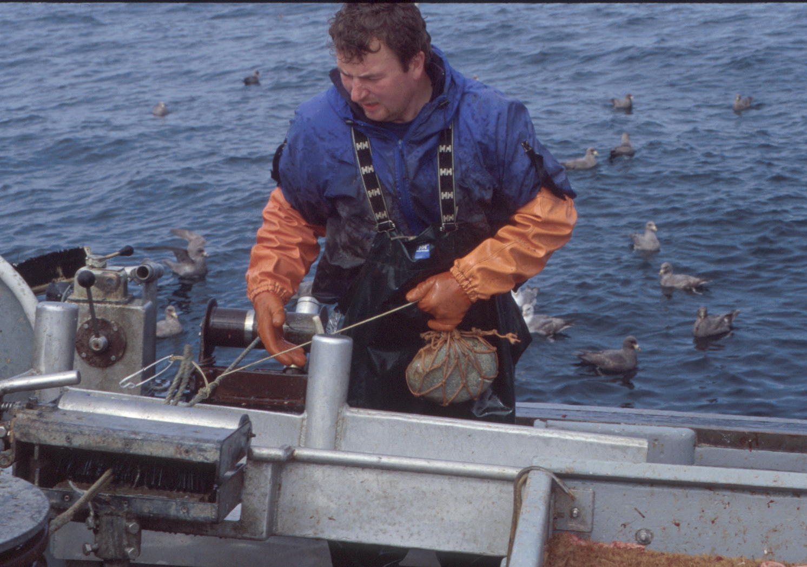
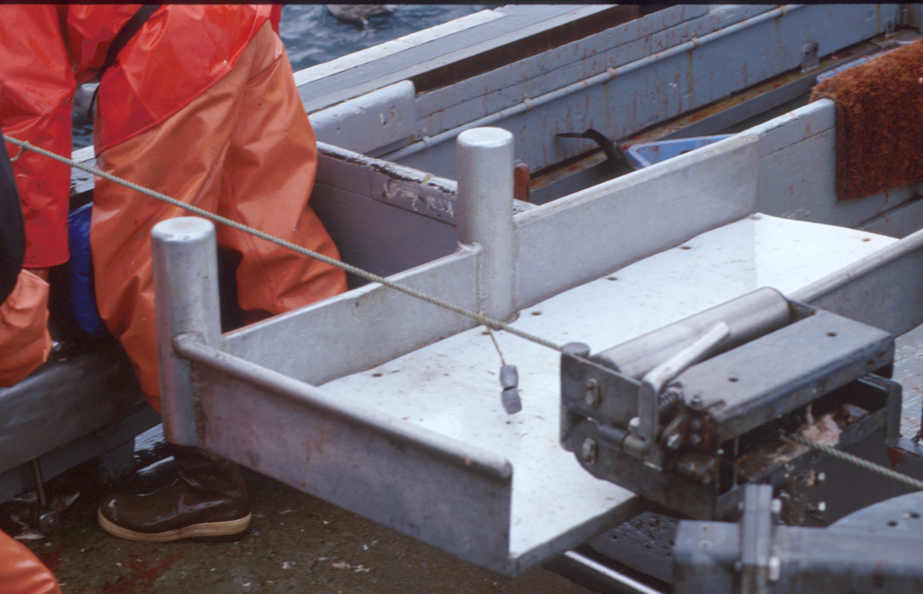
Autoline - Pacific Cod 2009
Weights (4.5 kg/90m)
79% Reduction
Lining Tube: 79% Reduction
Line Shooter: 54% Increase
Hand Bait – Sablefish 2009
Weights: 37% Reduction (28g/10 m + 2 kg/100 m)

Slide 22
Sablefish Results
Melvin et al., 2001, Washington Sea Grant

Slide 23
Pacific Cod Results
Melvin et al., 2001, Washington Sea Grant

Slide 24
Streamer Lines Did Not Effect Fish Catch
Sablefish Pacific Cod

Slide 25
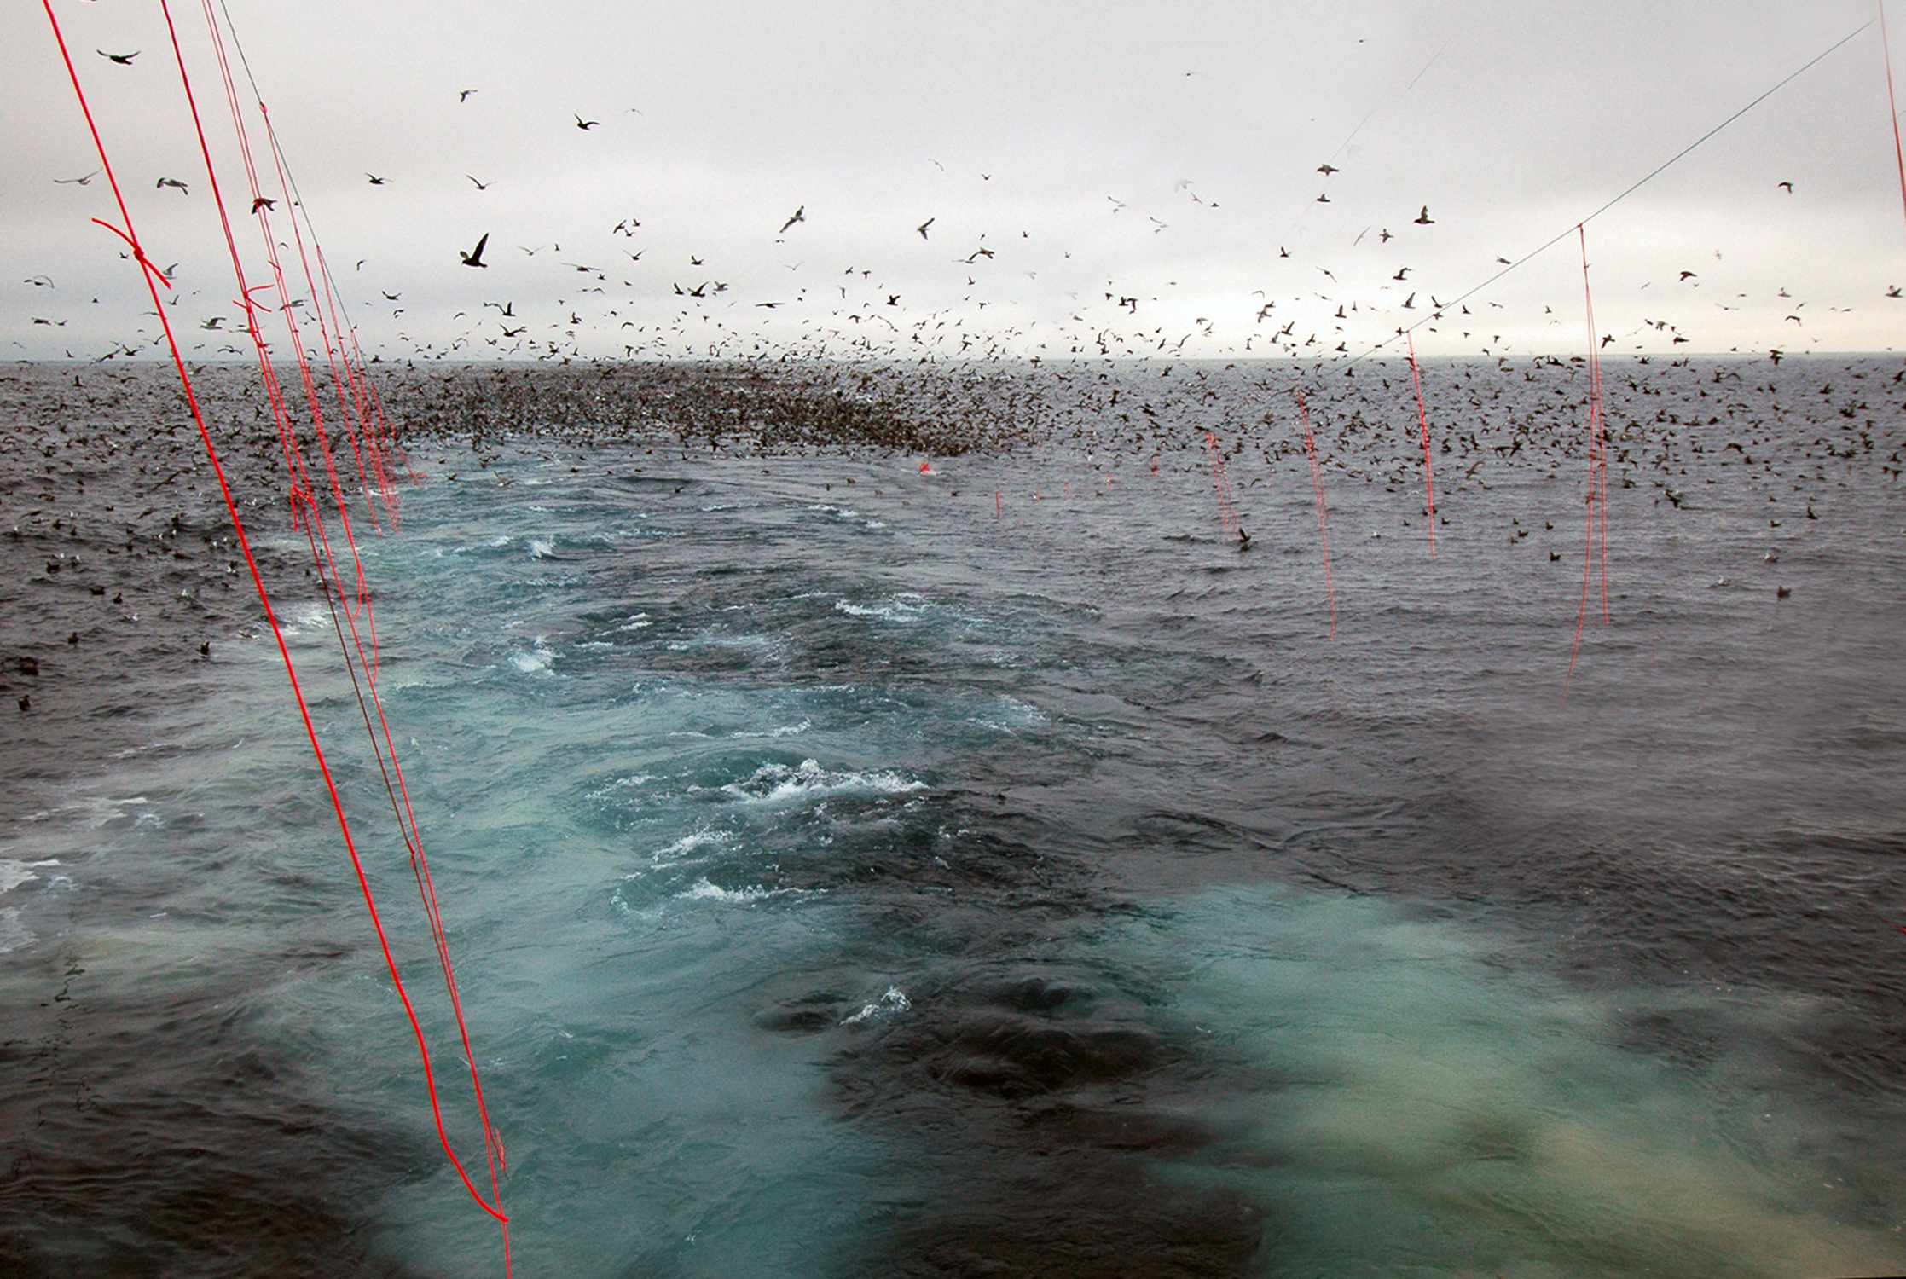
Paired Streamer Lines
Streamer lines were voluntarily adopted in 2002
and required in 2004
Notes:
What was novel in Alaska was tha fishermen who were innovating were adamant
That they should be used in pairs - port and starboard effectively creating a fence
That pecludes birds from the sinking line.

Slide 26
Lingering Issues: What About …
Small Boats < 55 feet
Inside Waters
Residual Bycatch

Slide 27
Small Boats (< 55 feet ) Issues
78 % of Alaska fleet (2004)
S-Lines/Performance standards appropriate?
Too Small for observers - no data on bird bycatch
Snap-on vs. fixed gear
Rigging/ infrastructure for streamer lines?
Small crews (one or two persons)
No discharge - deliver whole fish
Longline 5 to 15 days/year
Risk to albatrosses in Inside Waters (PWS, SE, CI)?
Melvin and Wainstein 2006 WSG-AS 05-07

Slide 28
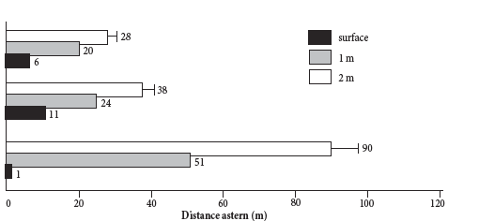



Solutions for Small Boats (< 55 feet)
Seabird Access Window (m)
Bowpicker/ Snap-on Gear
Combination/
Fixed Gear
Salmon Troller/
Snap-on Gear

Slide 29
Conclusions: Small Boats
Snap-on Gear:
  Slower setting speeds → shorter access window →less risk
  Reduced SL performance requirements (aerial extent) justified
Fixed Gear:
  Faster vessel speeds → longer access window → high risk
  Current requirements for larger vessels appropriate
Vessel speed critical to risk – not vessel length
Melvin and Wainstein 2006 WSG-AS 05-07

Slide 30





Seabird Observations from
Longline Stock Assessment Surveys
INTERNATIONAL PACIFIC
HALIBUT COMMISSION
June through August
2002 to 2004

Slide 31



More Industry Requested Research
Suryan et al. 2006, 2007, 2008, Suryan & Fischer 2010, Deguchi et al. 2014, Suryan & Kuletz 2018, Orben et al. 2018

Slide 32

Survey and Telemetry
Data Eliminate Seabird Avoidance Requirements in PWS, SE, CI
Affecting 42% of fleet of which 85% were small vessels
Notes:
Exemption: Operators of vessels 32 ft (9.8 m) LOA or less using hook-and-line gear in IPHC Area 4E in waters shoreward of the EEZ are exempt from seabird avoidance regulations. Vessels using inside waters of PWS & SEAK and AK State waters of Cook Inlet also exempt.

Slide 33

Integrated Weight Longlines: an alternative to added Weight for freezer-longline fleet
F/V Frontier Mariner
Auto Bait - 4.5 kg/ 90 m)
Early trials showed
that IW line sinks faster
and more uniformly than
added weight
CB
52
26
13
9
0
0
20
40
60
80
100
120
140
2 m Seabird Access Window

Slide 34


Integrated Weight- Streamer Line Results
July to December 2005
Two Vessels
> 13 million Hooks
5 months
Surface Feeders
Diving birds
Fish
Dietrich et al. 2008. Biol. Cons 141

Slide 35
Current Seabird Avoidance Measures
Alaska Longline Fisheries
Streamer lines required when setting longlines
  Number and performance standard vary by:
    gear type: fixed or snap-on
    vessel length > 55 feet or 55 or less
Exemptions in inside waters: Southeast AK, Prince William Sound, Cook Inlet and NE Bering Sea (IPHC Area 4C).
Exemptions for vessel 26 feet or less.
Vessels without infrastructure to support a streamer line and fishing outside waters required to tow a buoy to scare birds

Slide 36




Regulation Cards
In Collaboration with Anne Marie Eich, NOAA Alaska Regions, Sustainable Fisheries
Code of Federal Regulations
User Friendly Version

Slide 37


DOI: 10.1111/cobi.13288
ACAP SBWG 9, May 2019, Florianopolis, Brazil
Notes:
Was approached by the AK Region in 2013 to renew outreach efforts to the AK longline fleet to address an uptick in albatross mortality in extrapolated estimates.
I agreed on the condition that we can look at the data and look more closely with an emphasis on bycatch rates.
Plus I had been interested in writing up the case study because it is a great story of successful conservation.

Slide 38
Streamer Highly Effective in the Fishery
Seabird Bycatch Rates Before and After
Streamer Line adoption in Alaska Longline Fisheries
Before After
Reduction in Bycatch Rate
Albatrosses 89%
Nonalbatrosses 78%
Notes:
Albatross bycatch reduced by 89 %
Non-albatross bycatch reduced by 78%

Slide 39
Streamer Highly Effective in the Fishery
Seabird Bycatch Rates Before and After
Streamer Line adoption in Alaska Longline Fisheries
Before After
Seabirds Saved over 14 years
Albatrosses 9,450
Nonalbatrosses 131, 586
Total 141,036
Notes:
Albatross bycatch reduced by 89 %
Non-albatross bycatch reduced by 78%

Slide 40

Short-tailed Albatross Population on
Torishima & Reported Bycatch in Alaska
~6,800 total birds total in 2019
3
Begin use of streamer lines
1
2
1
2
2
# obs. mortalities
1
1
Hasegawa and Sievert, unpublished data, USFWS 2014
Notes:
Volunteer observations by the meteorology staff in the years following rediscovery, and dedicated research by scientists from the Yamashina Institute of Ornithology in Japan from the 1960’s onward have documented strong population growth of the Short-tailed albatrosses breeding on Torishima. The population is growing at a rate of about 6-8% every year, which
Remaining criteria for delisting – > 250 pairs on islands other than Torishima, > 75 pairs on island other than the Senkakus

Slide 41

Short-tailed Albatross & ESA
Current (2015) Incidental Take Statement
Alaska
Groundfish ((longline and trawl): 6 birds/ 2 years
Pacific Halibut: 2 birds/ 2 years
West Coast
Groundfish: 1 birds/ 2 years
Pacific Halibut: ? In preparation
Hawaii
  Deep Set Longline: 2 birds/ 5 years
  Shallow Set Longline: 1 bird/ 5 years
Photo by Rob Suryan

Slide 42
BPUE varies by fishery and seabird grouping
(post streamer line adoption, 2002 to 2015)
Albatrosses¹
Birds/1,000 hooks
Nonalbatross²
¹Laysan, Black-footed and Short-tailed
² Primarily northern fulmar, gulls and shearwaters
Notes:
Albatross BPUE 35 times higher than cod

Slide 43
Sablefish: Predicted Mean BPUE after streamer line adoption
Albatrosses
Nonalbatrosses
Notes:
Black line is the overall mean, shading is 95% CI
Albatross BPUE increasing across all regions suggests a pervasive area independent driver, but nonalbatross more curvilinear with recent downward trends that vary by region
A lot of variation in species specific response
Reasons for increase albatross: loss of urgency or generation turn over leading to poor awareness and proper use, habituation, but suspect reduced natural prey is important

Slide 44
Pacific Cod: Predicted Mean BPUE after streamer line adoption

Slide 45
Most of Bycatch is From a Few Vessels
(2013 to 2015: post restructuring of the observer program)
178 Sablefish & 98 Pacific Cod vessels sampled
Most vessels (67%-72%) did not catch birds!!!
3 vessels caught most (46%-78%) albatrosses
Dietrich et al. 2009 identified importance of vessel-specific bycatch. Above results from Melvin et al. 2019
Notes:
Most vessels monitored have no bycatch
> 72% in the sablefish fishery
> 67% in the cod fishery

Slide 46
Night¹ vs. Day Sets²
BPUE lower and CPUE higher at night
Fulmar BPUE significantly higher at night
¹Based on civil twilight ²After streamer line adoption

Slide 47
Conclusions
One of few cases where sharp reductions in bycatch demonstrated in research yielded sharp reductions in a fishery.
Can’t readily explain the increasing trend in albatross bycatch rates in the sablefish fishery from available data.
Night setting compelling but not practical in sablefish and halibut fisheries/ tradeoffs with northern fulmar
No evidence of time-area closure to manage bycatch
Strategic outreach to vessels with high bycatch rates in real time most promising management option.

Slide 48
Role of Economic Solutions
(under current management)
No penalty to individual fishermen or vessel for takes of endangered STAL or any other seabird.
Exceeding Incidental take limits is an existential treat to entire fleets:
  AK Groundfish (longline, trawl and pot) 6 birds/ 2 years
  Pacific Halibut (longline) 2 birds/2 years
No penalty or action to individual fishermen or vessel with anomalously high bycatch rates.

Slide 49
Reasons for Success
STAL incidental take limits posed an existential treat to a multi-million $ Industry
Preventing the loss of bait to birds with bird avoidance a clear bonus
Highly motivated – proactive industry called for regulations and research to stem bycatch and manage risk
  Strong and consistent industry leadership
Highly collaborative and comprehensive research over several years to address all vessels, gears and fleets.
Active communication among managers, researchers, industry, conservation organizations throughout research
Strong support and funding from fishery and wildlife managers
Final solution – streamer lines – were safe, practical, widely applicable and inexpensive
Extensive outreach and making streamer lines available at no cost

Slide 50
Our recipe for successful collaborative research
Industry involved at every step guaranteeing practical outcomes
  Identified potential bycatch solutions for testing
  Tested candidate solutions in the context of production fishing
  Results shared at every step to shape the direction of research and final recommendations to management
Research program yielded results credible to managers/ scientific community
  Large scale: > 7.5 million hooks, 8 vessels, 2 fleets over 2 years
  Controls of non-deterrent and scale produced unambiguous results
  Incentives for participating vessels
    Free observer coverage (both fleets)
    Exempted fishing permit allowing one month of pre season fishing for two vessels
  Focused on the two fleet posing the greatest risk to birds
  Research staged in areas of highest known seabird interaction
  Adapted and evolved based on results and changing needs

Slide 51
Economic Research
No research has occurred on economics, incentives or market mechanisms to reduce seabird bycatch in Alaskan longline fisheries.

Slide 52
Current Issues: Alaskan Longline
Hundreds of albatrosses and thousands of other birds killed annually
Increasing trend in the albatross BPUE in sablefish fishery in all areas
Increasing trend in non-albatross BPUE in the cod fishery in the Aleutian Islands
A very small number of vessels accounted for 46% to 78% of albatross bycatch
Incidental take statement for groundfish expanded to include trawl fisheries
  6 birds in two years
STAL population is increasing at 6 to 8% per year

Slide 53
Current Actions
At this point in time, neither NOAA Fisheries nor the North Pacific Fishery Management Council is considering further adjustments to seabird bycatch regulations.

Slide 54
Generalizations
Fishery participants must accept that a problem exists that must be solved
Need resources (funding, leadership and structure) to test industry ideas on their vessels at a scope that provides unambiguous outcomes.
Leadership by university scientists unlinked to regulatory institutions, but strongly supported by fishery and wildlife managers.
Solutions imported from other fisheries may not be universally applicable to all fisheries or species. Local testing essential.
Industry engagement throughout the development of solutions is critical.
Outreach and innovation should be ongoing as the environment and populations of bycatch species change over time.

Slide 55

Discussion?
Notes:
Thank you

Slide 56
Drivers: Alaska Longline Fisheries
Threat of lost fishing opportunity
Proactive industry
Collaborative research at a robust scale with adequate funding
  Tested fishermen’s ideas informed by CCAMLR CM
  8 vessels, 2 target fisheries, 2 years, >7.5 million hooks
  Control of non-deterrent = unambiguous results
  During standard fishing operations
  Shared results before and after each phase
  Streamer lines: safe, affordable and widely applicable
Extensive Outreach (video, flyers, meetings)
Free streamer lines to the fleet

