Slide 1
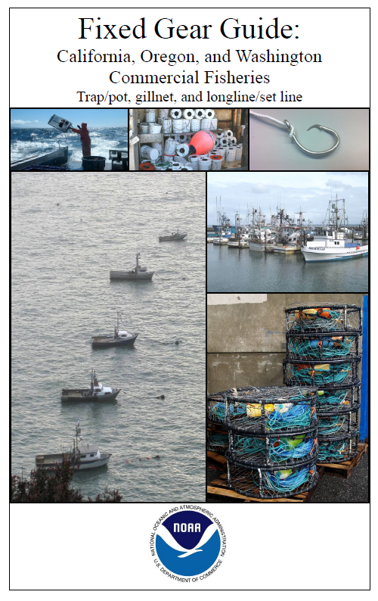
FAO resources

Slide 2
Brief Review of Most Common Gear Types
LINK to gear videos:
https://docs.google.com/document/d/1nQBKUPgUFlkeTNuTPpWvLh_mMQ2Y9H3yCqSsJeK3pZQ/edit?usp=sharing

Slide 3
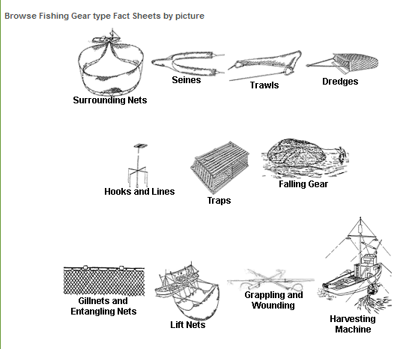
http://www.fao.org/fishery/geartype/search/en

Slide 9
Fyke nets

Slide 10
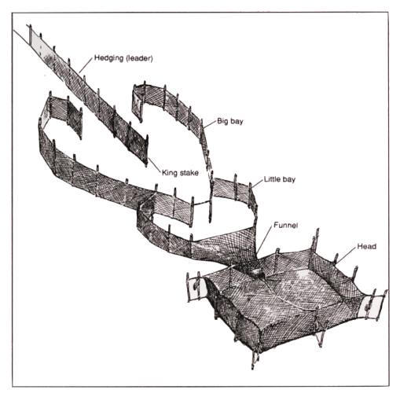
Pound nets

Slide 12
Issues with traps
GOOD… many live captures, allows selectivity
GOOD…. Very little bycatch
GOOD… Less fuel consumption
BAD Ghost fishing
BAD Entanglements on cables
BAD Production low, but valuable species
Can we develop new models of traps for other species? Floating traps?

Slide 13
Craig S. Rose - NOAA

Slide 14
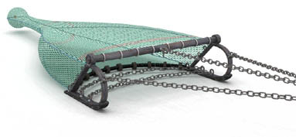
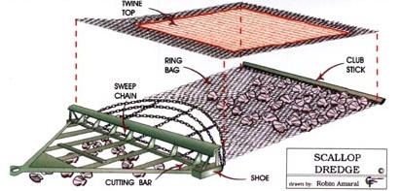
Active Fishing Gears: Gear moves to the fish
Beam Trawls
Dredges
Otter Trawls

Slide 15
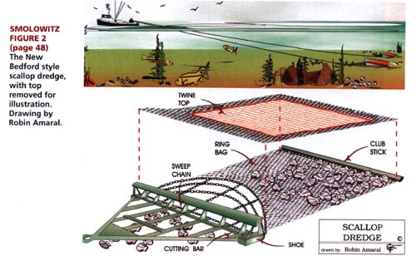
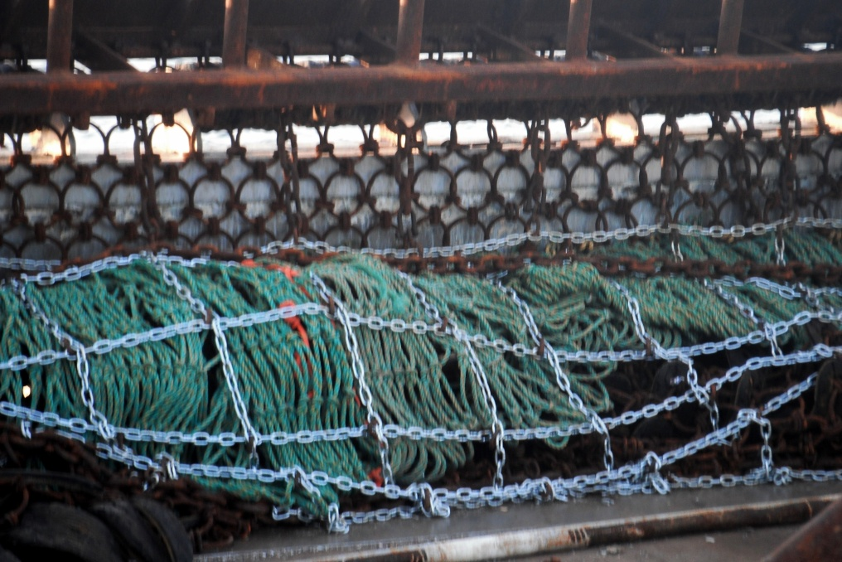
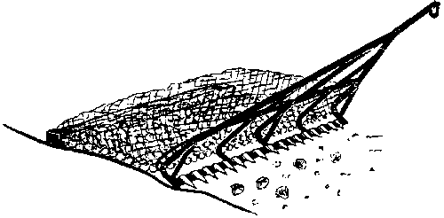
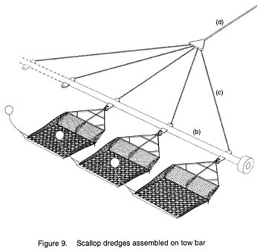
Scallop Dredges
From "Bottom Tending Gear Used In New England" by Ronald Smolowitz
(in Effects of Fishing Gear on the Seafloor of New England edited by Dorsey & Pederson)
New Bedford dredge (USA)
Collect bivalves from seafloor surface
Toothed dredges (Europe)

Slide 17
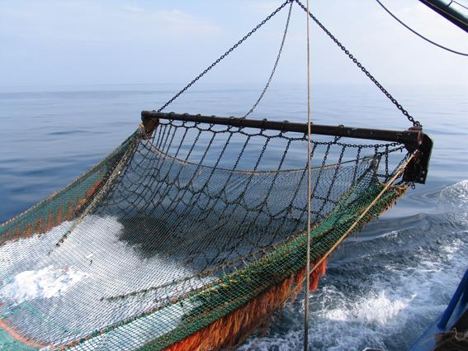
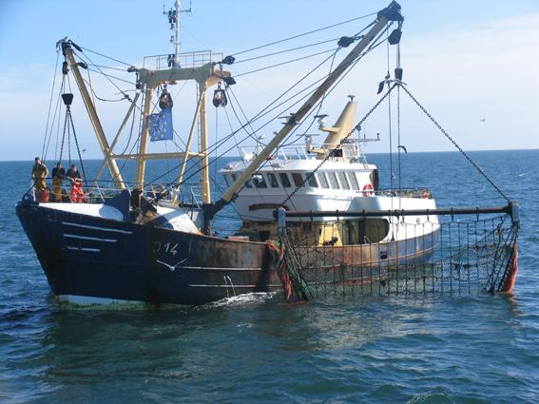
Beam Trawls
www.ilvo.vlaanderen.be/Pictures/BeamTrawlFisheries/
Net spread horizontally with a rigid beam: flatfish capture – chain mats to chase off-bottom

Slide 18
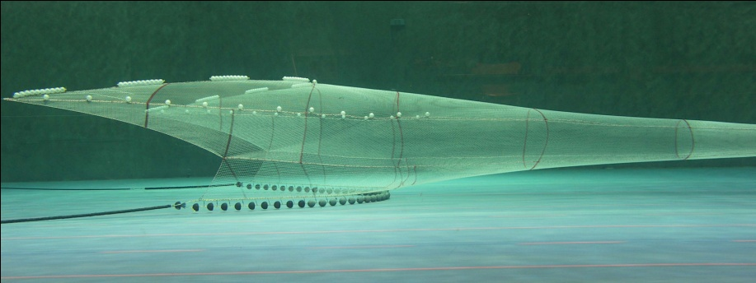
Otter trawls – nets spread by hydrodynamic spreading plates/wings (Doors)
Model net in towing tank

Slide 19
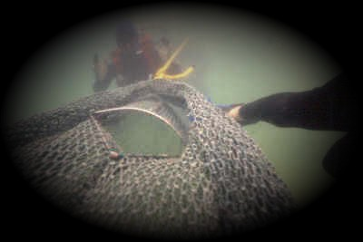
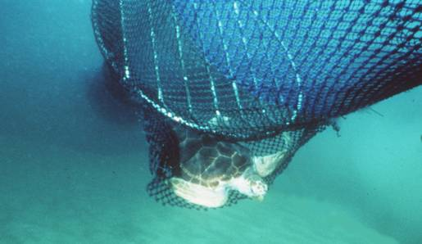
GULF FISHEYE BRD
Fisheye
Notes:
‹#›

Slide 21
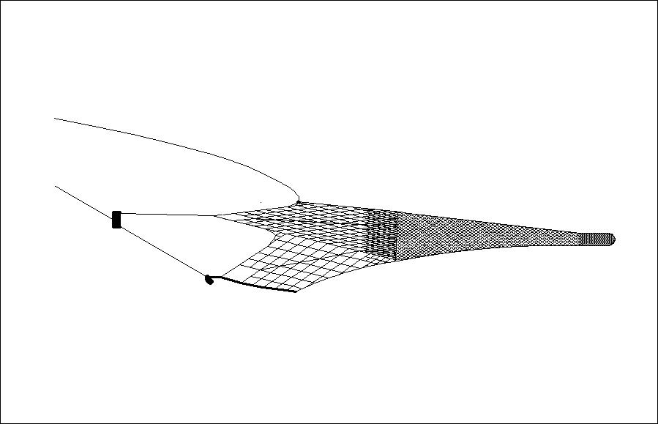
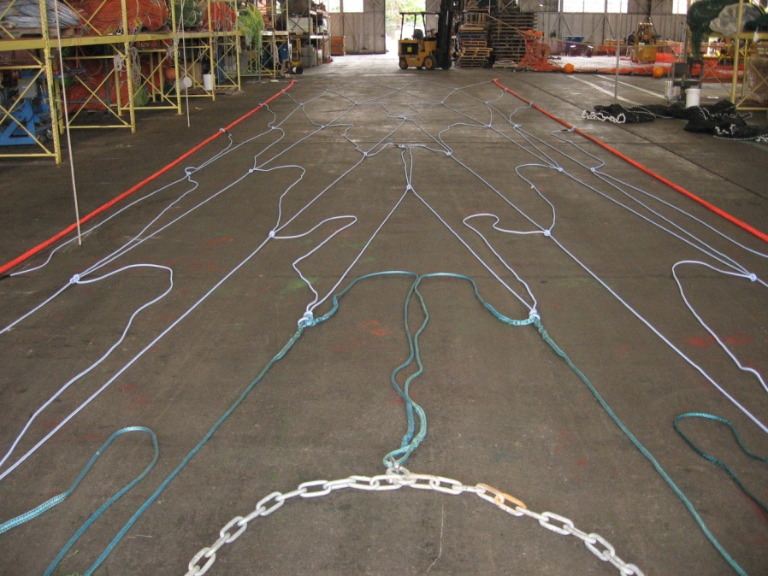
Pelagic trawls – Alaska pollock Very large front meshes - herding
Mesh size 4 meters

Slide 22
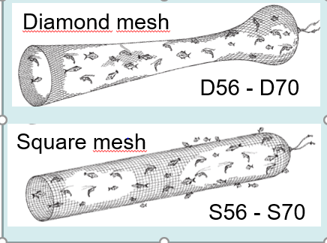
Mesh types

Slide 23
Main Trawl bycatch issues
Sea turtles especially in shrimp fisheries
Solutions available, but implementation issues
Fish bycatch
Some bottom trawls occasionally encounter turtles
Problem?
Sea lions and dolphins entering trawls
Habitat impacts

Slide 25
= Snoods

Slide 26
Horizontal Vertical
Manual Hydraulic, etc

Slide 28
Shallow and Deep sets
e.g. Swordfish
e.g. Bigeye tuna

Slide 29
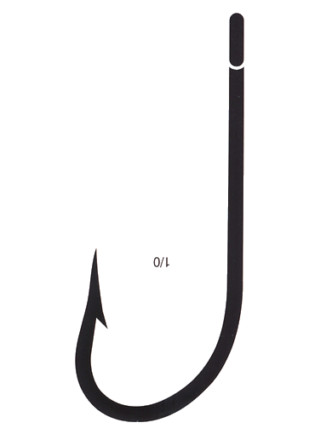
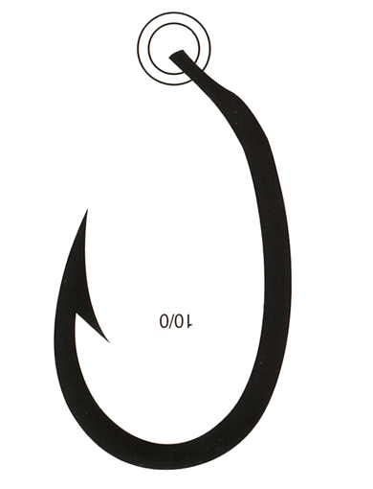
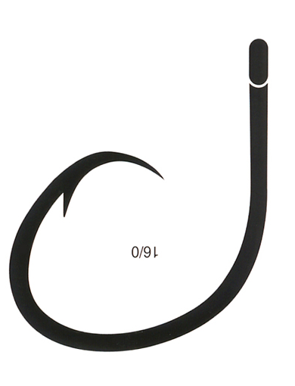
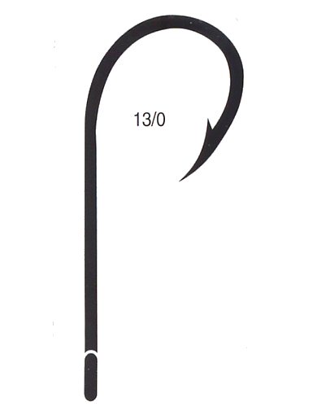
Types of hooks used in the eastern Pacific
“intermediate” baiter
J hook
Circle hook
Straight J hook
Japanese-style
(Tuna hook)
Circle hook
Half Claw

Slide 30
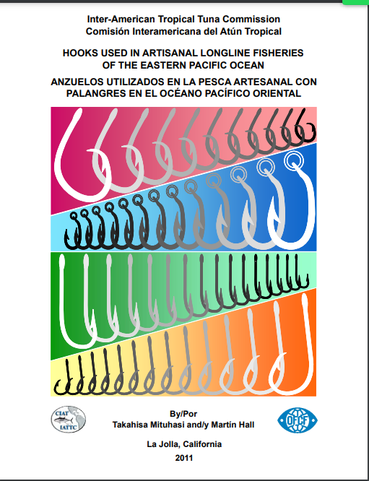
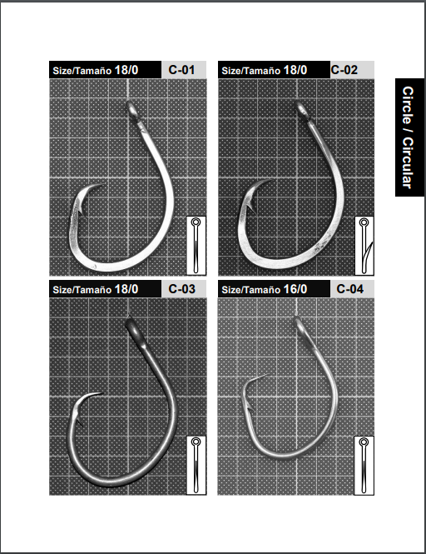
Eastern Pacific HOOK Catalog
LINK https://www.iattc.org/Downloads/Hooks-Anzuelos-Catalogue.pdf

Slide 31
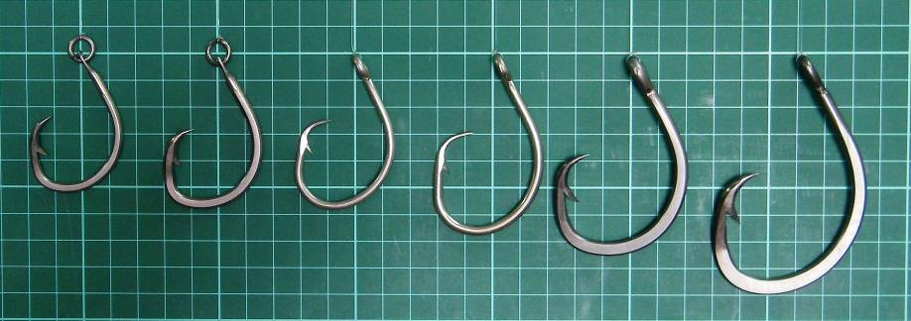
Hooks used in surface longlining
J # 5
J # 4
J # 0/6
J # 0/8
J # 38
J # 38
C12/0
C13/0
C14/0
C15/0
C16/0
C18/0

Slide 32
% sea turtles encountered dead
in longlines:
Bottom longlines few hookings,
but lower survival
J hooks higher % dead turtles.
Surface

Slide 33
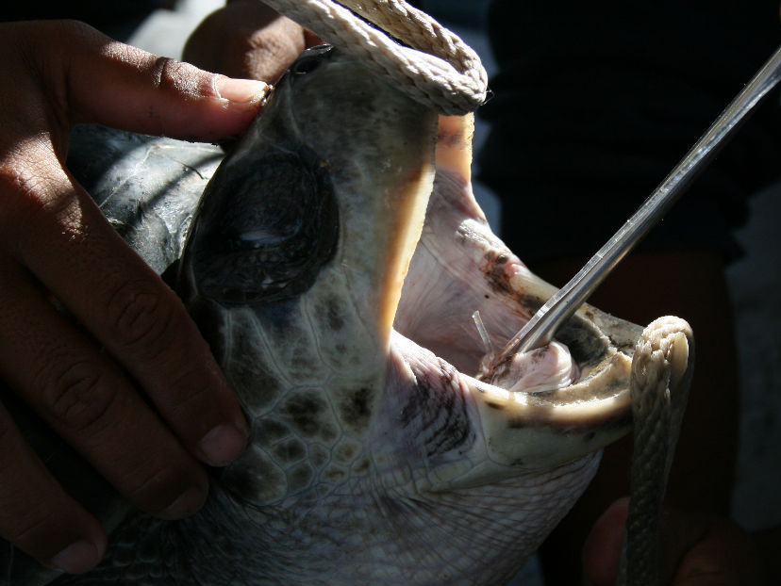
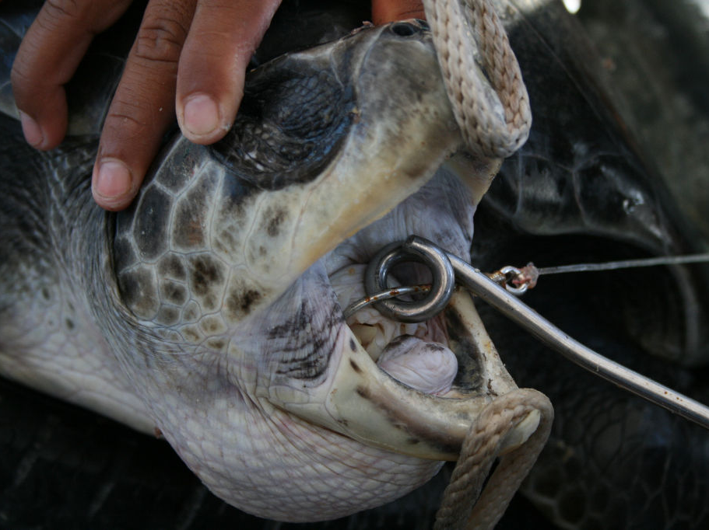
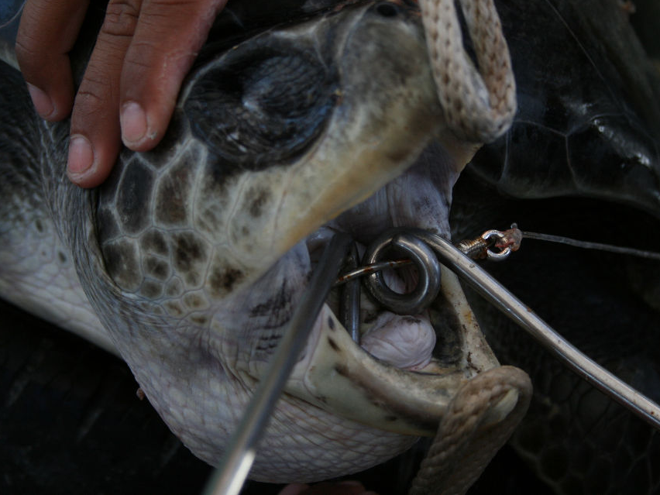
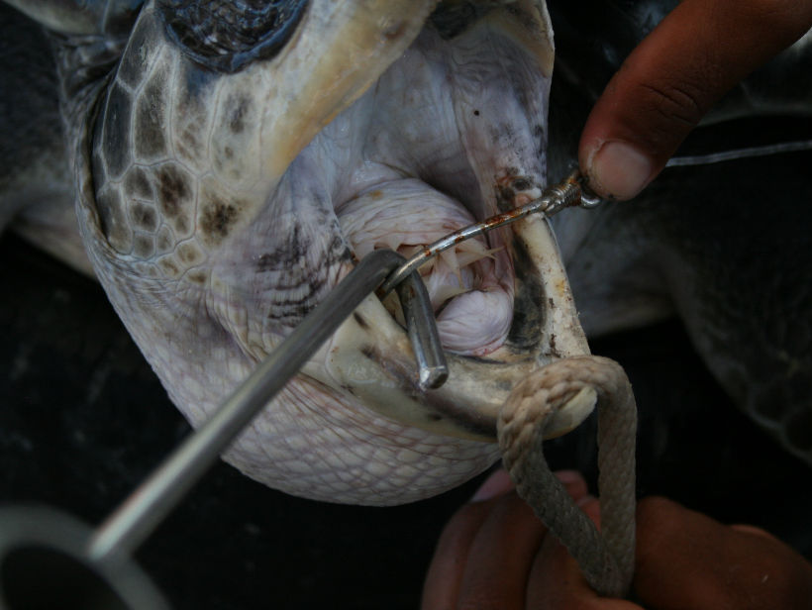

Slide 34
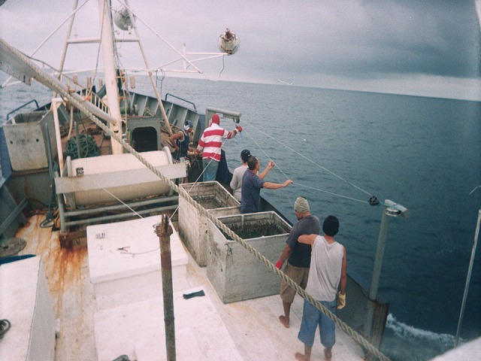
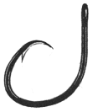
4
Number of hook deployed per set: 1000 -1500
Number of hooks between floats: 5 - 6
Bait: Sardine, Squid (frezen, but thawed before use)
Green jack, Threadfin shad (live bait)
Type: Drifting longline
Main target species: Yellow fin tuna
Port and Country: Vacamonte, Panama
5 fa -6 fa
Mainline
25 fa -30 fa
Branch line
7.2 fa – 16 fa
Mainline PA mono φ 3.0 - 3.5 mm
Swivel snap (Clip)
SUS
Branch line
7 fa – 14 fa PA mono φ 2.5 - 3.0 mm
PE braided
50cm -60cm
Leader
1 ft WIRE SUS φ 1.6 mm, or
2 fa PA mono φ 2.0 – 3.0 mm
Hook
Tuna hook size： 8
Circle hook size 15/0, 16/0

Slide 35
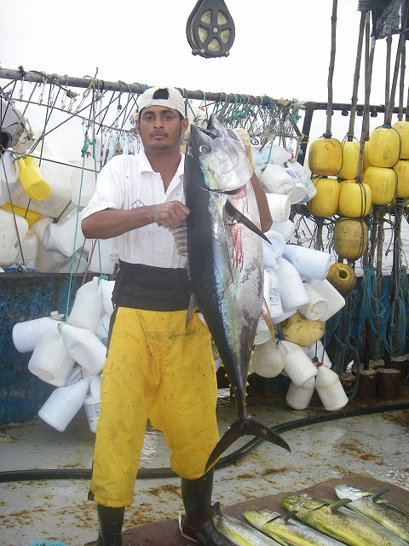
5
Number of hook deployed per set: 700 - 1200
Number of hooks between floats: 5 - 7
Bait: Sardine, Squid (frezen, but thawed before use)
Green jack, Threadfin shad (live bait)
Type: Drifting longline
Main target species: Dolphin fish (Mahi mahi)
Port and Country: Vacamonte, Panama
13 fa -14 fa
1 fa
Mainline
6.2 fa
Branch line
Mainline PA mono φ 3.0 mm
Swivel snap (Clip)
SUS
Branch line
2 fa PA mono φ 2.0 mm
Leader
1 ft
WIRE SUS φ 1.6 mm
Hook
Tuna size： 3.6

Slide 36
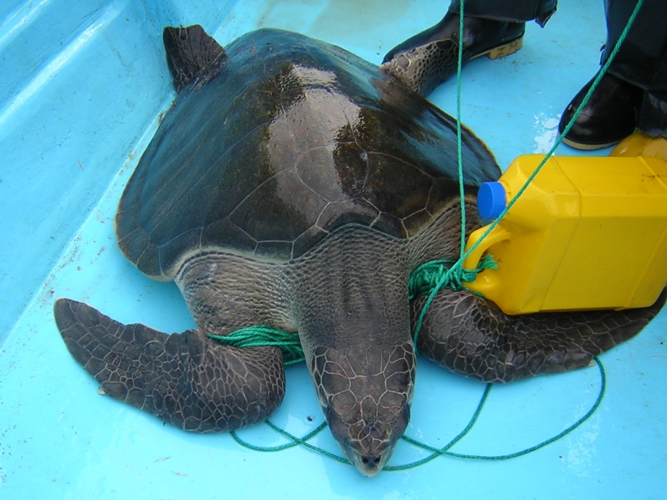
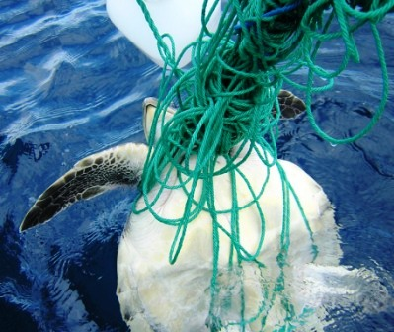
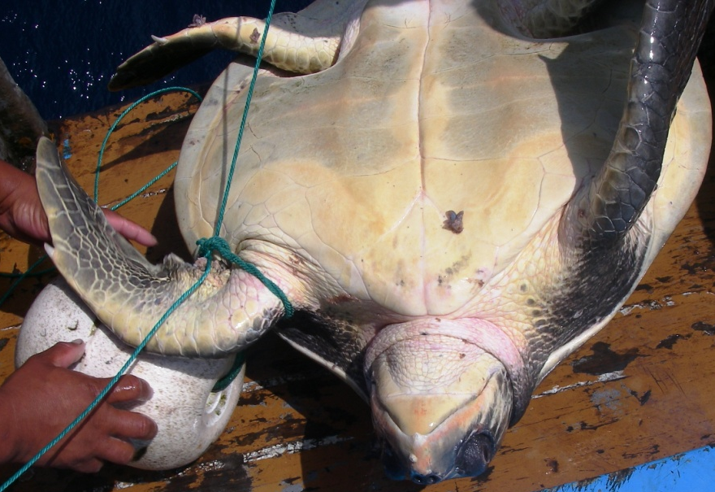
Types of entanglements

Slide 37
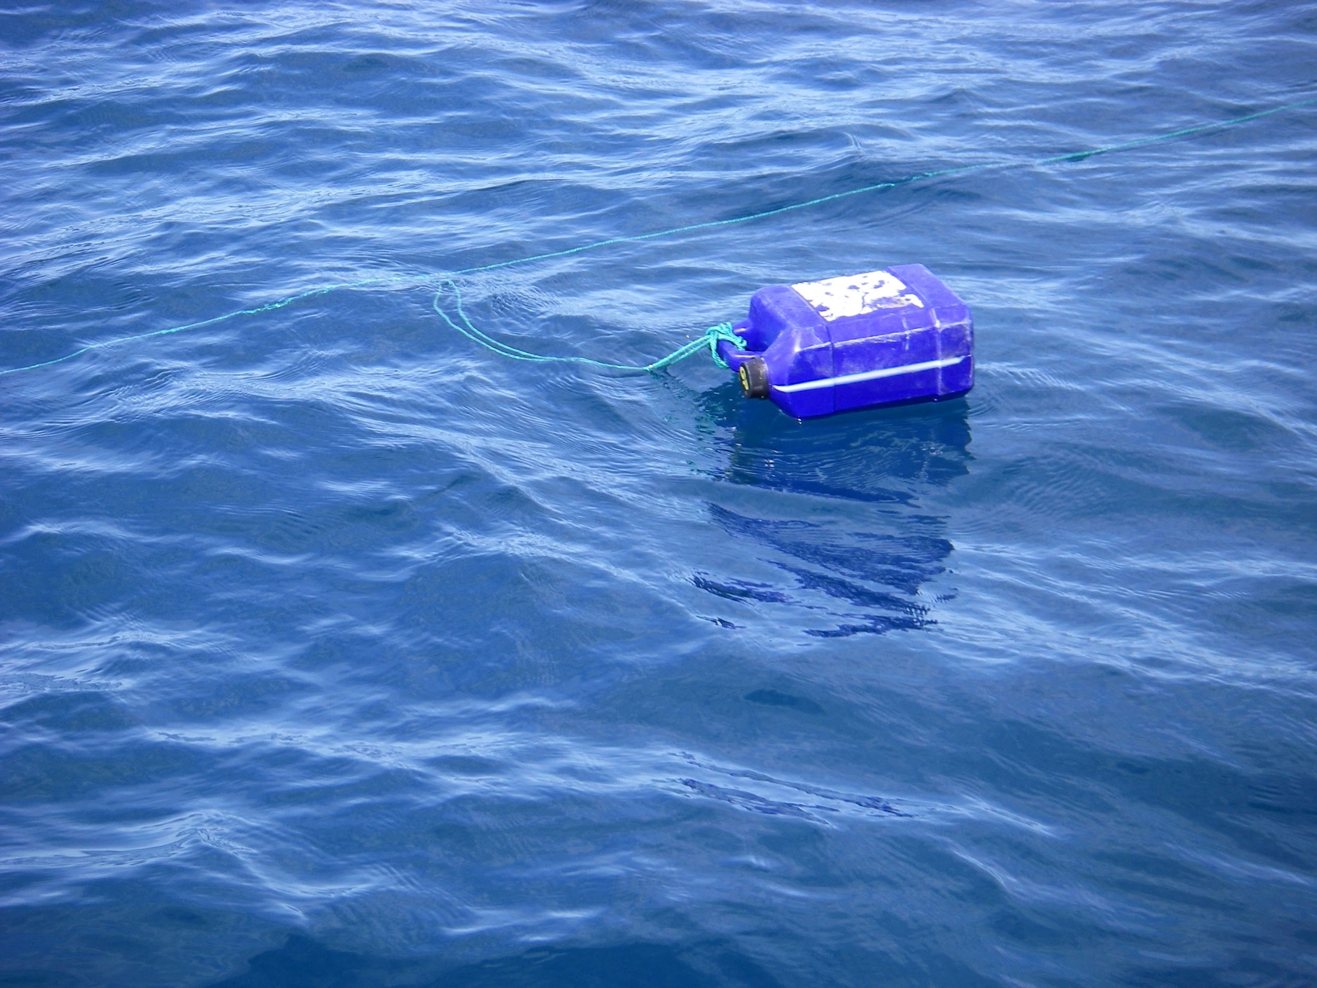
Some regions many entanglements, others practically none
Know thy gear materials matter

Slide 38
Experimental and control longlines
Experimental
Float
In 12 sets 2,367 floatlines
1 turtle entangled
PA monofilament (3.5mm)
Motherline
(Polyipropylene 2.5mm）
0.5m
Swivel
Swivel
Snap
PA monofilament (2.6 mm)
length: 1 Bz.
Control
1.8m
In 12 sets, 2,367 floatlines
13 turtles entangled
Motherline
（Polypropiylene.5mm）

Slide 39
Main LL bycatch issues
Lack of data
Seabirds in high latitudes
Solutions available, implementation problems
Sea turtles everywhere
Solutions available, but implementation difficult because there are massive artisanal and industrial fleets
Sharks are frequently targets
Entanglements

Slide 41
GILLNET
Distance between floats
Float line
Float
Diameter
Bridge
Bridge length
Bridge
Diameter
Mesh
Height
Lead line
Weight
Distance between weights

Slide 42
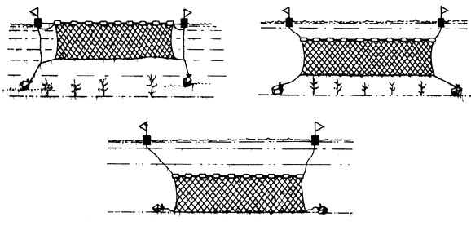
Gillnets. FAO
Midwater
Surface
Bottom

Slide 43
For all nets: See what is caught and where is caught

Slide 44
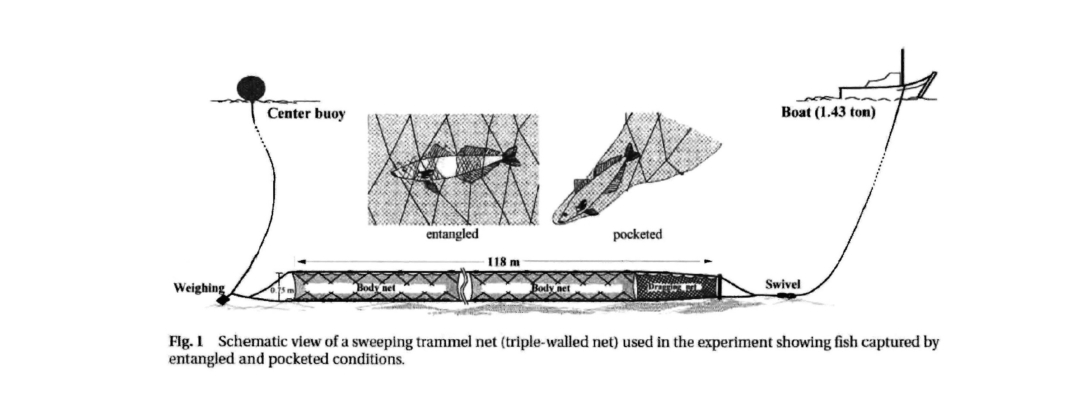
Fisheries Science. 67: 21-29 (2001)
Trammel Net

Slide 45
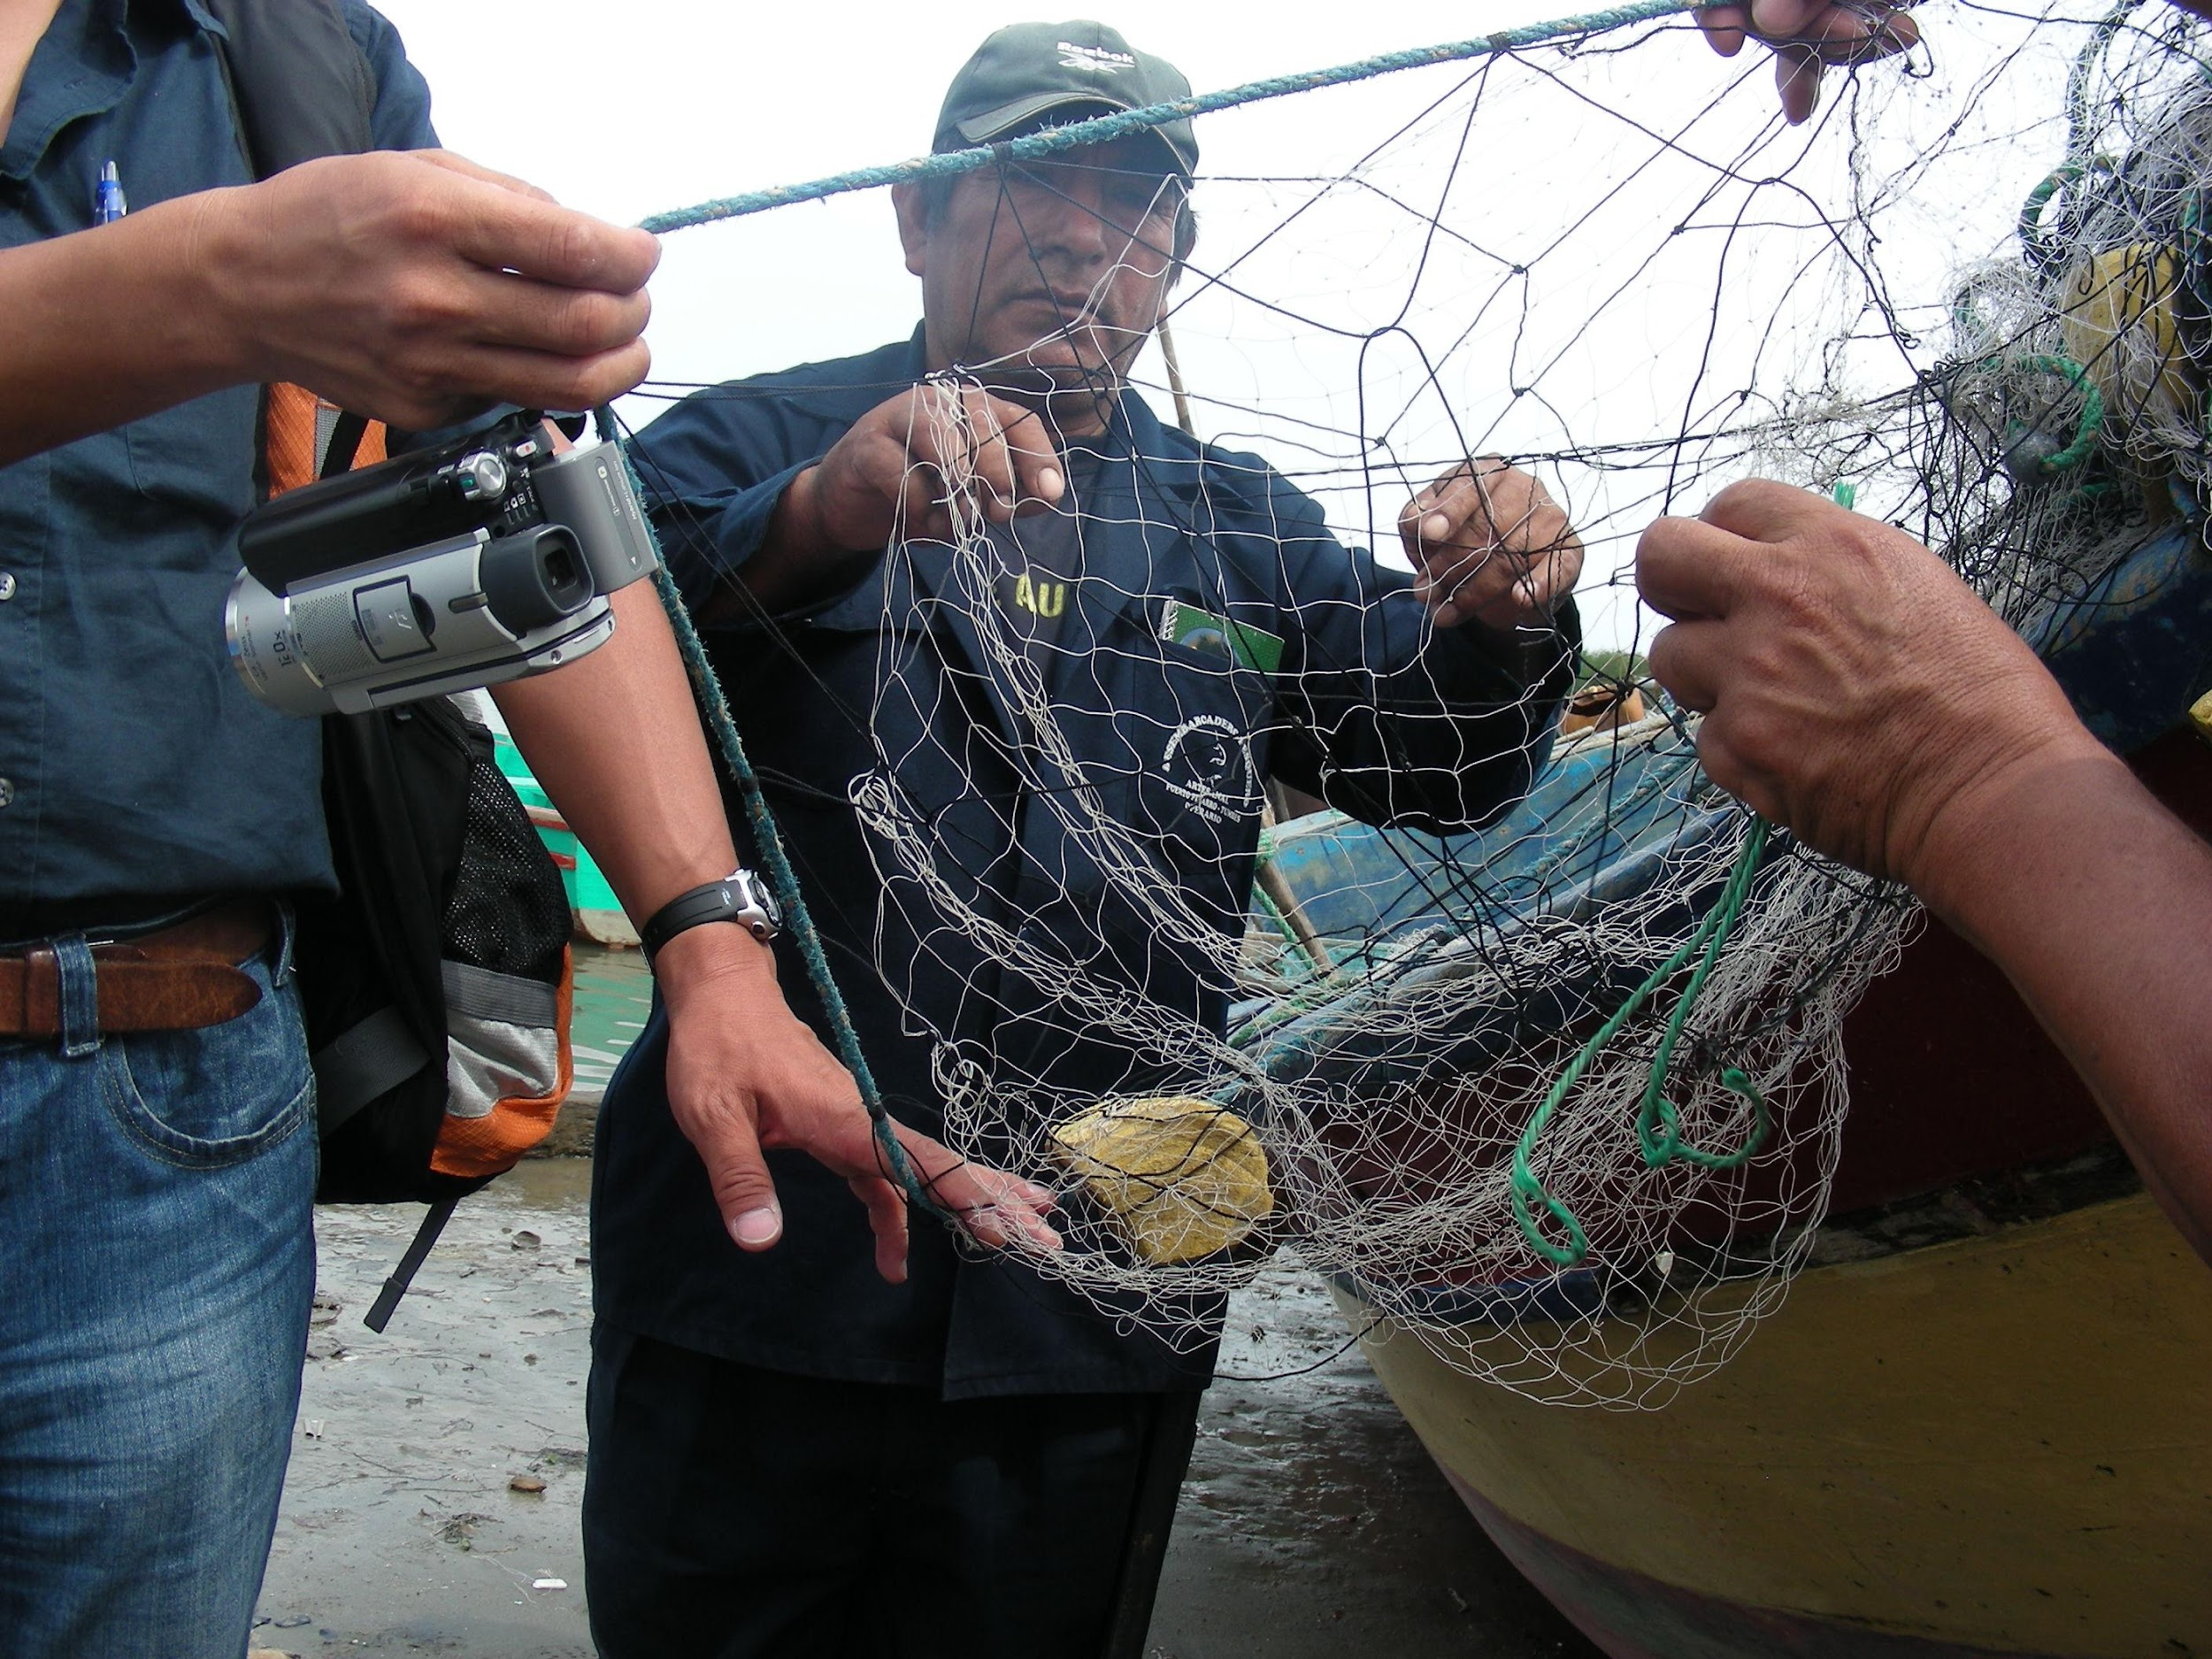
Trammel net

Slide 46
PASSIVE FISHING GEAR (NETS)
Sweeping
Surface
Midwater
Bottom
Anchored
Gillnets
Staked
Passive
Gear
Surface
Midwater
Bottom
Drifting
Sweeping
Trammel
nets
Anchored
Staked
Bottom
Fixed

Slide 47
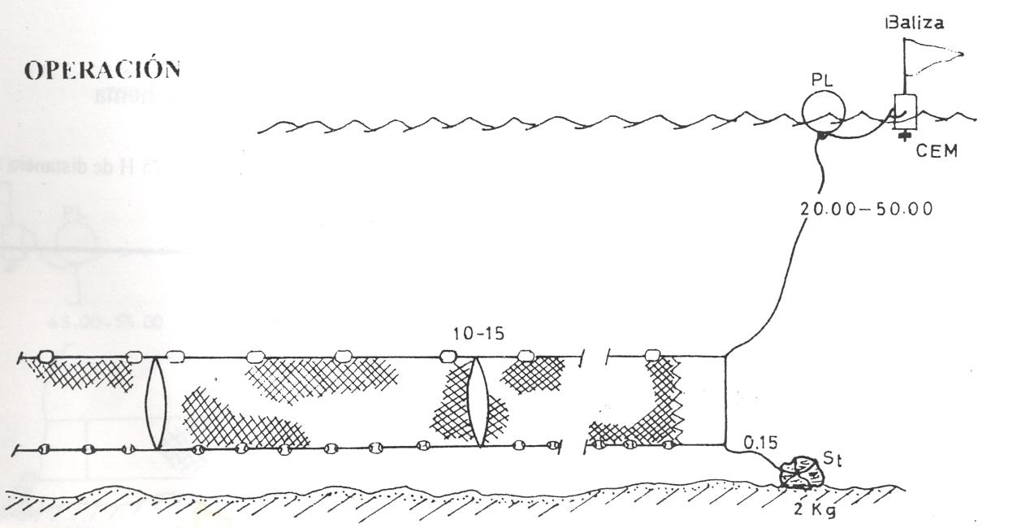
Net = nr of panels
Dropline
Twine forms mesh
Float line
Tie down
Panel
Lead line

Slide 48
Effects of shortening tie down lines
tie down lines
net

Slide 49
Main GN bycatch issues
Lack of data. EM in development
Solutions not yet available, (pingers or lights in some cases)
Sea turtles, dolphins everywhere
Massive artisanal fleets
Entanglements, ghost fishing

Slide 51
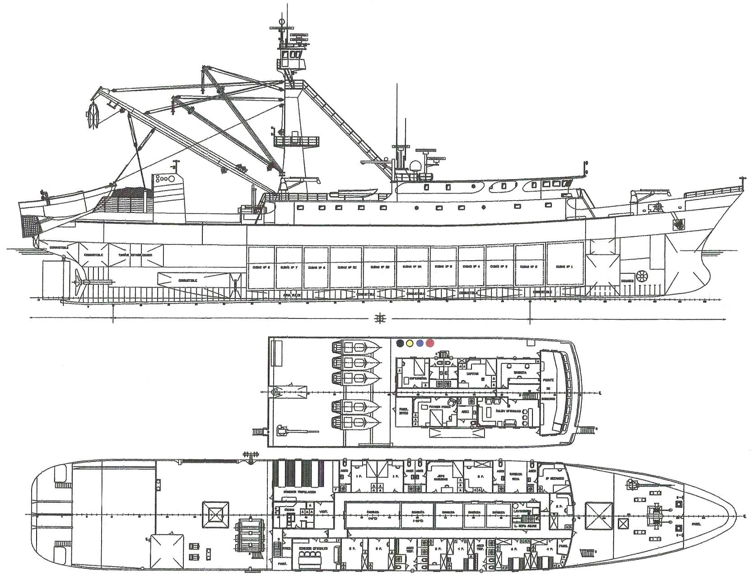
FIGURE
Diagram of a tuna purse seine vessel
Crow’s nest
Mast
Bird radar
Purse seine net
Skiff
Fuel
Fuel
Wells
Speedboats
Bow thruster
Bridge deck
Gear console
Upper deck
Net deck
Main winch

Slide 52
Purse Seines

Slide 53
Seine Net Animation

Slide 54
Notes:
‹#›

Slide 55
Main PS bycatch issues
Shark and ray bycatches
Pinnipeds and seabirds
Catches of many species associated with FADs
Entanglements in FADs
Lost and abandoned FADs
Tuna-dolphin issue

Slide 56




