Slide 1

SIOB 296 : Bycatch: Problems and Solutions
Spring 2022
-Instructors:
Brice Semmens (bsemmens@ucsd.edu, Hubbs Hall 3140)
Martin Hall mhall665@gmail.com
14 to 15 hs Tuesdays and Thursdays
Location: 100 Vaughn Hall
Grade options: Letter grade or P/F
Office hours: By appointment

Slide 2

This course is jointly organized with redCID
Red para el Estudio de Capturas Incidentales y Descartes
Organizers:JC Baez, LA Cocas, S Dans, ME Gongora, M Hall, D Monteiro, P Rossero, M SanMartin, E Secchi

Slide 3
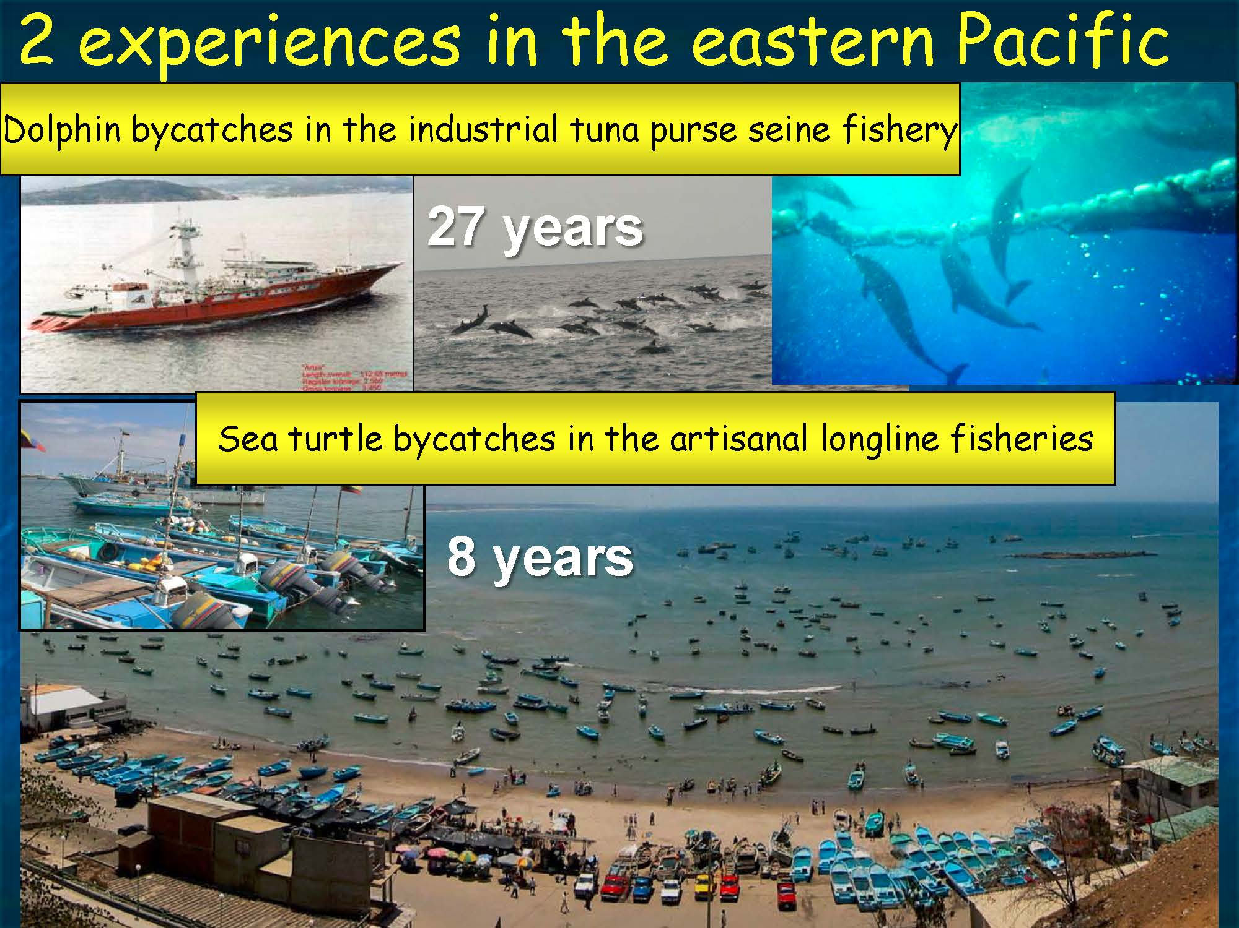
Experiences in the eastern Pacific
38 years
10 years
Readings

Slide 4
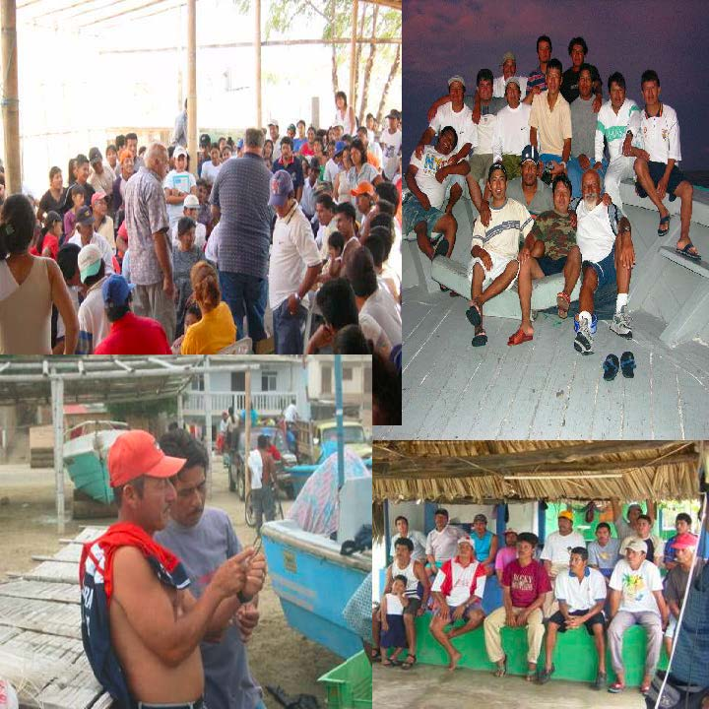
:

Slide 5
Three angles
Fisheries in an evolutionary context
The bycatch basic model
The Sequential Approach

Slide 6
What is a fishery in ecological terms?
          It is an invasion

Slide 7
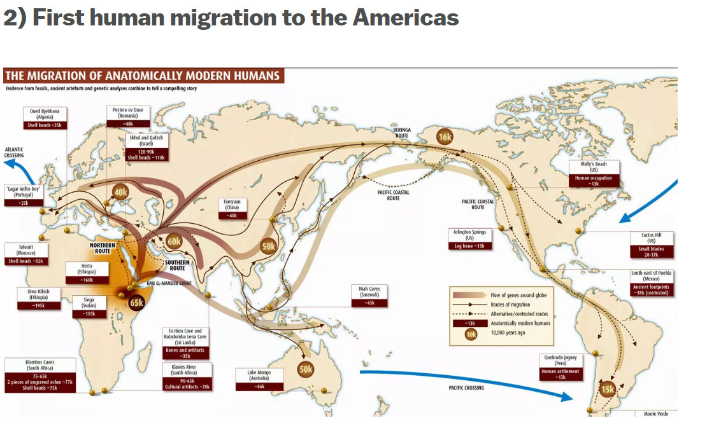
“Standstill” 10,000 years??

Slide 8
Year | - 23 000 | 1 | 1500 | 1700 | 2000 | 2030
American population | 250 | 7 | 20 | 13 | 834 | 1115
In millions

Slide 9
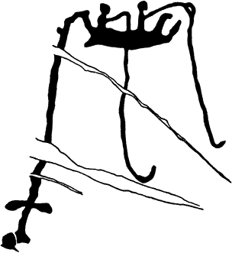

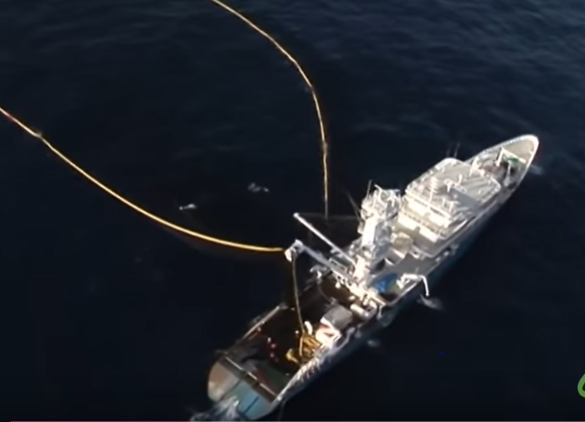
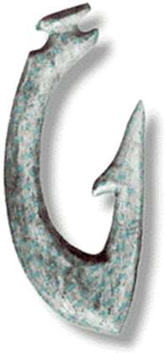

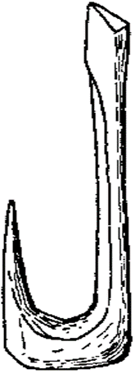
Egypt - 2,000
- 30,000
- 4,000
- 6,200
bone
Purse seine diameter 600 m

Slide 10
Lopez de la Lama et al., 2021
Peru
Fishhooks - 10,000
Traps - 8,500
Nets - 7,500
Nets w/floats - 2,500
Sailing - 1,500
https://besjournals.onlinelibrary.wiley.com/doi/epdf/10.1002/pan3.10153

Slide 11

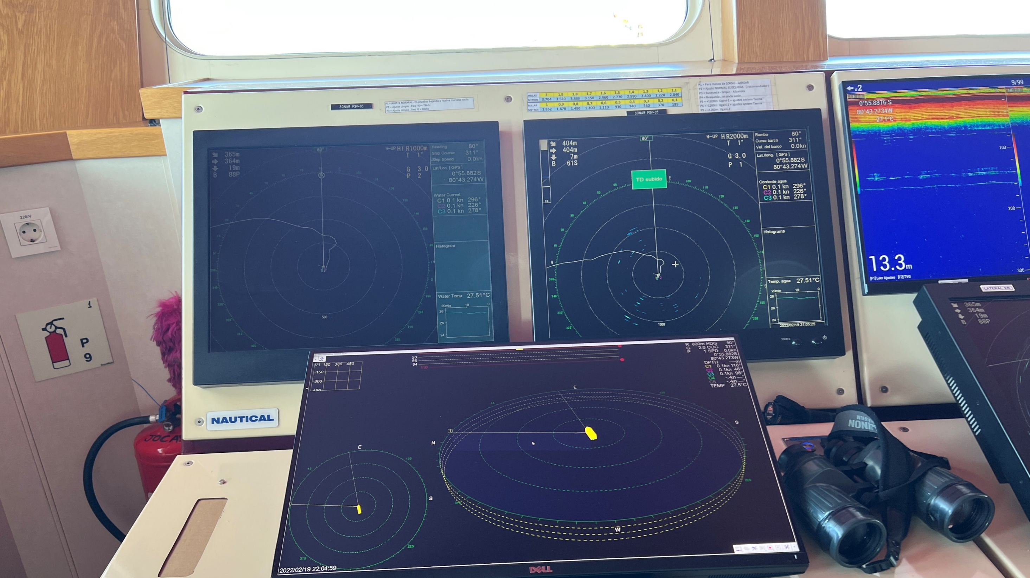

Bridge of a purse seiner

Slide 12
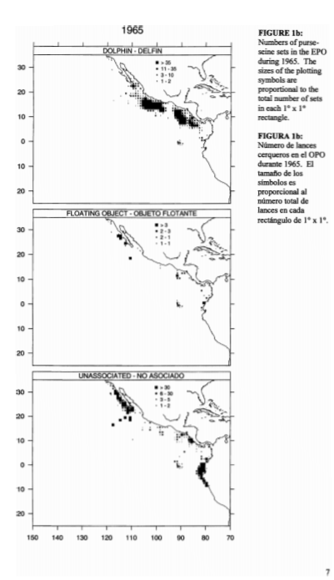
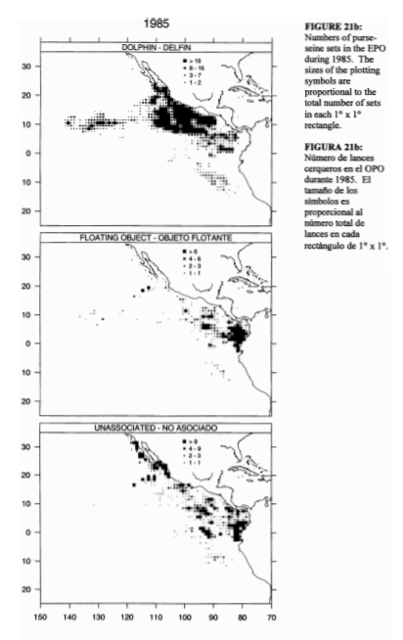
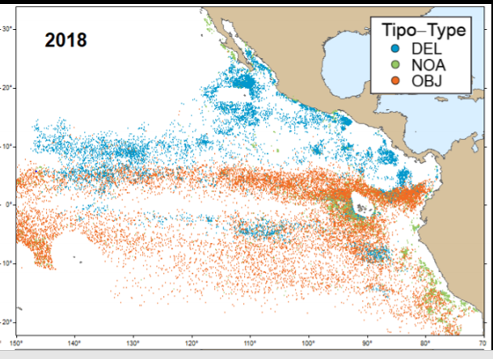
1965
1985

Slide 13
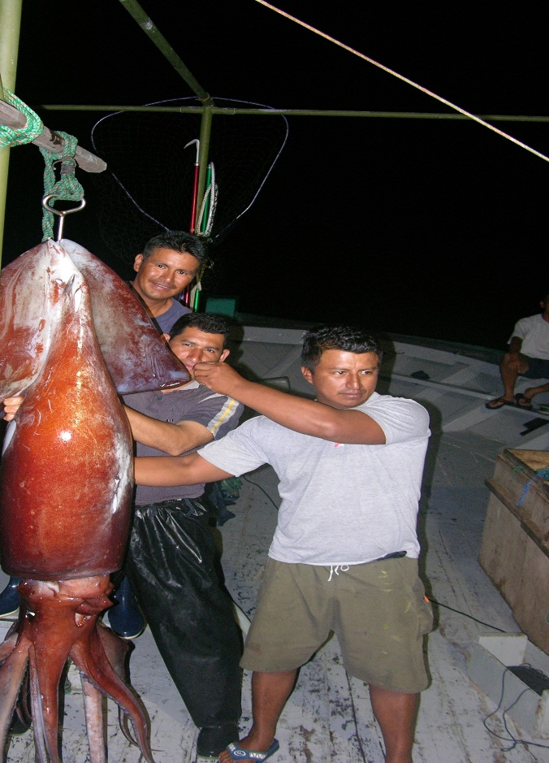
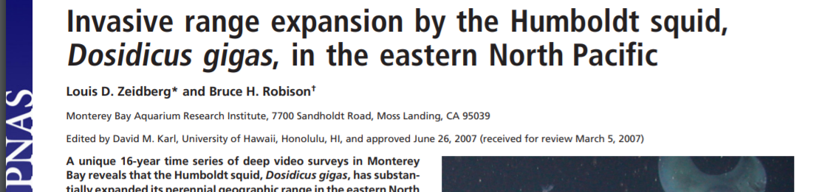
Invasions happen all the time in ecosystems
https://www.pnas.org/content/pnas/104/31/12948.full.pdf

Slide 14
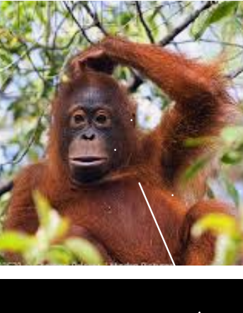
NATURAL INVADERS VS FISHING FLEETS
Improvements in efficiency through genetic changes that need to accumulate and expand spatially
Improvements in technology are faster and easier to spread
Other differences between an invasion by a predator and by a fishery?

Slide 15
  Natural predators tend to be predators of individuals;
  trawlers and purse seiners are predators of schools
  The school doesn’t offer protection; on the contrary it attracts the predators

Slide 16
Consequences of the invasion:
The fishery may become the dominant predator for many species, and a major player in the ecosystem
“Fisheries Induced Evolution FIE ?”

Slide 17
Fisheries-induced evolution Physiology
  Hollins, J., Thambithurai, D., Koeck, B., Crespel, A., Bailey, D.M., Cooke, S.J., Lindström, J., Parsons, K.J. and Killen, S.S., 2018. A physiological perspective on fisheries‐induced evolution. Evolutionary applications, 11(5), pp.561-576.
  https://onlinelibrary.wiley.com/doi/pdf/10.1111/eva.12597

Slide 18
If bycatch species are predators of targets
Fishery reduces prey sizes
Bycatch species are frequently predators of target and must adapt to prey changes A domino effect
  Increase foraging to make up for smaller sizes of prey?
  Switch to another prey?
  Grow slower and shrink in size?

Slide 19
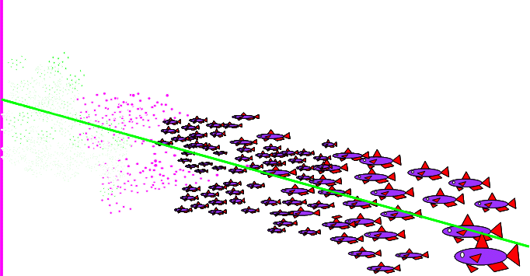
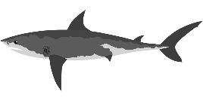
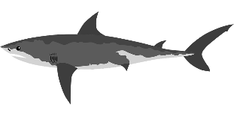
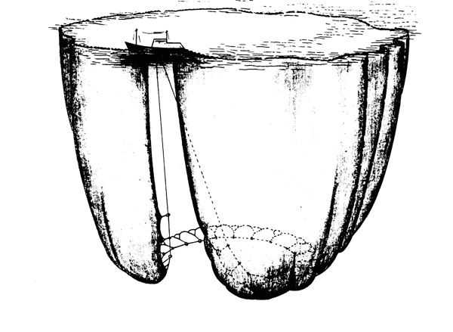
Size spectrum of community
Predators and bycatch
phytoplankton
zooplankton
Biomasa
Small fish
Large fish
Size
Jeppe Kolding

Slide 20
Changes in bycatch species caused by fishing
Hypothetical physiological changes
  Better ways to detect nets (visual acuity, etc).
  More speed and endurance (for trawl fisheries)
  More resistant to stress, handling, injuries

Slide 21
Fisheries-induced evolution Behavior
Behavioral changes
  Escape behaviors
  Migratory behavior
  Schooling behavior
has schooling become maladaptive?
Is there a different optimal school size now?
(fewer natural predators, more boats)

Slide 22
Can you imagine a few physiological, anatomical, behavioral, ecological changes that may be evolving
because of fishing?

Slide 23
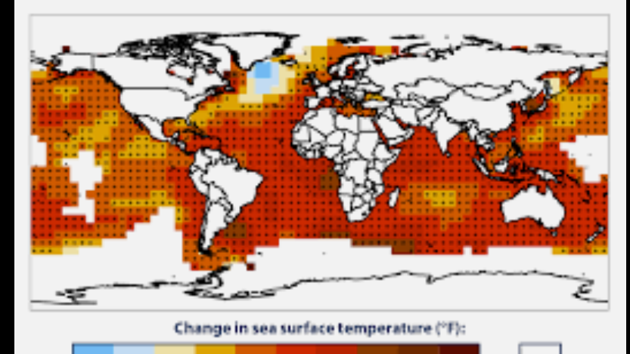
And if that wasn’t enough………
Change in sea surface temperature (ºF)

Slide 24
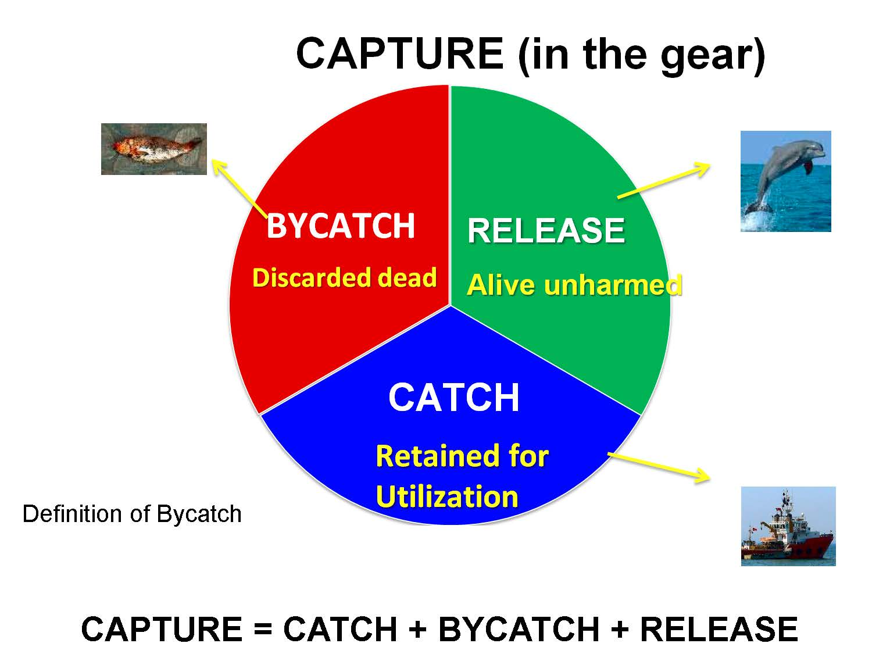
Bycatches are one of the ways fisheries impact ecosystems
What is bycatch?
Definitions:
You need to know what
you and others are
talking about

Slide 25
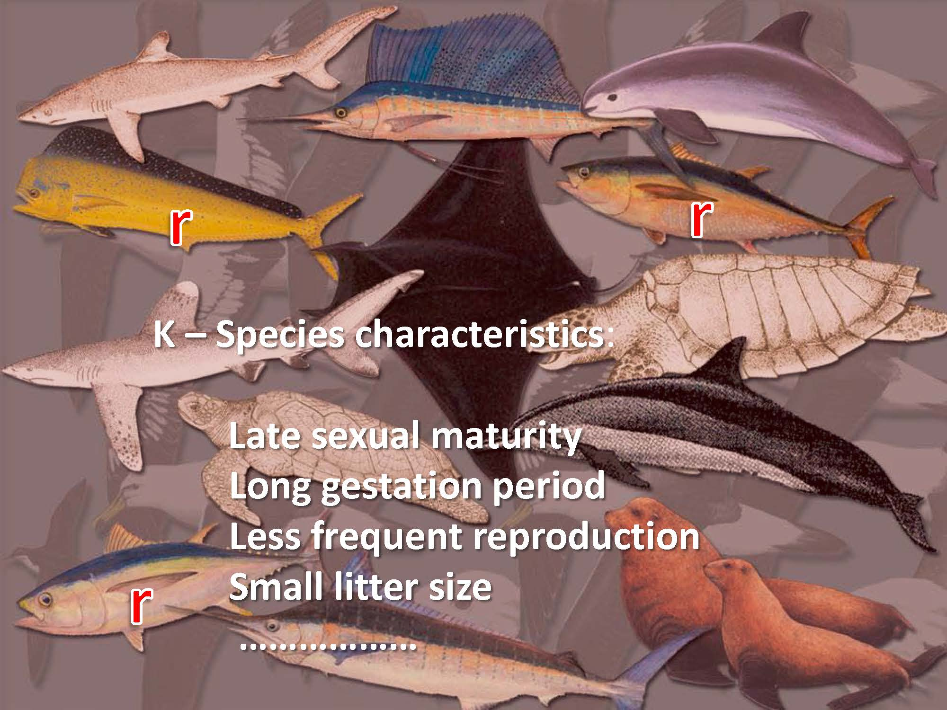

Slide 26
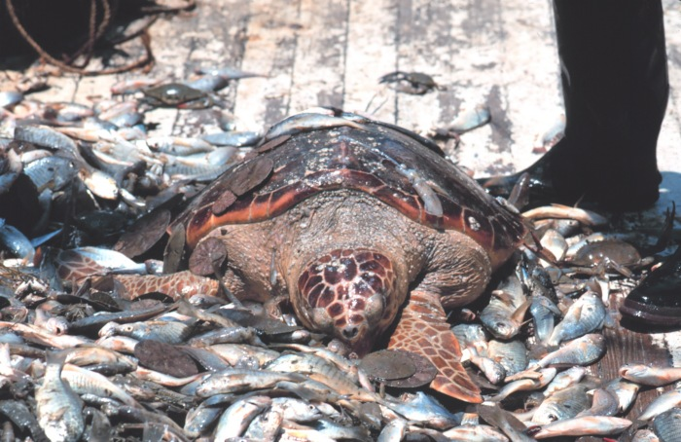

Slide 27
LIFE HISTORY STRATEGIES
 | r strategy | K strategy
Longevity | Short life | Long life
Growth | Fast growth | Slow growth
Environments | Unstable | Stable
Age at first maturity | Early maturity | Late maturity
Nr offspring | Many small offspring | Few large offspring
Parental care | Little parental care | High parental care
Investment in individual offspring | Little | High
Trophic level | Lower | Higher
MANY EXCEPTIONS

Slide 28
To Estimate Bycatch
Bycatch = Effort x Bycatch per unit effort

Slide 29
Estimating the Components
Bycatch = Effort x Bycatch per unit effort
Port records
Logbooks
Electronic monitoring
Satellites, VMS
Observers
Electronic monitoring

Slide 31
To reduce bycatch we have to
reduce some of its components
Bycatch = Effort x Bycatch per unit effort
Closures, limits
Market demand
Gear changes
Capacity control
Technological and operational changes
Training, decision-making
Management, regs

Slide 32
The
Sequential
Approach
1. Avoid encounters with gear
2. Avoid capture in gear
3. Release from the gear
4. Release from the deck
5. Improve survival of the released ones

Slide 33
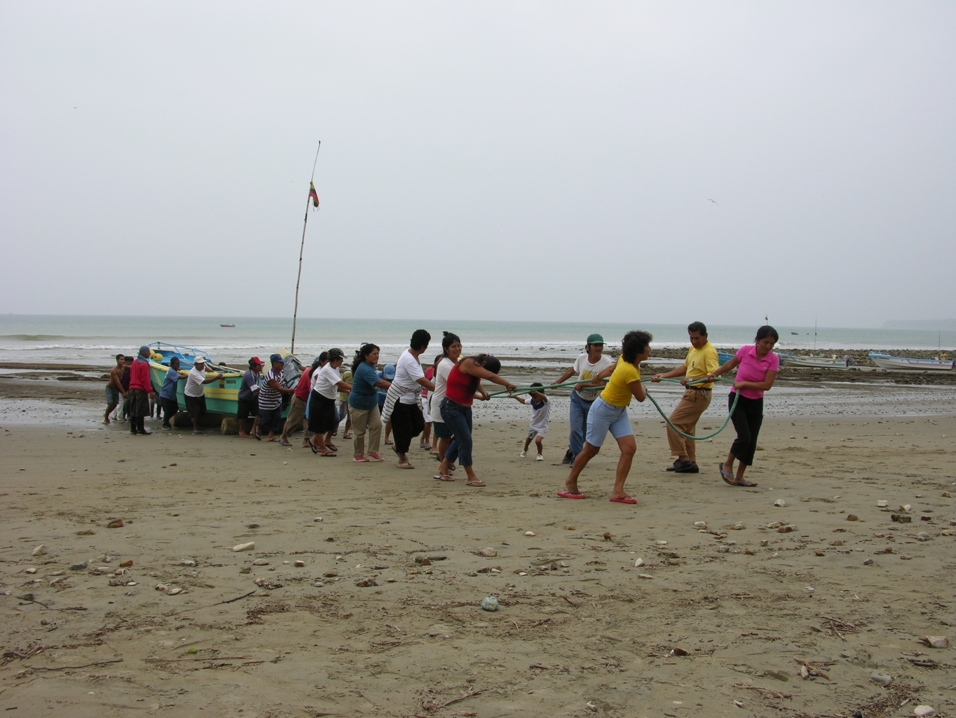

Slide 34
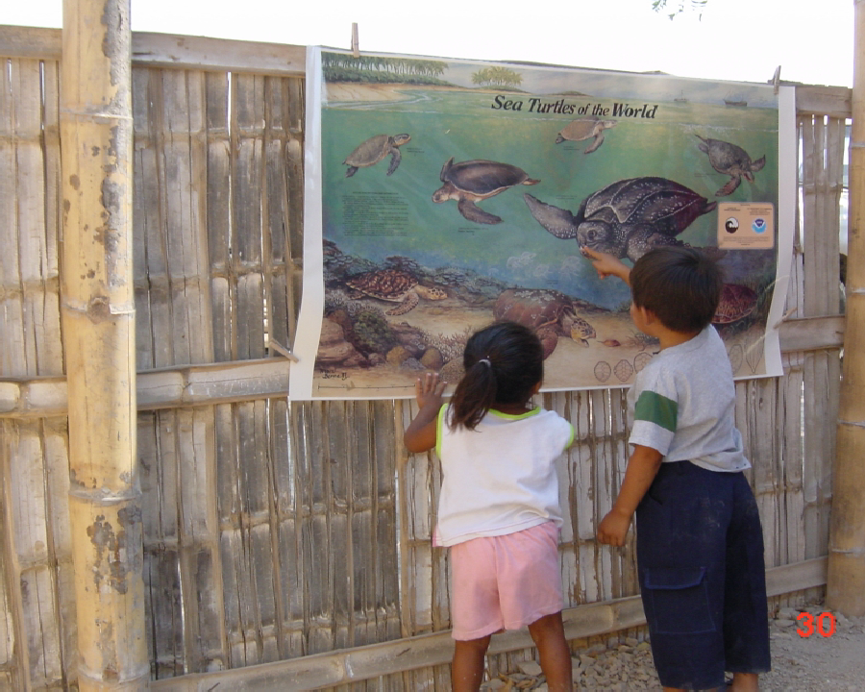
Y.Swimmer

